Slide 1
Test Appeals
Medical Leaves
& Wellness

Slide 2
Test Appeals
In keeping with our mission to create a nurturing environment, Valley Christian High School provides an appeals system for students seeking an academic exemption due to a high volume of tests scheduled. This process is designed for two scenarios:
A student has MORE than 2 tests scheduled for one day
A student has MORE than 4 tests scheduled for one week
This does NOT apply to finals

Slide 3
Test Appeals
Quizzes factor into test appeals
In the appeal process, 2 quizzes = 1 test
Scenarios and if they are eligible for an appeal:
  2 tests + 1 quiz in one day → NO; does not exceed limit
  2 tests + 2 quizzes in one day → YES; does exceed limit
  4 tests + 1 quiz in one week → NO; does not exceed limit
  4 tests + 2 quizzes in one week → YES; does exceed limit

Slide 4
Test Appeals
Deadlines for Test Appeals
  9am the school day PRIOR to the day with more than 2 tests
  3pm the school day PRIOR to the week with more than 4 tests
Student can appeal to postpone ONE of the tests until the next scheduled Warrior Time test makeup day

Slide 5
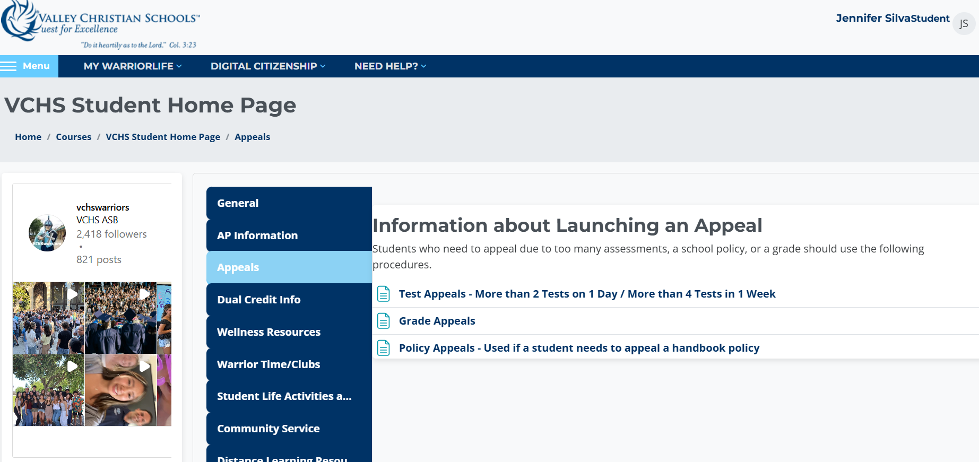
How to Make An Appeal

Slide 6
Medical Leaves
Applies to: Concussions and Extended Illnesses (more than 10 days)
Parents need to reach out to Dr. Eshoff, the Dean of Instruction (reshoff@vcs.net)
Need a doctor’s note that includes date of diagnosis and doctor’s required physical or cognitive limitations for the student
Wellness counselor and the Dean of Instruction will develop a plan

Slide 7
Wellness
Your Well-Being Matters
Everyone faces challenges from time to time. You don't have to handle them alone.
The Counseling Center is here to support you. You can meet with:
Your Academic Counselor
A Wellness Counselor

Slide 8
Wellness
Students come for many reasons, including:
Managing stress or anxiety
Feeling overwhelmed
Friendship or relationship challenges
Family concerns
School or academic pressure
Grief, loss, or major life changes
Or simply because you need someone to talk to
Reaching out is a sign of strength. We're here to listen, support, and help you find the resources you need.

Slide 9
Wellness
We all have moments when life feels difficult. If you are worried about yourself or a friend, don't carry that concern alone.
Talk to a trusted adult
If you or someone you know needs immediate emotional support, you can also call or text 988 to reach the Suicide & Crisis Lifeline.
If there is an immediate emergency or someone is in immediate danger, call 911.
Asking for help is one of the best ways to care for yourself and for others.

Slide 10
Check for Understanding
You have 4 tests on one week – what do you do?
You have 3 tests on one day – what do you do?
You break your arm – what do you do?
You are overwhelmed with balancing your school activities and your homework – what do you do?
You see an acquaintance post something about self-harm online at home – what do you do?

Slide 11
Looking forward to having a great year with you, Warrior Family!

