Slide 1
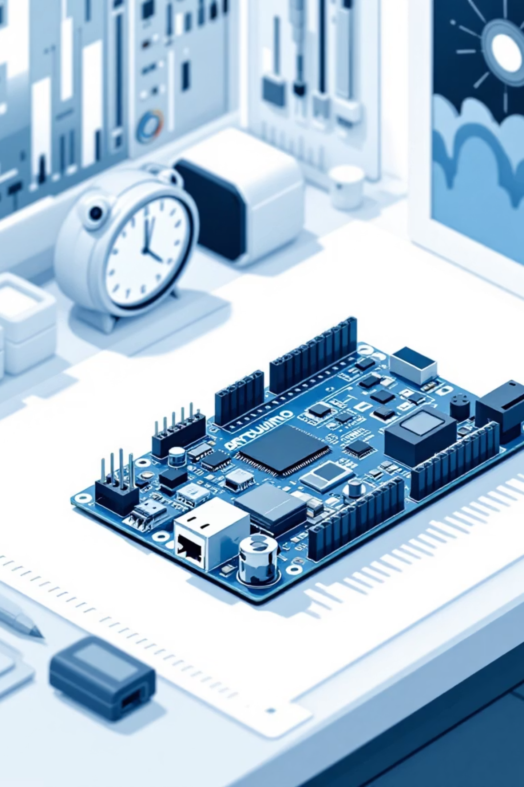
Introduction to Arduino & I²C Communication
Arduino is a small, programmable microcontroller that bridges the gap between the physical and digital worlds. It reads data from sensors, processes information, and controls outputs like LEDs, motors, and displays. I²C (Inter-Integrated Circuit) is an elegant communication protocol that allows your Arduino to talk to multiple devices simultaneously using just two wires—making complex projects simple and organized.

Slide 2
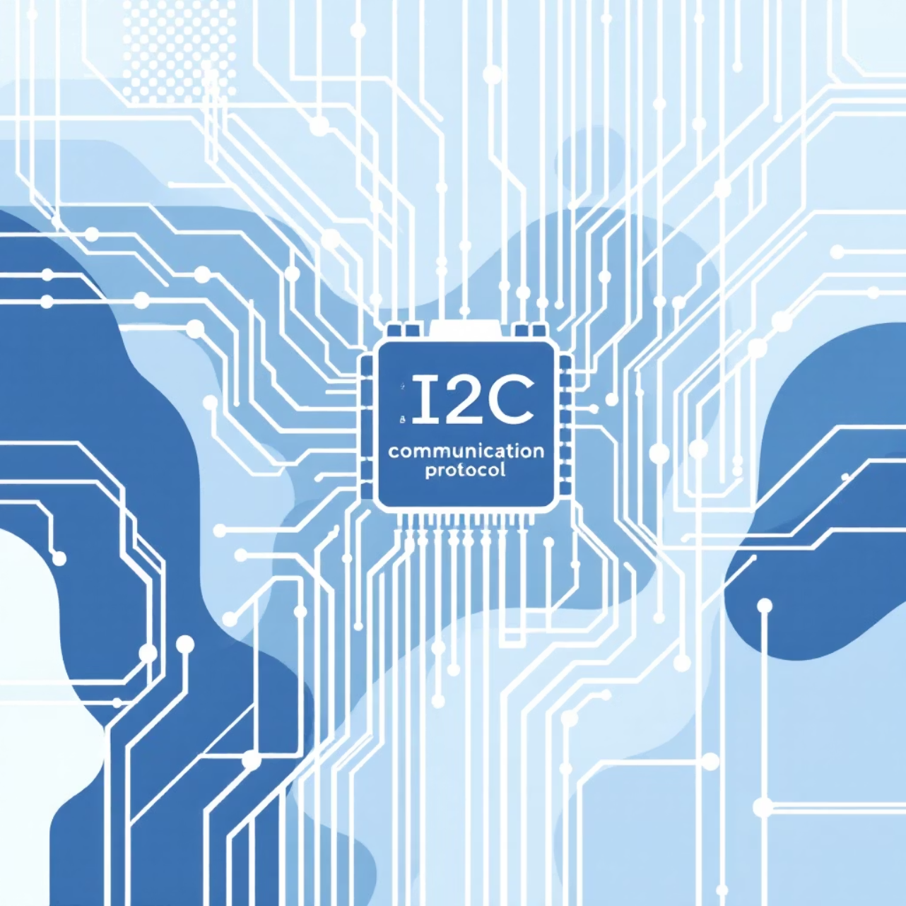
PROTOCOL BASICS
What Is I²C?
I²C stands for Inter-Integrated Circuit, a serial communication protocol developed by Philips in the 1980s. It's designed for short-distance communication between integrated circuits on the same board.
The protocol uses just two shared wires to create a communication bus:
SDA (Serial Data) – carries the actual data bits
SCL (Serial Clock) – synchronizes timing between devices
In an I²C system, one device acts as the master (typically your Arduino), orchestrating all communication with multiple slave devices like sensors, displays, and memory chips.

Slide 3
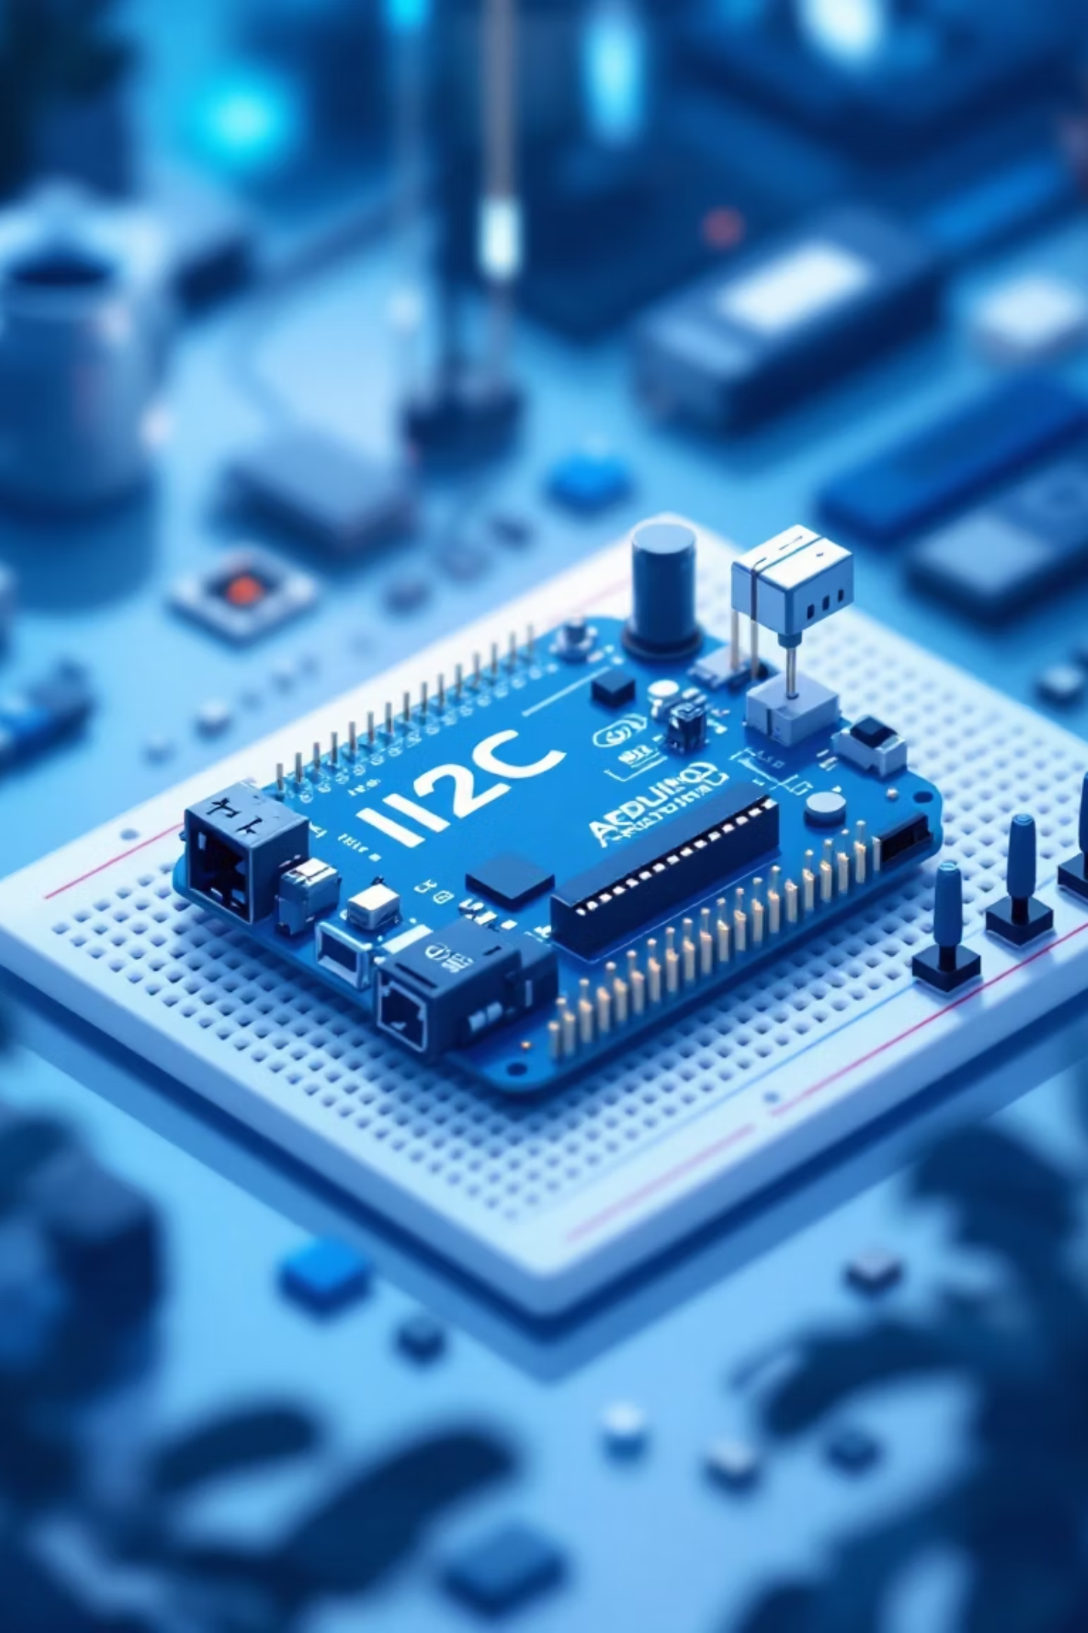





BUS ARCHITECTURE
I²C Bus Diagram
Arduino (Master)
Controls all communication and timing on the bus
Sensor (0x40)
Temperature/humidity sensor responds to address 0x40
Display (0x3C)
OLED screen listens at address 0x3C
RTC (0x68)
Real-time clock module at address 0x68
All devices share the same two wires (SDA and SCL), but each has a unique address. The Arduino can talk to any device by calling its specific address—like selecting a contact from your phone. This architecture keeps wiring simple even as projects grow more complex.

Slide 4

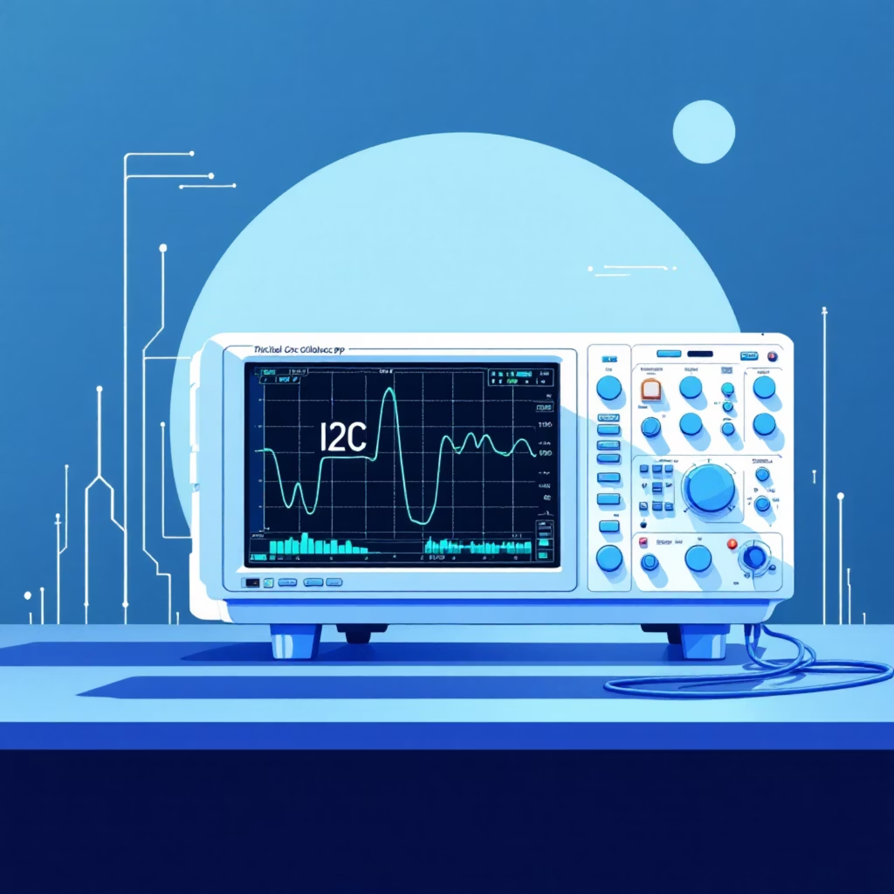
TIMING
Clock Controls Data Flow
The SCL (clock) line acts like a metronome, keeping perfect time for data transmission. Each rising edge of the clock pulse signals when data on the SDA line should be read.
How it works:
Data changes when SCL is LOW
Data is sampled when SCL goes HIGH
Each clock pulse transfers one bit
Typical speeds: 100 kHz (standard) or 400 kHz (fast mode)
Think of SCL as asking "ready?" and SDA as answering with a 0 or 1. This synchronized dance ensures reliable communication even with multiple devices on the same wires.

Slide 5
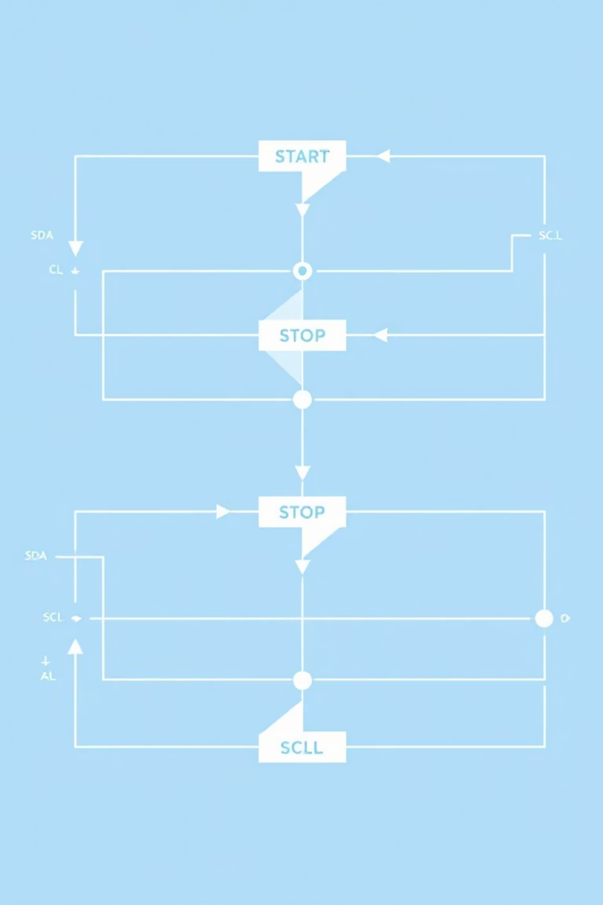



Start & Stop Signals
Every I²C conversation begins with a START condition and ends with a STOP condition. These special signals tell all devices on the bus when communication is beginning or ending.
START Condition
SDA line drops from HIGH to LOW while SCL remains HIGH. This unique pattern alerts all devices that the master is about to send an address.
STOP Condition
SDA line rises from LOW to HIGH while SCL is HIGH. This releases the bus, allowing other operations to begin.
Key insight: During normal data transmission, SDA only changes when SCL is LOW. START and STOP conditions break this rule intentionally—changing SDA while SCL is HIGH creates unmistakable boundary markers.

Slide 6
DEVICE ADDRESSING
Addresses & Acknowledgment
Unique Device Addresses
ACK: Acknowledgment Bit
Every I²C device has a unique 7-bit address (0x00 to 0x7F). When the Arduino sends an address after the START condition, only the device with that matching address responds—all others stay silent and listen.
After receiving each byte of data, the receiving device sends an ACK (acknowledgment) by pulling the SDA line LOW during the 9th clock pulse.
ACK = Success: "I received your message correctly"
Common address examples:
NACK = Problem: Line stays HIGH, signaling an error or end of transmission
0x3C or 0x3D – OLED displays
0x40 – HTU21D humidity sensor
This handshake ensures reliable communication—the master knows immediately if a device is present and responding.
0x68 – DS3231 real-time clock
0x76 or 0x77 – BMP280 pressure sensor

Slide 7
Why the Wires Don't Fight
01
02
03
Open-Drain Architecture
Pull-Up Resistors
Safe Communication
I²C devices can only pull the SDA and SCL lines LOW—they cannot actively drive them HIGH. This prevents electrical conflicts when multiple devices share the same wires.
External resistors (typically 4.7kΩ) connect both lines to +5V (or +3.3V). These resistors naturally pull the lines HIGH when no device is actively pulling them LOW.
When a device "speaks" by pulling a line LOW, it's like pressing a button. When it "listens," it releases the line and the pull-up resistor brings it back HIGH. This simple design prevents short circuits and allows multiple devices to coexist safely.
Result: LOW means "someone is talking" and HIGH means "silence." Multiple devices can safely share the bus without damage.

Slide 8





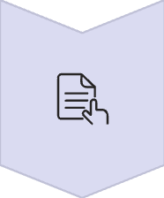


COMPLETE PROTOCOL
Full I²C Conversation
A complete I²C transaction follows a precise sequence of events, creating a rule-based conversation between master and slave devices.
START Condition
Master signals the beginning of communication
Address + R/W Bit
Master sends 7-bit device address plus read/write bit
ACK from Slave
Addressed device acknowledges by pulling SDA LOW
Data Byte(s)
Master or slave transmits data, one byte at a time
ACK after Each Byte
Receiver acknowledges successful receipt of data
STOP Condition
Master signals end of communication, releasing the bus
Remember: I²C is a synchronous, master-controlled protocol. Every bit is timed precisely by the clock signal, and every byte is acknowledged. This structure makes I²C reliable and perfect for embedded systems where multiple sensors and peripherals need to communicate with a single microcontroller.

