Slide 1
Breadboarding and Electronic Components
Principles Of Engineering
© 2012 Project Lead The Way, Inc.

Slide 2
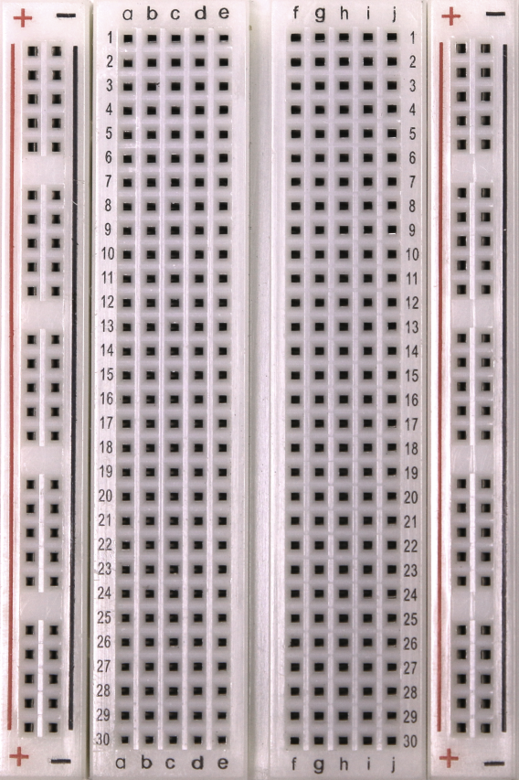
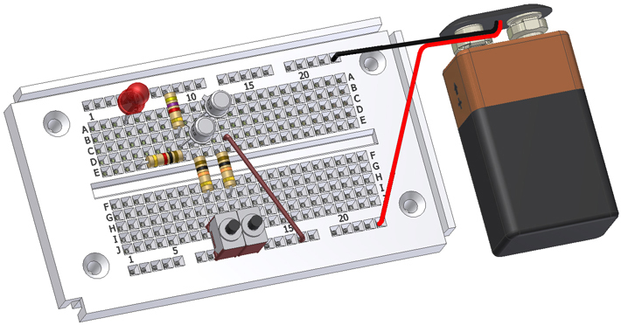
What is a Breadboard?
Sometimes called a protoboard
Reusable platform for temporarily built electronic circuits

Slide 3
Why Breadboard?
It takes less time (and money) to breadboard a circuit than to design and fabricate a printed circuit board (PCB).
Because of the cost, a PCB should be reserved for the final working design.
As a complement to circuit simulation, breadboarding allows designers to observe how, and if, the actual circuit functions.

Slide 4
Why Breadboard?
Breadboards give designers the ability to quickly change components during development and testing, such as swapping resistors or capacitors of different values.
Breadboards allow designers to easily modify a circuit to facilitate measurements of voltage, current, or resistance without soldering.

Slide 5
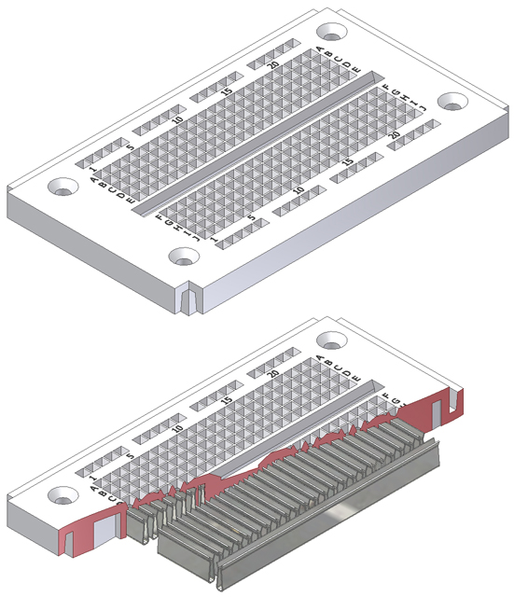
How a Breadboard Works
Electric component leads and wire are inserted into holes arranged in grid pattern on breadboard surface
Series of internal metal strips connect specific rows of holes

Slide 6
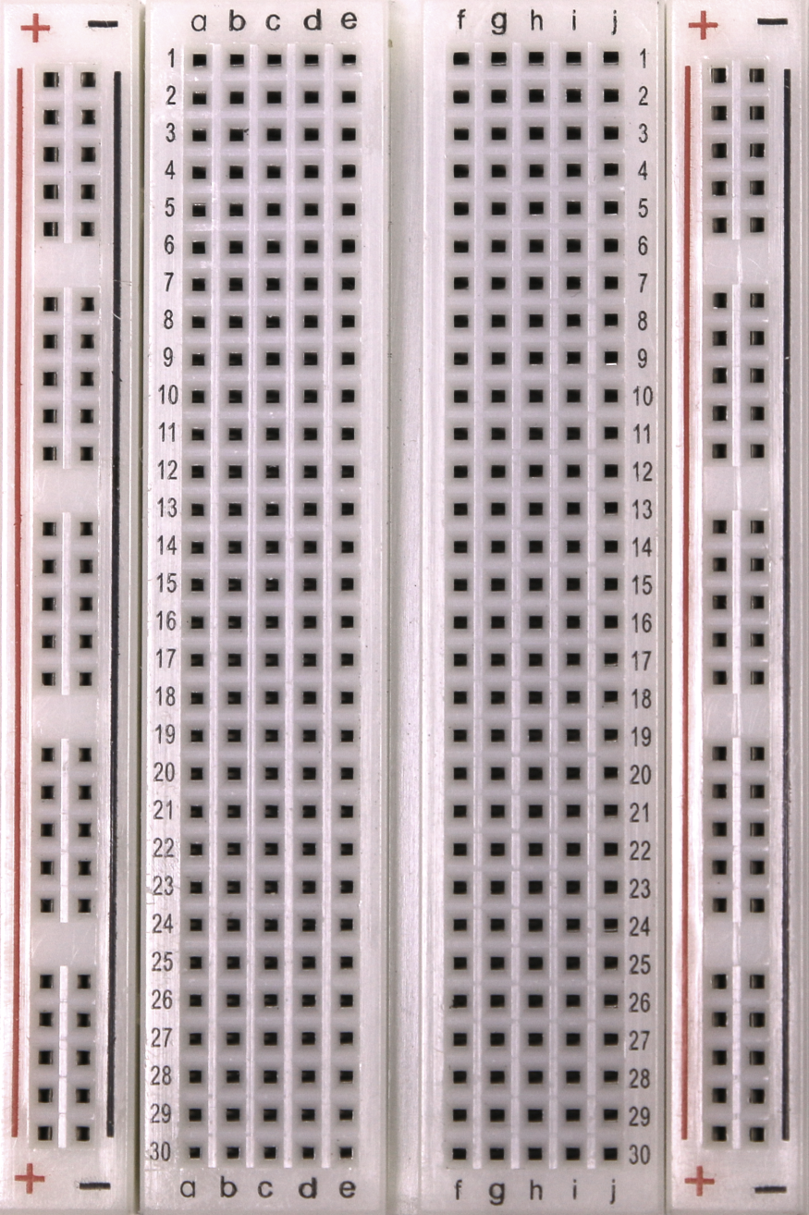
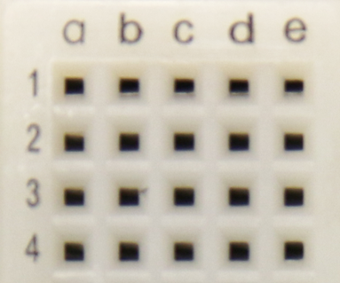
Breadboard Connections
Columns and rows connected
Holes to
insert wires

Slide 7
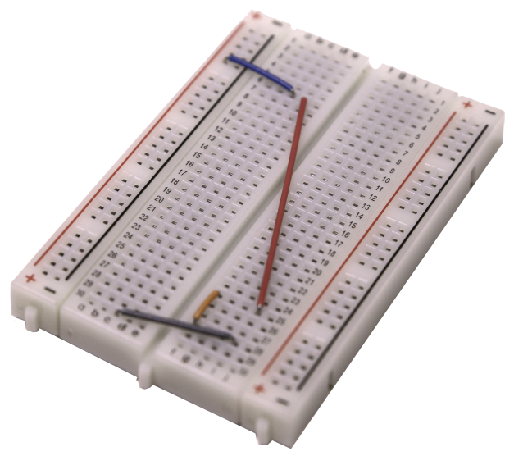
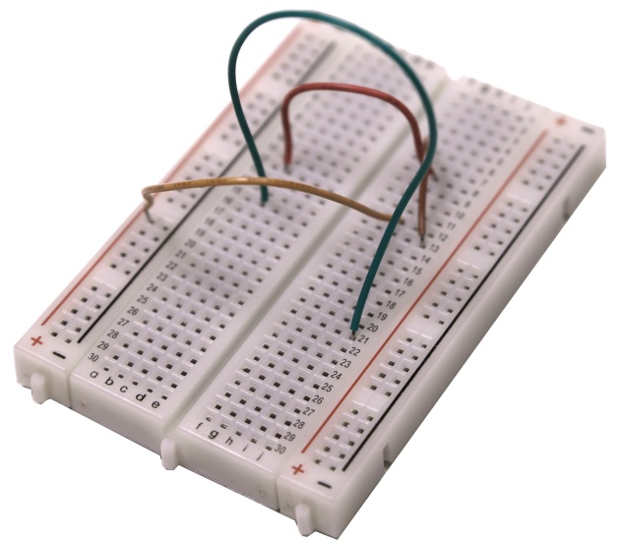
Breadboard: Guidelines and Tips
Use as few jumper wires as possible. Internal breadboard strips should make the majority of connections
Keep jumper wires as short as possible to avoid jumbled wires which are difficult to troubleshoot
Good
Bad

Slide 8
Breadboard: Guidelines and Tips
Breadboard circuit closely to layout of the schematic circuit to aid troubleshooting
Use schematic and check off component and wires as added to breadboard
Cut component leads to short lengths to avoid contact and shorts
Have someone check the circuit for errors

Slide 9
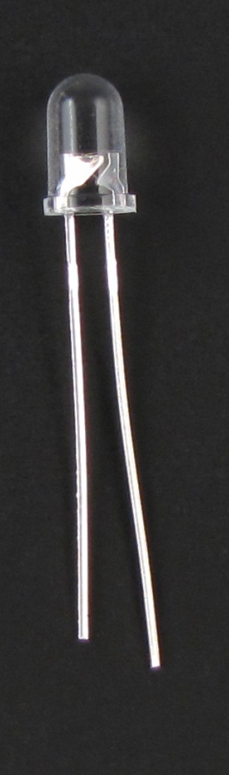
Diode
Allows current to flow in only one direction
Negative ( - ) lead
Larger metal component
inside of case or case flat spot is cathode or
negative (-) lead
Schematic Symbol
Shorter wire is cathode or
negative (-) lead

Slide 10

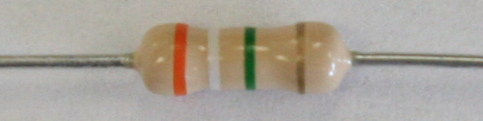
Resistors
A resistor is an electronic component that resists the flow of electrical current.
A resistor is typically used to control the amount of current that is flowing in a circuit.
Resistance is measured in units of ohms (Ω) and named after George Ohm, whose law (Ohm’s Law) defines the fundamental relationship between voltage, current, and resistance.
Notes:
Definition of a resistor.
http://www.wisegeek.com/

Slide 11
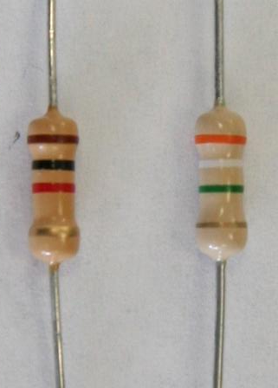
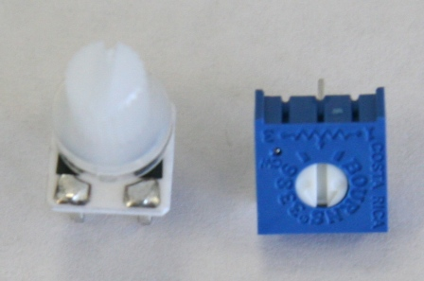

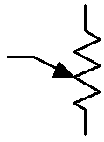
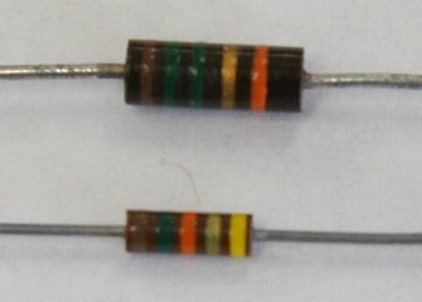
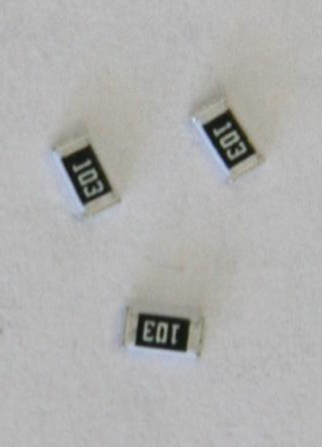
Resistors: Types and Package Styles
Carbon Film Resistors
Variable Resistors
(potentiometer)
4 Bands
Carbon Film Resistors
Surface Mount Resistors
5 Bands
Notes:
Explain that there are two main types of resistors, fixed and variable. Fixed resistors are available in both thru-hole and surface mount technology. The variable resistor may also be called a potentiometer. The schematic symbols for each type are on the left. The arrow is used to denote a resistor that is variable.

Slide 12
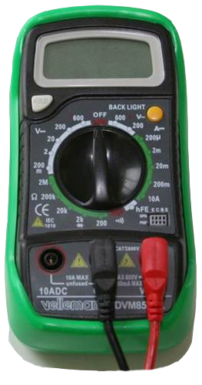
Determining a Resistor’s Value
Color Code
Measured Value
Resistors are labeled with color bands that specify the resistor’s nominal value.
The nominal value is the resistor’s face value.
A digital multimeter can measure the resistor’s actual resistance value.

Slide 13
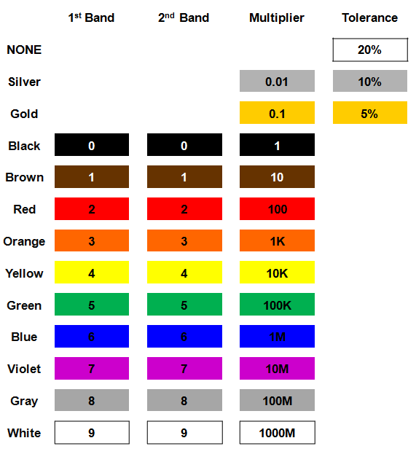
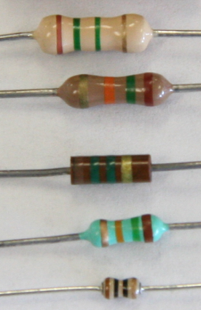
How to Read a Resistor’s Value
Resistor Color Code
Notes:
Resistor color code chart.

Slide 14
Resistor Value: Example #1
Example:
Determine the nominal value for the resistor shown.
Notes:
Pause the presentation and allow students to complete the example. The solution is on the next slide.

Slide 15
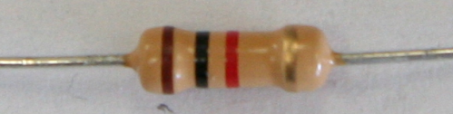
Resistor Value: Example #1
Example:
Determine the nominal value for the resistor shown.
Solution:
10 x 100 Ω ±5%
1000 Ω ±5%
1 K Ω ±5%
Notes:
This slide includes the solution to Resistor Value Example #1. If you print handouts, do not print this page.

Slide 16
Resistor Value: Example #2
Example:
Determine the nominal value for the resistor shown.
Notes:
Pause the presentation and allow students to complete the example. The solution is on the next slide.

Slide 17
Resistor Value: Example #2
Example:
Determine the nominal value for the resistor shown.
Solution:
39 x 100K Ω ±5%
3900000 Ω ±5%
3.9 M Ω ±5%
Notes:
This slide includes the solution to Resistor Value Example #2. If you print handouts, do not print this page.

Slide 18
Resistor Value: Example #3
Example:
Determine the color bands for a 1.5 K Ω ±5% resistor.
?
?
?
?
Notes:
Pause the presentation and allow students to complete the example. The solution is on the next slide.

Slide 19
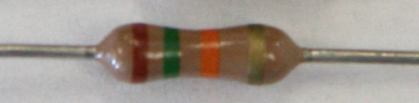
Resistor Value: Example #3
Example:
Determine the color bands for a 1.5 K Ω ±5% resistor.
?
?
?
?
Solution:
1.5 K Ω ±5%
1500 Ω ±5%
15 x 100 Ω ±5%
1: Brown
5: Green
100: Red
5%: Gold
Notes:
This slide includes the solution to Resistor Value Example #3. If you print handouts, do not print this page.

Slide 20
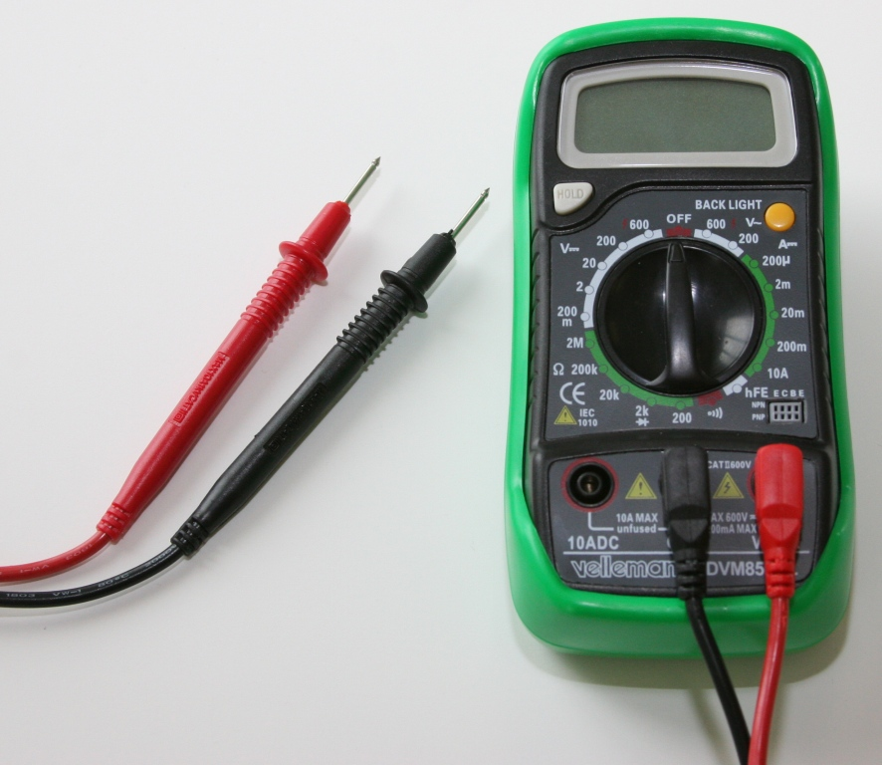
Measured Value
Use a digital multimeter (DMM) to measure resistance.
Notes:
Briefly pause the presentation and give a demonstration on how to use a DMM to measure resistance.
Resistor value can be measured by connecting the multimeter in parallel with resister while the power is off. Connect a multimeter lead to a resister lead then connect a multimeter lead to the other resister lead. Read the resistance on the multimeter.

