Slide 1
Introduction to Electricity
Principles of Engineering

Slide 2




Electricity
Movement of electrons
Invisible force that provides
light, heat, sound, motion . . .

Slide 3
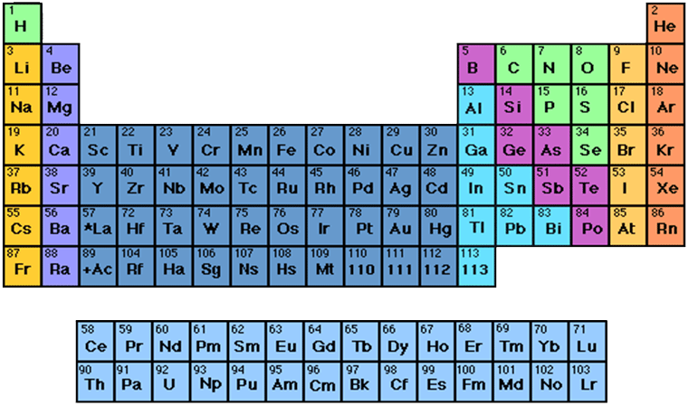
Electricity at the Atomic Level
Elements—The simplest form of matter
Atoms—Smallest piece of an element containing all of the properties of that element

Slide 4


Components of an Atom
Electricity at the Atomic Level
Nucleus
The center portion of an atom containing the protons and neutrons
Protons
Positively charged atomic particles
Neutrons
Uncharged atomic particles

Slide 5
Atomic Number
Electricity at the Atomic Level
The atomic number is equal to the number of protons in the nucleus of an atom.
The atomic number identifies the element.
How many protons are in this nucleus?

Slide 6
Electrons
Electricity at the Atomic Level
Negatively charged particles
Electron Orbitals Orbits in which electrons move around the nucleus of an atom
Valence Electrons The outermost ring of electrons in an atom
2D
3D
Notes:
Electron

Slide 7
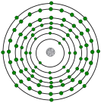

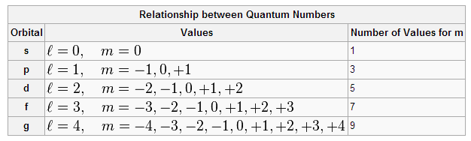
Models and Representations of Atoms
How do we understand and describe what can’t be seen?
Over hundreds of years scientists have generated mathematical models to describe the structure of atoms, how particles interact, and how the structures of atoms give them their physical properties.
The Bohr Model
Negatively charged particles orbit around a nucleus.
The Electron Cloud Model Probability function describes a region where an electron is likely to be found.
Quantum Mechanics Mathematically describes interactions at a nanoscale level.

Slide 8
Models and Representations of Atoms
How do we understand and describe what can’t be seen?
It is important to note that each model can useful in describing properties of an element, even if it is not completely accurate based on our most current understandings of the atom.
The outermost ring (valence electrons) strongly influence an elements physical properties.
In the following examples, a Bohr representation of the atom is used to describe the number of electrons in the valence shell.
Bohr Model
Electron Cloud Model
Quantum Mechanics

Slide 9
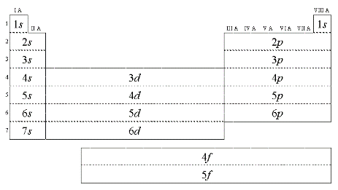
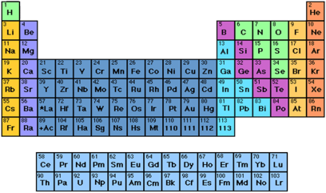
Models and Representations of Atoms
As you study chemistry in more depth, you will learn that the periodic table reflects electron configurations of elements based on our understanding of all these models of the atom.
These electron configurations (and consequent location on the periodic table) identify an elements properties.

Slide 10

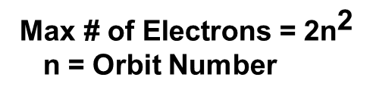
Electron Orbits
Electricity at the Atomic Level
Orbit Number | Maximum Electrons
1 | 2
2
3
4
5
6
Valence Orbit
2
8
18
32
50
72
8
$$\text{Max}\text{ \# }\text{of} \text{Electrons}\text{ = 2}{\text{n}}^{\text{2}}$$
n = Orbit Number
Orbits closest to the nucleus fill first
Notes:
Each principal energy level (Orbit Number)in the Bohr model can be broken down into sub levels s,p,d, and f (these sub levels are not shown in this image) Some of these sublevels are described as overlapping. Example: the 3d sublevel is actually at a lower energy level than the 4p. Because of these overlapping sublevels in the Bohr model the outside, or valence orbit, never has more than 8 electrons.

Slide 11
Electron Orbits
Electricity at the Atomic Level
Atoms like to have their valence ring either filled (8) or empty(0) of electrons.
Copper
Cu
29
How many electrons are in the valence orbit?
1
Is copper a conductor or insulator?
Conductor
Why?

Slide 12
Electron Orbits
Electricity at the Atomic Level
Sulfur
S
16
How many electrons are in the valence orbit?
6
Is sulfur a conductor or insulator?
Insulator
Why?

Slide 13
Electron Flow
Electricity at the Atomic Level
An electron from one orbit can knock out an electron from another orbit.
When an atom loses an electron, it seeks another to fill the vacancy.
Copper
Cu
29

Slide 14
Electron Flow
Electricity at the Atomic Level
Electricity is created as electrons collide and transfer from atom to atom.
Play Animation

Slide 15
Conductors and Insulators
Conductors | Insulators
Electrons flow easily between atoms
1–3 valence electrons in outer orbit
Examples: Silver, Copper, Gold, Aluminum
Electron flow is difficult between atoms
5–8 valence electrons in outer orbit
Examples: Mica, Glass, Quartz

Slide 16

Conductors and Insulators
Identify conductors and insulators
Insulators
Conductors

Slide 17
Electrical Circuit
A system of conductors and components forming a complete path for current to travel
Properties of an electrical circuit include
Voltage Volts V
Current Amps A
Resistance Ohms Ω

Slide 18
Current
The flow of electric charge
- measured in Amperes (A)
Tank (Battery)
Faucet (Switch)
Pipe (Wiring)
When the faucet (switch) is off, is there any flow (current)?
NO
When the faucet (switch) is on, is there any flow (current)?
YES

Slide 19




Current in a Circuit
off
on
off
on
When the switch is off, there is no current.
When the switch is on, there is current.

Slide 20
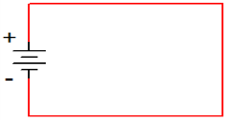
Current Flow
Conventional current assumes that current flows out of the positive side of the battery, through the circuit, and back to the negative side of the battery. This was the convention established when electricity was first discovered, but it is incorrect!
Electron flow is what actually happens. The electrons flow out of the negative side of the battery, through the circuit, and back to the positive side of the battery.
Conventional
Current
Electron
Flow
Notes:
Conventional current vs. Electron flow
Scientists vs. Engineers—since this is an engineering course, guess who wins?

Slide 21
Engineering vs. Science
The direction that the current flows does not affect what the current is doing; thus, it doesn’t make any difference which convention is used as long as you are consistent.
Both conventional current and electron flow are used. In general, the science disciplines use electron flow, whereas the engineering disciplines use conventional current.
Since this is an engineering course, we will use conventional current .
Electron
Flow
Conventional
Current
Notes:
Of course, the engineers win!

Slide 22
Voltage
The force (pressure) that causes current to flow
- measured in Volts (V)
Tank (Battery)
Faucet (Switch)
Pipe (Wiring)
When the faucet (switch) is off, is there any pressure (voltage)?
YES—Pressure (voltage) is pushing against the pipe, tank, and the faucet.
When the faucet (switch) is on, is there any pressure (voltage)?
YES—Pressure (voltage) pushes flow (current) through the system.

Slide 23
Voltage in a Circuit
off
on
off
on
The battery provides voltage that will push current through the bulb when the switch is on.

Slide 24
Resistance
The opposition of current flow
- measured in Ohms (Ω)
Tank (Battery)
Faucet (Switch)
Pipe (Wiring)
What happens to the flow (current) if a rock gets lodged in the pipe?
Flow (current) decreases.
Notes:
All materials have resistance. Conductors have little resistance. Insulators provide a lot of resistance. Some electronic components (resistors) have a specific resistance. These are often needed to reduce current in order to protect other components or to adjust the amount of current that goes to other components.

Slide 25
Resistance in a Circuit
Resistor
off
on
Resistors are components that create resistance.
Reducing current causes the bulb to become more dim.

Slide 26
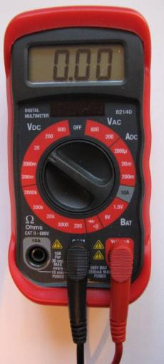
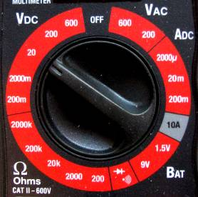





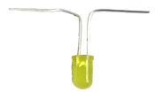
Measuring Voltage
Set multimeter to the proper V range.
Measure across a component.
Switch
Battery
Resistor
Light
Notes:
The positive and negative signs represent polarity and flow.
A digital multimeter will give a negative reading if the positive and negative terminals are reversed.
The voltage reading can be different between any measured component.

Slide 27
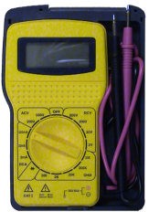

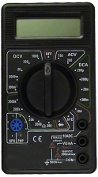
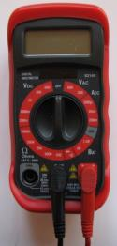
Multimeter
An instrument used to measure the properties of an electrical circuit, including
Voltage Volts
Current Amps
Resistance Ohms
Notes:
Sometimes the multimeter is referred to as the “Swiss Army Knife” of electricity.
Common measurements include continuity, voltage, current, and resistance. These are further discussed in this presentation and other presentations in this lesson.

Slide 28
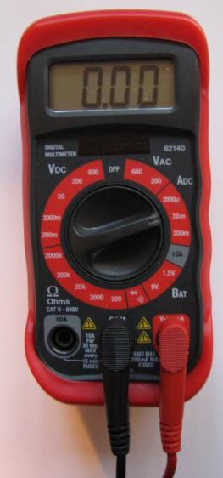
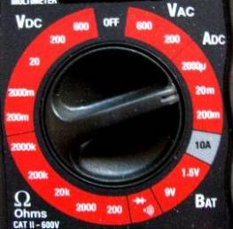
Measuring Current
Set multimeter to the proper ADC range.
Circuit flow must go through the meter.
Switch
Battery
Resistor
Light

Slide 29
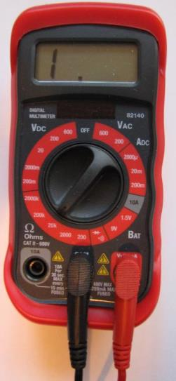
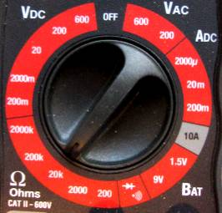
Measuring Resistance
Set multimeter to the proper Ohms range.
Measure across the component being tested.
Power must be off or removed from the circuit.
Switch
Battery
Resistor
Light

Slide 30
Ohm’s Law
Current in a resistor varies in direct proportion to the voltage applied to it and is inversely proportional to the resistor’s value
The mathematical relationship between current, voltage, and resistance
If you know two of the three quantities, you can solve for the third.
Quantities | Abbreviations | Units | Symbols
Voltage | V | Volts | V
Current | I | Amperes | A
Resistance | R | Ohms | Ω
V=IR
I=V/R
R=V/I

Slide 31

Ohm’s Law Chart
Cover the quantity that is unknown.
Solve for V
V
V=IR
I
R

Slide 32
Ohm’s Law Chart
Cover the quantity that is unknown.
Solve for I
V
I=V/R
I
R

Slide 33
Ohm’s Law Chart
Cover the quantity that is unknown.
Solve for R
V
R=V/I
I
R

Slide 34

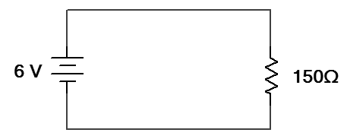
Example: Ohm’s Law
The flashlight shown uses a 6-volt battery and has a bulb with a resistance of 150 Ω. When the flashlight is on, how much current will be drawn from the battery?
Schematic Diagram
I_{R}
V
+
-
V_{T} =
V_{R}
I
R

Slide 35
Circuit Configuration
Components in a circuit can be connected in one of two ways.
Series Circuits
Components are connected end-to-end.
There is only a single path for current to flow.
Parallel Circuits
Both ends of the components are connected together.
There are multiple paths for current to flow.
Components
(i.e., resistors, batteries, capacitors, etc.)
Notes:
Overview of series and parallel component configuration.

Slide 36
Kirchhoff’s Laws
Kirchhoff’s Voltage Law (KVL):
The sum of all voltage drops in a series circuit equals the total applied voltage
Kirchhoff’s Current Law (KCL):
The total current in a parallel circuit equals the sum of the individual branch currents

Slide 37
Series Circuits
A circuit that contains only one path for current flow
If the path is open anywhere in the circuit, current stops flowing to all components.

Slide 38
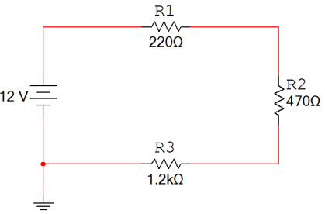
Series Circuits
Characteristics of a series circuit
The current flowing through every series component is equal.
The total resistance (R_{T}) is equal to the sum of all of the resistances (i.e., R₁ + R₂ + R₃).
The sum of all voltage drops (V₁ + V₂ + V₃) is equal to the total applied voltage (V_{T}). This is called Kirchhoff’s Voltage Law.
V_{R1}
I_{T}
+
-
+
+
V_{T}
V_{R2}
-
-
R_{T}
-
+
V_{R3}
Notes:
Characteristics of a series circuit.

Slide 39
Example: Series Circuit
For the series circuit shown, use the laws of circuit theory to calculate the following:
The total resistance (R_{T})
The current flowing through each component (I_{T}, I₁, I₂, & I₃)
The voltage across each component (V_{T}, V₁, V₂, & V₃)
Use the results to verify Kirchhoff’s Voltage Law
V_{R1}
I_{T}
+
-
+
I_{R1}
+
V_{T}
I_{R2}
V_{R2}
-
I_{R3}
-
R_{T}
-
+
V_{R3}
Notes:
Pause the presentation and allow the student to work on the example. The solution is on the next three slides.

Slide 40
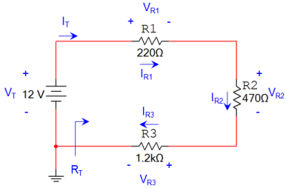
Example: Series Circuit
Solution:
Total Resistance:
Current Through Each Component:
V
I
R
Notes:
This slide provides the solution. If you print handouts, do not print this page. (1 of 3)

Slide 41
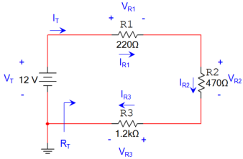
Example: Series Circuit
Solution:
Voltage Across Each Component:
V
I
R
Notes:
This slide provides the solution. If you print handouts, do not print this page. (2 of 3)

Slide 42

Example: Series Circuit
Solution:
Verify Kirchhoff’s Voltage Law:
Notes:
This slide provides the solution. If you print handouts, do not print this page. (3 of 3)

Slide 43


Parallel Circuits
A circuit that contains more than one path for current flow
If a component is removed, then it is possible for the current to take another path to reach other components.

Slide 44
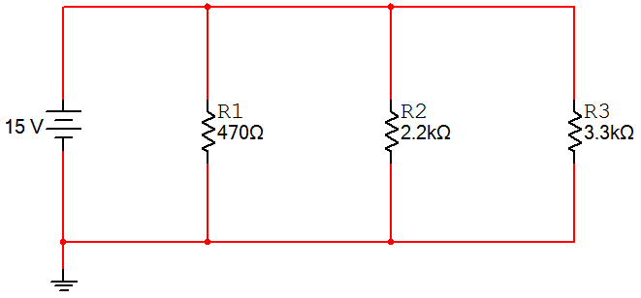
Parallel Circuits
Characteristics of a Parallel Circuit
The voltage across every parallel component is equal.
The total resistance (R_{T}) is equal to the reciprocal of the sum of the reciprocal:
The sum of all of the currents in each branch (I_{R1} + I_{R2} + I_{R3}) is equal to the total current (I_{T}). This is called Kirchhoff’s Current Law.
I_{T}
+
+
+
+
V_{T}
V_{R1}
V_{R2}
V_{R3}
-
-
-
-
R_{T}
Notes:
Characteristics of a parallel circuit.

Slide 45
Example Parallel Circuits
For the parallel circuit shown, use the laws of circuit theory to calculate the following:
The total resistance (R_{T})
The voltage across each component (V_{T}, V₁, V₂, & V₃)
The current flowing through each component (I_{T}, I₁, I₂, & I₃)
Use the results to verify Kirchhoff’s Current Law
I_{T}
I_{R1}
I_{R2}
I_{R3}
+
+
+
+
V_{T}
V_{R1}
V_{R2}
V_{R3}
-
-
-
-
45
R_{T}
Notes:
Pause the presentation and allow the student to work on the example. The solution is on the next three slides.

Slide 46
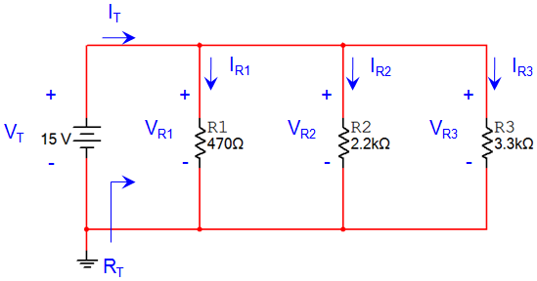
Example Parallel Circuits
Solution:
Total Resistance:
Voltage Across Each Component:
Notes:
This slide provides the solution. If you print handouts, do not print this page. (1 of 3)

Slide 47

Example Parallel Circuits
Solution:
Current Through Each Component:
V
I
R
Notes:
This slide provides the solution. If you print handouts, do not print this page. (2 of 3)

Slide 48
Example Parallel Circuits
Solution:
Verify Kirchhoff’s Current Law:
Notes:
This slide provides the solution. If you print handouts, do not print this page. (3 of 3)

Slide 49


Combination Circuits
Contain both series and parallel arrangements
What would happen if you removed light 1? Light 2? Light 3?
1
2
3

Slide 50
Electrical Power
Electrical power is directly related to the amount of current and voltage within a system.
Power is measured in watts

Slide 51
Image Resources
Microsoft, Inc. (2008). Clip art. Retrieved November 20, 2008, from http://office.microsoft.com/en-us/clipart/default.aspx

