Slide 1
Calculating Truss Forces
Principles of Engineering
© 2012 Project Lead The Way, Inc.

Slide 2
Forces
Compression
A body being squeezed
Tension
A body being stretched

Slide 3
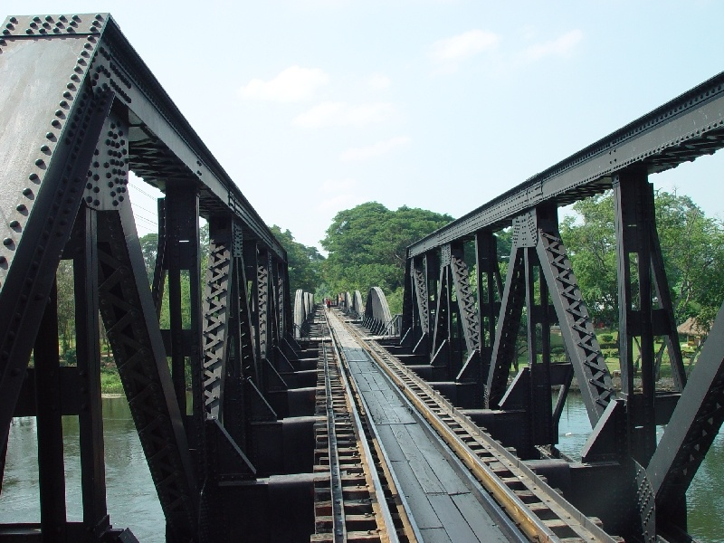
Truss
A truss is composed of slender members joined together at their end points.
  They are usually joined by welds or gusset plates.

Slide 4
Simple Truss
A simple truss is composed of triangles, which will retain their shape even when removed from supports.

Slide 5
Pinned and Roller Supports
A pinned support can support a structure in two dimensions.
A roller support can support a structure in only one dimension.

Slide 6
Solving Truss Forces
Assumptions:
All members are perfectly straight.
All loads are applied at the joints.
All joints are pinned and frictionless.
Each member has no weight.
Members can only experience tension or compression forces.
What risks might these assumptions pose if we were designing an actual bridge?

Slide 7
Static Determinacy
A statically determinate structure is one that can be mathematically solved.
2J = M + R
J = Number of Joints
M = Number of Members
R = Number of Reactions
Notes:
A statically determinate truss will always have one solution for reaction forces and member tensions/compressions for a given load, and will always obey this relationship among J,M, and R.
If 2J is not equal to M+R, the truss has the potential to have “built-in” tension or compression, so there is not enough information to determine the tensions; it depends on the tensions members were under, for instance, when they were bolted together. Even if bolted/welded together without tension/compression, later temperature changes might cause internal forces in the truss, and an indeterminate truss does not have the freedom to expand or contract to relieve those forces.

Slide 8

Statically Indeterminate
B
Each pin connection contributes TWO reaction forces
A
C
D
F_{D} = 500 lb
A truss is considered statically indeterminate when the static equilibrium equations are not sufficient to find the reactions on that structure. There are simply too many unknowns.
Try It
2J = M + R
2(4) ≠ 5 + 4
Notes:
Each pin has two reaction forces: an x-component and a y-component. Since there are two pins, there are 4 reaction forces.

Slide 9

Statically Determinate
B
Is the truss statically determinate now?
A
C
D
F_{D} = 500 lb
A truss is considered statically determinate when the static equilibrium equations can be used to find the reactions on that structure.
Try It
2J = M + R
2(4) = 5 + 3

Slide 10
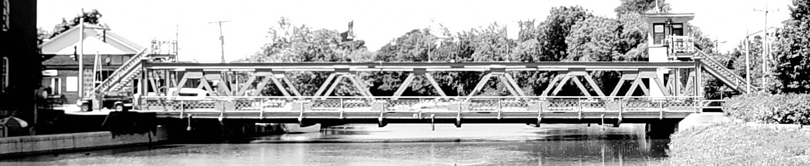
Static Determinacy Example
Each side of the main street bridge in Brockport, NY has 19 joints, 35 members, and three reaction forces (pin and roller), making it a statically determinate truss.
What if these numbers were different?

Slide 11
Equilibrium Equations
The sum of the moments about a given point is zero.

Slide 12
Equilibrium Equations
The sum of the forces in the x-direction is zero.
Do you remember the Cartesian coordinate system? A vector that acts to the right is positive, and a vector that acts to the left is negative.

Slide 13
Equilibrium Equations
The sum of the forces in the y-direction is zero.
A vector that acts up is positive, and a vector that acts down is negative.

Slide 14






Using Moments to Find R_{CY}
A force that causes a clockwise moment is a negative moment.
A force that causes a counterclockwise moment is positive moment.
3.0 ft
7.0 ft
$$\sum{M_{A}}=0$$
F_{D} contributes a negative moment because it causes a clockwise moment about A.
R_{Cy} contributes a positive moment because it causes a counterclockwise moment around A.
$$−F_{D}\left(3.0 ft\right)+R_{C_{y}} \left(10.0 ft\right)=0$$
$$−500 lb \left(3.0 ft\right)+R_{C_{y}} \left(10.0 ft\right)=0$$
$$−1500 lb∙ft+R_{C_{y}} \left(10.0 ft\right)=0$$
$$R_{C_{y}} \left(10.0 ft\right)=1500 lb∙ft$$
$$R_{C_{y}}=150 lb$$
Notes:
Stress that the only forces used when summing the moments are the external forces. Members’ internal forces are not used.
Note: Choose the point that we will use as our "pivot" when summing the moments.
In this example, point A was chosen as the pivot because it eliminates the moments from two unknown forces. Forces that are pointing directly toward or away from the pivot do not cause a moment because the distance is zero.
Note: If the answer for a reaction force is negative, the direction of the reaction force is opposite to what was originally chosen.

Slide 15



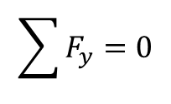


Sum the y Forces to Find $R_{A_{y}}$
We know two out of the three forces acting in the y-direction. By simply summing those forces together, we can find the unknown reaction at point A.
Please note that a negative sign is in front of F_{D} because the drawing shows the force as down.
$$\sum{F_{y}}=0$$
$$−F_{D}+R_{C_{y}}+R_{A_{y}}=0$$
$$−500. lb+150.\underline{00} lb+R_{A_{y}}=0$$
$$−350. lb+R_{A_{y}}=0$$
$R_{A_{y}}=350. lb$
Notes:
Stress that the only forces used when summing the moments are the external forces. Member forces are not used.
Note: Positive answer means the chosen direction is correct. If the answer is negative, the direction of the reaction force would be opposite to what is originally chosen.

Slide 16
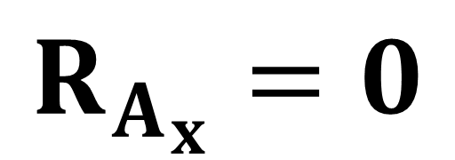
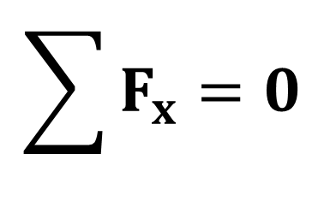

Sum the x Forces to Find $A_{x}$
Because joint A is pinned, it is capable of reacting to a force applied in the x-direction.
However, since the only load applied to this truss (F_{D}) has no x-component, R_{Ax} must be zero.
$$\sum{F_{x}}=0$$
$$R_{A_{x}}=0$$
Notes:
Stress that the only forces used when summing the moments are the external forces. Member forces are not used.
Note: A positive answer means the chosen direction is correct. If the answer is negative, the direction of the reaction force would be opposite to what is originally chosen.

Slide 17
Method of Joints
Use cosine and sine to determine x and y vector components.
Assume all members to be in tension. A positive answer will mean the member is in tension, and a negative number will mean the member is in compression.
As forces are solved, update free body diagrams. Use correct magnitude and sense for subsequent joint free body diagrams.
Notes:
If the direction of a member force changes, there will be two free body diagrams that need to be updated.

Slide 18
Method of Joints
Truss Dimensions
B
4.0 ft
A
C
θ₁
θ₂
R_{Ax}
D
3.0 ft
7.0 ft
R_{Ay}
R_{Cy}
500lb
Notes:
Once the reaction forces and angles are found, we will no longer use the distance measurements.

Slide 19
Method of Joints
Using Truss Dimensions to Find Angles
B
4.0 ft
4.0 ft
A
C
θ₁
θ₂
D
3.0 ft
7.0 ft
Notes:
Once the reaction forces and angles are found, we will no longer use the distance measurements.

Slide 20
Method of Joints
Using Truss Dimensions to Find Angles
B
4.0 ft
4.0 ft
A
C
θ₁
θ₂
D
3.0 ft
7.0 ft
Notes:
Once the reaction forces and angles are found, we will no longer use the distance measurements.

Slide 21
Method of Joints
Draw a free body diagram of each pin.
B
A
C
53.130°
29.745°
R_{Ax}
D
R_{Ay}
R_{Cy}
500lb
Every member is assumed to be in tension. A positive answer indicates the member is in tension, and a negative answer indicates the member is in compression.
Notes:
To get the free body diagram for each joint, simply erase the middle of each member and put arrows on the end.

Slide 22
Method of Joints
Where to Begin
Choose the joint that has the least number of unknowns.
Reaction forces at joints A and C are both good choices to begin our calculations.
B
AB
BC
BD
A
C
R_{Ax}
AD
CD
0
D
350lb
500lb
150lb
R_{Ay}
R_{Cy}

Slide 23
Method of Joints
COMPRESSION
Notes:
As the forces are summed, choose the sign based on the direction of the vector arrow in the force diagram.
Note: A negative answer means the original assumption is incorrect. Instead of the member being in tension, it is actually under compression.

Slide 24
Method of Joints
Update the all force diagrams based on AB being under compression.
B
AB
BC
BD
A
C
R_{Ax}=
0
AD
CD
D
R_{Ay}=
350lb
500lb
R_{Cy}=
150lb

Slide 25
Method of Joints
TENSION
Notes:
As the forces are summed, choose the sign based on the direction of the vector arrow in the updated force diagram.
Note: There is a negative on the x-component of AB because of the updated direction of AB.
Note: A positive answer means the original assumption is correct and the member is under tension. If the answer is negative, the direction of the reaction force would be opposite to what is originally chosen.

Slide 26
Method of Joints
COMPRESSION
Notes:
As the forces are summed, choose the sign for each component based on the direction of the vector arrow in the force diagram.
Note: A negative answer means the original assumption is incorrect. Instead of the member being in tension, it is actually under compression.

Slide 27
Method of Joints
Update the all force diagrams based on BC being under compression.
B
AB
BC
BD
A
C
R_{Ax}=
0
AD
CD
D
R_{Ay}=
350lb
500lb
R_{Cy}=
150lb

Slide 28
Method of Joints
TENSION
Notes:
As the forces are summed, choose the sign based on the direction of the vector arrow in the updated force diagram.
Note: A positive answer means the original assumption is correct and the member is under tension. If the answer is negative, the direction of the reaction force would be opposite to what is originally chosen.

Slide 29
Method of Joints
500lb
BD
D
500lb
TENSION
Notes:
As the forces are summed, choose the sign based on the direction of the vector arrow in the force diagram.
Note: A positive answer means the original assumption is correct and the member is under tension. If the answer is negative, the direction of the reaction force would be opposite to what is originally chosen.
Note: After solving for joint A, solving for joint D is an alternative and slightly easier method. Always look for joints that are easy to solve, such as joints where all forces are at right angles to one another. The progression for solving in the PPT gives the students exposure to trigonometry, which tends to be more of a stumbling block.

