Slide 1
Moments
Principles of Engineering

Slide 2
Moment
The moment of a force is a measure of the tendency of the force to rotate the body upon which it acts.
FORCE
Notes:
The force applied to drive the bolt produces a measurable moment, and the wrench rotates about the axis of the bolt.

Slide 3
Terminology
= F
FORCE
lever arm
pivot
distance
= d
The distance must be perpendicular to the force.

Slide 4
Moments Formula
= F
FORCE
pivot
distance
= d
M
M = d x F
Moment

Slide 5
Units for Moments
 | Force | Distance | Moment
English Customary | Pound force (lbf) | Foot (ft) | lbf-ft
SI | Newton (N) | Meter (m) | N-m

Slide 6
Rotation Direction
In order to add moments, it is important to know if the direction is clockwise (CW) or counterclockwise (CCW).
CCW is positive
CW is negative

Slide 7
Right-Hand Rule
Curl your fingers to match the direction of rotation.
+
Thumb is pointing . . . .
Up = Positive
Down = Negative
Toward You = Positive
Away from You = Negative
counterclockwise

Slide 8
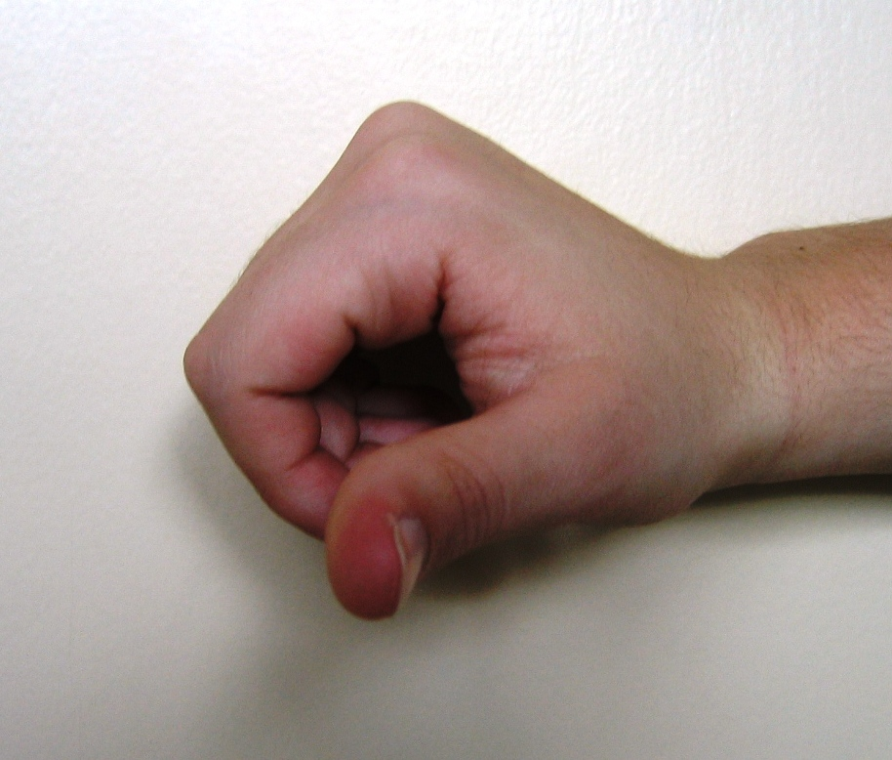
Right-Hand Rule
FORCE
THUMB POINTS TOWARD YOU
POSITIVE

Slide 9
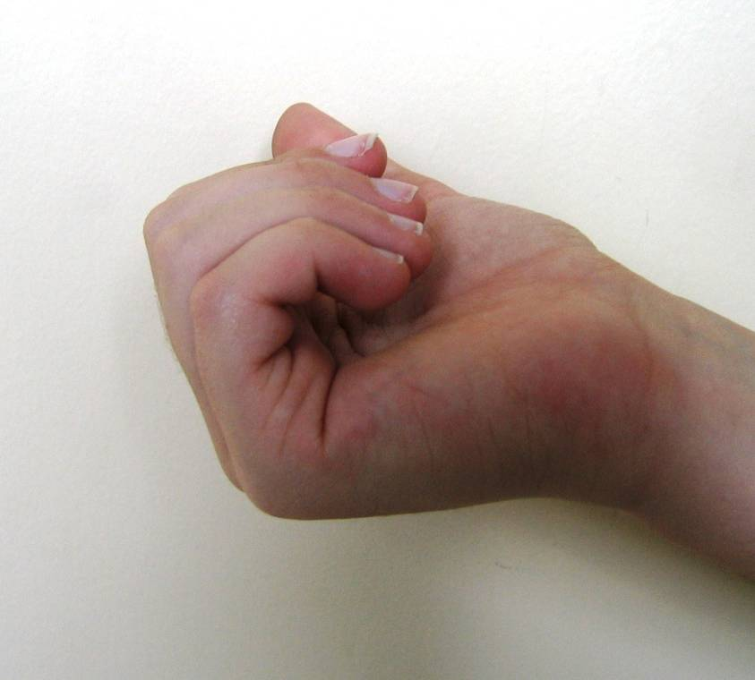

Right-Hand Rule
THUMB POINTS AWAY FROM YOU
FORCE
NEGATIVE

Slide 10
Moment Calculations
Wrench
F = 20. lb
FORCE
¯
M = d x F
Use the right-hand rule to determine positive and negative.
d = 9.0 in. = .75 ft
M = -(20. lb x .75 ft)
M = -15 lb-ft
^{(15 lb-ft clockwise)}
d = 9.0 in.

Slide 11
Moment Calculations
Longer Wrench
F = 20. lb
FORCE
M = d x F
M = -(20. lb x 1.0 ft)
M = -20. lb-ft
¯
d = 1.0 ft

Slide 12
Moment Calculations
L-Shaped Wrench
F = 20. lb
FORCE
d = 3 in. = .25 ft
M = d x F
M = -(20. lb x .25 ft)
M = -5 lb-ft
3 in.
¯
d = 1.0 ft
Notes:
If you have a vertical force, you are looking for a horizontal distance to the pivot.
If you have a horizontal force, you are looking for a vertical distance to the pivot.

Slide 13
Moment Calculations
Z - Shaped Wrench
F = 20. lb
FORCE
d = 8 in. + 10 in. = 1.5 ft
M = d x F
M = -(20. lb x 1.5 ft)
M = -30. lb-ft
9 in.
¯
8 in.
10. in.
Notes:
Given a vertical force, look for a horizontal distance.

Slide 14
Moment Calculations
Wheel and Axle
d = r = 50. cm = 0.50 m
M = d x F
Use the right-hand rule to determine positive and negative.
M = 100 N x 0.50 m
M = 50 N-m
r = 50. cm
+
F = 100 N
Notes:
Given a vertical force, look for a horizontal distance.

Slide 15
Moment Calculations
Wheel and Axle
F_{y} = Fsin50.° = (100. N)(.766)
F_{y} = 76.6N
d = r = 50. cm = 0.50 m
M = d x F_{y}
M = 76.6 N x 0.50 m
M = 38 N-m
r = 50. cm
50.º
50.º
F = 100. N
F_{y}
Notes:
Given a vertical force, look for a horizontal distance.

Slide 16
What is Equilibrium?
The state of a body or physical system with an unchanging rotational motion.
  Two cases for that condition:
    Object is not rotating OR
    Object is spinning at a constant speed
  In either case rotation forces are balanced: The sum of all moments about any point or axis is zero.
ΣM = 0
M₁ + M₂ + M₃ . . . = 0
Notes:
Moments
Principles of EngineeringTM
Unit 4 – Lesson 4.1 - Statics
During PoE we will address the first case. We will not have trusses spinning. Trusses will be stationary.

Slide 17
Moment Calculations
See-Saw

Slide 18
Moment Calculations
ΣM = 0
M₁ + M₂ = 0
Use the right-hand rule to determine positive and negative.
M₁ = -M₂
d₁ x F₁ = d₂ x F₂
25lb x 4.0ft - 40. lb x d₂=0
100 lb-ft = 40. lb x d₂
See-Saw
F₂ = 40. lb
F₁ = 25 lb
¯
40. lb 40. lb
+
2.5 ft = d₂
d₁ = 4.0 ft
d₂ = ? ft

Slide 19


Moment Calculations
Loaded beam
Select A as the pivot location. Solve for R_{By}
ΣM = 0
M_{B} + M_{C} = 0
M_{B} = -M_{C}
d_{AB} x R_{By} = d_{AC} x F_{C}
10.00 ft x R_{By} = 3.00 ft x 35.0 lb
10.0 ft x R_{By} = 105 lb-ft
d_{AB} = 10.00 ft
d_{AC}= 3.00 ft
C
10.00 ft 10.00 ft
A
B
R_{By} = 10.5 lb
R_{Ay} + R_{By} = 35.0 lb
R_{Ay} = 35.0 lb – 10.5 lb = 24.5 lb
F_{C} = 35.0 lb
R_{Ay}
R_{By}

Slide 20
Moment Calculations
Truss
F_{B} = 500. lb
B
Replace the pinned and roller supports with reaction forces.
12 ft
R_{Ax}
A
24 ft
C
8 ft
D
d_{AC} = 24 ft
d_{CD} = 8 ft
d_{CB} = 12 ft
d_{AD} = 32 ft
R_{Ay}
F_{c} = 600. lb
R_{Dy}

Slide 21
Moment Calculations
Truss
Select A as the axis of rotation. Solve for R_{DY}
ΣM = 0
M_{D} – M_{B} – M_{C} = 0
M_{D} = M_{B} + M_{C}
d_{AD} x R_{Dy} = (d_{CB} x F_{B}) + (d_{AC} x F_{C})
32 ft x R_{Dy} = (12 ft x 500. lb)
+ (24 ft x 600. lb)
R_{Dy} x 32 ft = 6000 lb-ft + 14400 lb-ft
R_{Dy} x 32 ft = 20400 lb-ft
F_{B} = 500. lb
B
12 ft
12 ft
R_{Ax}
A
24 ft
C
8 ft
D
32 ft 32 ft
d_{AC} = 24 ft
d_{CD} = 8 ft
d_{CB} = 12 ft
d_{AD} = 32 ft
R_{DY} = 640 lb
R_{Ay}
F_{c} = 600. lb
R_{Dy}

