Slide 1
Free Body Diagrams
Principles of Engineering
© 2012 Project Lead The Way, Inc.

Slide 2
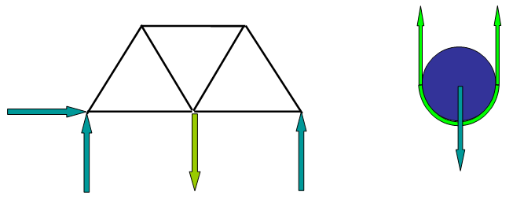
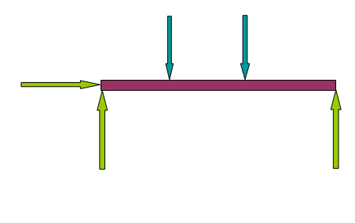
Free Body Diagram
Visual representation of force and object interactions
Individual objects or members are isolated from their environment or system, illustrating all external forces acting upon them
Notes:
Every object exists surrounded by other objects, perhaps resting against something, perhaps moving through its surroundings. While an object is in a given environment, it interacts with other objects around it, exerting forces on those objects and having forces exerted upon it.
A free body diagram isolates an object from its environment, or system, and symbolically examines all of the forces acting on the object.
This allows engineers to focus on the forces acting upon the object. From the free body diagram, engineers develop equations which can describe equilibrium, motion, momentum, strength, and many other physical properties.

Slide 3
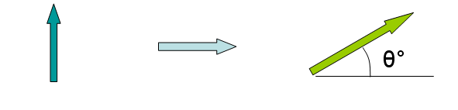
Free Body Diagram Components
Force
A straight line push or pull acting upon an object
Vector quantity has direction and magnitude
Direction is illustrated by arrowhead
Magnitude is illustrated by length of line segment and is the amount of push or pull

Slide 4
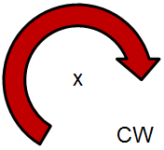
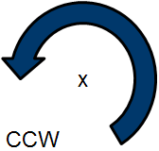
Free Body Diagram Components
Moment
The twisting effort about a point or axis when a force is applied at a distance
Arc with an arrowhead acting about a point indicating direction of CW or CCW

Slide 5

Moment Review
Moment (M) =
Force (F) x distance (d)
Distance (d) is called the moment arm. It must be measured perpendicular to the line of action of the force.
Point of Rotation
d
Line of Action
F

Slide 6
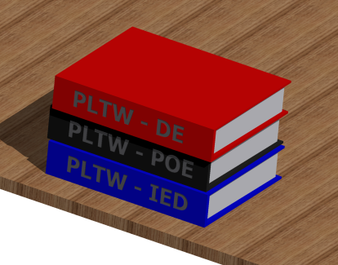
Free Body Diagram Procedure
A stack of three books, each weighing 5 lb, is sitting on top of a table. Draw the Free Body Diagram (FBD) of the top book.

Slide 7
Free Body Diagram Procedure
1. Sketch the isolated object.
What is the isolated object?
Top Book
Notes:
Free body diagrams should be drawn completely isolated from all other objects. We “free” the body from its system. Instead of taking time to draw the object in detail, we substitute a simple geometric shape, such as a square or a circle. For these exercises the shape we draw is considered dimensionless.

Slide 8
Free Body Diagram Procedure
2. Sketch the applied and norm forces.
When an object is in contact with and is supported by a second object, the second object can be replaced with a normal force which is perpendicular to the surface of the second object.
Notes:
Free body diagrams should be drawn completely isolated from all other objects. We “free” the body from its system. Instead of taking time to draw the object in detail, we substitute a simple geometric shape, such as a square or a circle. For these exercises the shape we draw is considered dimensionless.

Slide 9
Free Body Diagram Procedure
2. Sketch the applied force and norm forces.
Normal Force Reaction force pushing up on the book, causing it not to fall
Applied Force Weight of top book
Notes:
Free body diagrams should be drawn completely isolated from all other objects. We “free” the body from its system. Instead of taking time to draw the object in detail, we substitute a simple geometric shape, such as a square or a circle. For these exercises the shape we draw is considered dimensionless.

Slide 10
Free Body Diagram Procedure
3. Label objects and forces.
N=5 lbf
PLTW – DE book
W=5 lbf
Notes:
Free body diagrams should be drawn completely isolated from all other objects. We “free” the body from its system. Instead of taking time to draw the object in detail, we substitute a simple geometric shape, such as a square or a circle. For these exercises the shape we draw is considered dimensionless.
Ask the question: Why are these two forces equal? A typical answer would be that they are not moving. Go a little bit further and ask what law of motion explains this situation. Answer=Newton’s Second Law, which is F=ma. If there is no acceleration, then there is no net force.

Slide 11
Free Body Diagram Procedure
4. Label dimensions.
For more complex free body diagrams, proper dimensioning is required, including length, height, and angles.
N=5 lbf
10 ft
8 ft
PLTW – DE book
8 ft
38.6°
45°
W=5 lbf
Notes:
Free body diagrams should be drawn completely isolated from all other objects. We “free” the body from its system. Instead of taking time to draw the object in detail, we substitute a simple geometric shape, such as a square or a circle. For these exercises the shape we draw is considered dimensionless.

Slide 12
Free Body Diagram Practice
Create a FBD for the sled pictured below.
F_{app}
F_{app}
θ
F_{N}
F_{f}
θ
F_{f}
W
W
F_{N}

Slide 13
Free Body Diagram Practice
Create a FBD for the refrigerator pictured below.
F_{N}
F_{app}
F_{app}
F_{f}
W
W
θ
F_{f}
F_{N}
θ

Slide 14
Free Body Diagram Practice
Create a FBD for the pulley system pictured below.
F_{T}
FBD of Mass 1:
W₁
F_{T}
F_{T}
FBD of the movable pulley:
M2
W_{2 + W pulley}
M1
Tension Forces (F_{T} ) are equal throughout the system.
Notes:
Free body diagrams are frequently used while solving pulley system problems. It is useful to isolate the parts of a pulley system to discover relationships between the parts. This pulley system consists of an upper fixed pulley, which is supporting block M1, and a lower movable pulley. The movable pulley is supporting block M2. A single rope or cord connects these pulleys. Both pulleys are considered mass-less and frictionless.
A free body diagram of M1 would start with a small shape. Two forces are acting on M1: The weight of M1 and the tension force of the rope.
We can also isolate the pulleys. Looking at the lower movable pulley, we draw the free body. The weight of the block M2 is pulling down on the pulley. Two strands of the rope are pulling up on the pulley, and each of the strands is exerting a tension force.
The tension force in the rope is equal in each free body diagram within the system since there is a single tension force in the entire rope.

Slide 15
Free Body Diagram Reactions
Different types of support reactions
Cable, rope, or chain
Pin
Roller
Built-in end – Cantilever
To aid in completing free body diagrams, connections are often identified with letters.

Slide 16
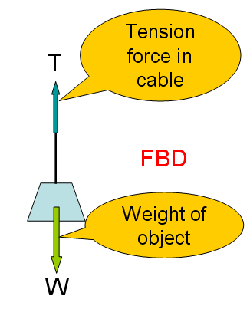
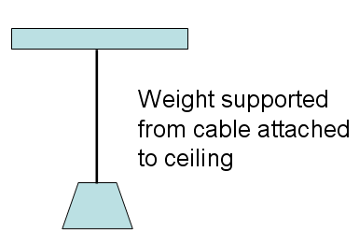
Cable Support
Cable, rope, chain – Replace with a tension force only.

Slide 17
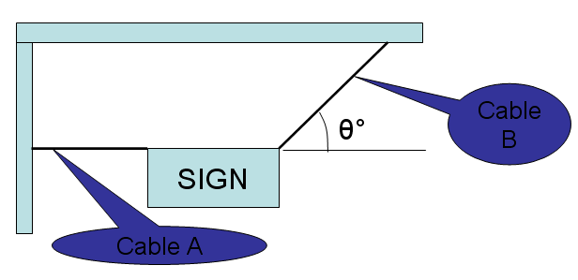
Cable Support
A sign with weight W is hung by two cables as shown. Draw the FBD of the sign and cables.

Slide 18
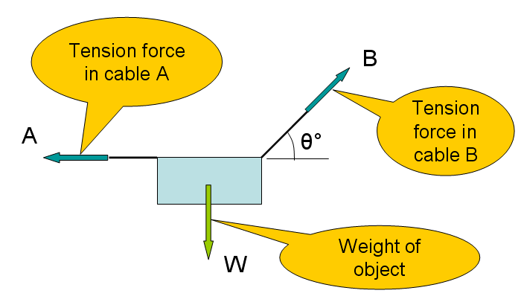
Cable Support
FBD of sign and cables

Slide 19
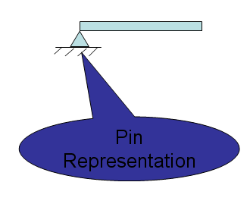
Pin Support
Pin – Replaced with TWO reaction forces, one vertical (y) and one horizontal (x).
Joint / Pin A
Reaction Force
x-direction
A
R_{Ax}
A
Joint / Pin A
R_{Ay}
y-direction
Reaction Force

Slide 20
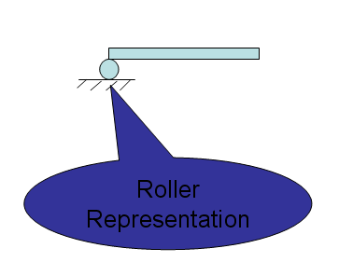
Roller Support
Roller – Replaced with ONE reaction force, perpendicular to surface
A
A
Joint / Roller A
R_{Ay}
y-direction
Reaction Force

Slide 21
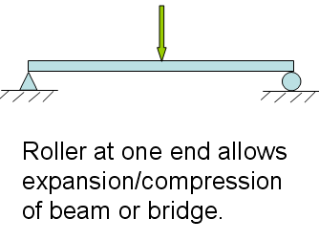
Common Support Reactions
Beams and truss bridges are usually supported with one pin support and one roller support. This is called a simply supported object.
Create a FBD for the simply supported beam.
A
B
R_{Ax}
R_{Ay}
R_{By}

Slide 22
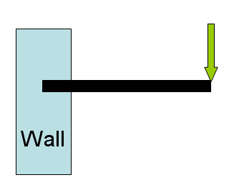
Built-In-End Support
Built-in-end (cantilever) – Replaced with TWO forces: one horizontal and one vertical, and ONE moment
Create a FBD for the built-in-end cantilever.
A
MA_{ccw}
R_{Ax}
R_{Ay}

Slide 23
Summary Support Reactions
Contact – Replace with a normal force
Cable, rope, chain – Replace with tension force
Pin – Replace with two reaction forces; one vertical and one horizontal
Roller – Replace with one reaction force perpendicular to surface
Built-in-end (cantilever) – Replace with one horizontal force, one vertical force, and one moment

Slide 24


Truss Bridge FBD
Supported with a pin at one end and a roller at the other
Draw the FBD of the entire truss bridge.
E
D
B
A
C
500 lb

Slide 25
Truss Bridge FBD
FBD of the entire truss bridge
E
D
R_{Ax}
B
C
R_{Ay}
R_{Cy}
500 lbf

