Slide 1
Introduction to Statics
Principles of Engineering
© 2012 Project Lead The Way, Inc.

Slide 2
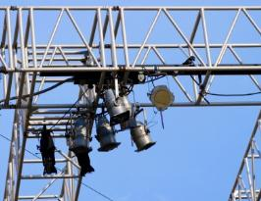
Statics
The study of forces and their effects on a system in a state of rest or uniform motion
©iStockphoto.com
©iStockphoto.com
©iStockphoto.com
Notes:
Uniform motion means constant velocity. State of rest is constant velocity also, specifically v=0.

Slide 3
Statics Principles
Newton’s First Law of Motion (law of inertia):
An object in a state of rest or uniform motion will continue to be so unless acted upon by a net force
©iStockphoto.com
Notes:
Describes the relationship between velocity and forces.

Slide 4
Statics Principles
Newton’s Second Law of Motion:
The acceleration of an object is proportional to the net force acting on the object and inversely proportional to the object’s mass
Force = Mass x Acceleration
Notes:
Describes the acceleration of an object in the direction of the net force applied to it.

Slide 5
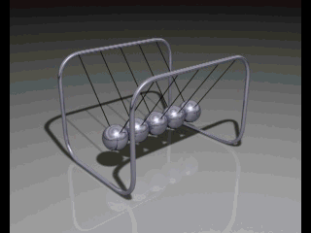
Statics Principles
Newton’s Third Law of Motion:
For every action force, there is an equal and opposite reaction force
©iStockphoto.com
Notes:
Describes action-reaction pairs.

Slide 6
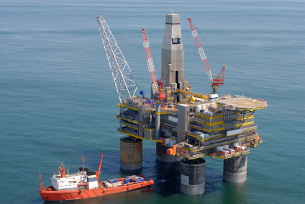
Equilibrium
Static Equilibrium:
A condition where there is not a net external force acting upon a particle or rigid body and the body remains at rest or continues at a constant velocity
©iStockphoto.com

Slide 7
Equilibrium
Translational Equilibrium:
The state in which there are no unbalanced forces acting on a body
©iStockphoto.com
©iStockphoto.com
Balanced
Unbalanced

Slide 8
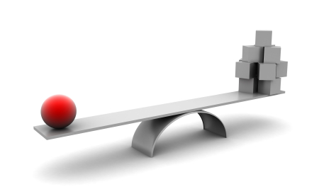
Equilibrium
Rotational Equilibrium:
The state in which the sum of all the clockwise moments equals the sum of all the counterclockwise moments about a pivot point
Remember
M = d x F
©iStockphoto.com

Slide 9
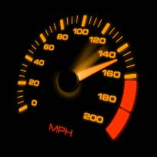
Statics Principles
Scalar Quantities: A physical quantity that has magnitude only
Examples: Mass, length, time, volume, temperature, pressure, and speed
©iStockphoto.com
©iStockphoto.com

Slide 10
Statics Principles
Vector Quantities: A physical quantity that has both a magnitude and direction
Examples: Position, velocity, force, and moment
©iStockphoto.com
©iStockphoto.com

Slide 11
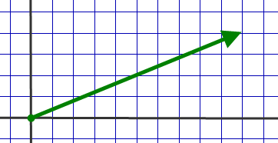
What Is a Force?
The pushing or pulling interaction of objects
A vector quantity defined by its known magnitude, direction
In addition, the point of application of a vector is important.
45 lbf
A
21.8°NE

Slide 12
Force Units
British System of Units
pound-force (lbf)
International System of Units
newton (N)
Conversions between Unit Systems
1lbf = 4.448 N
1N = 0.2248 lbf

Slide 13
Static Equilibrium Force Principles
Forces always occur in pairs acting on two different objects.
Force pairs act in opposite directions and have the same magnitude.

Slide 14
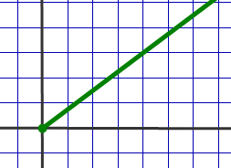
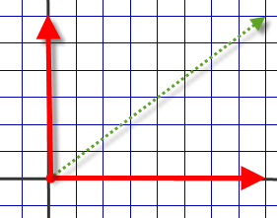
Force Components
A single force can be replaced by component forces if their combination produces the same effect as the original force.
F_{ay}
F_{a}
a
a
F_{ax}

Slide 15
Resultant Force
A single force that has the same effect as two or more concurrent forces
Resultant
=
5lbf
2lbf
7lbf
Resultant
2lbf
5lbf
=
3lbf

