Slide 1
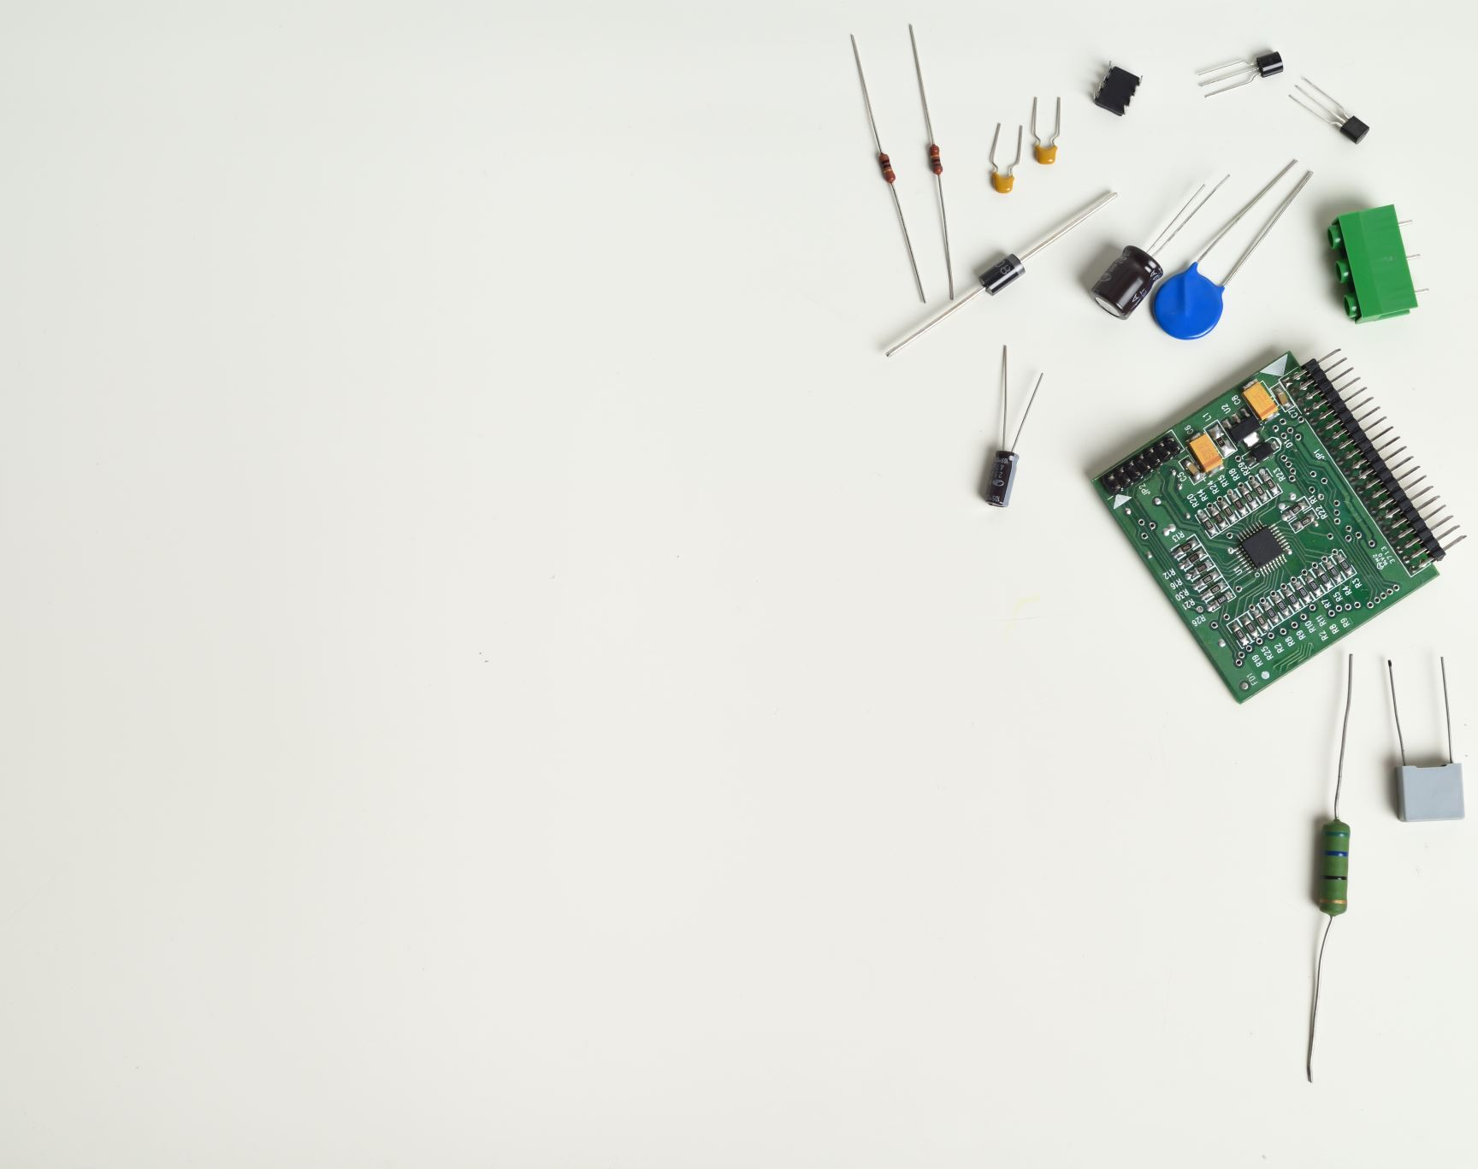
Transistors, Capacitors, and Astable Multivibrator Circuits
Principles of Engineering

Slide 2
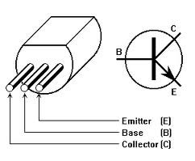
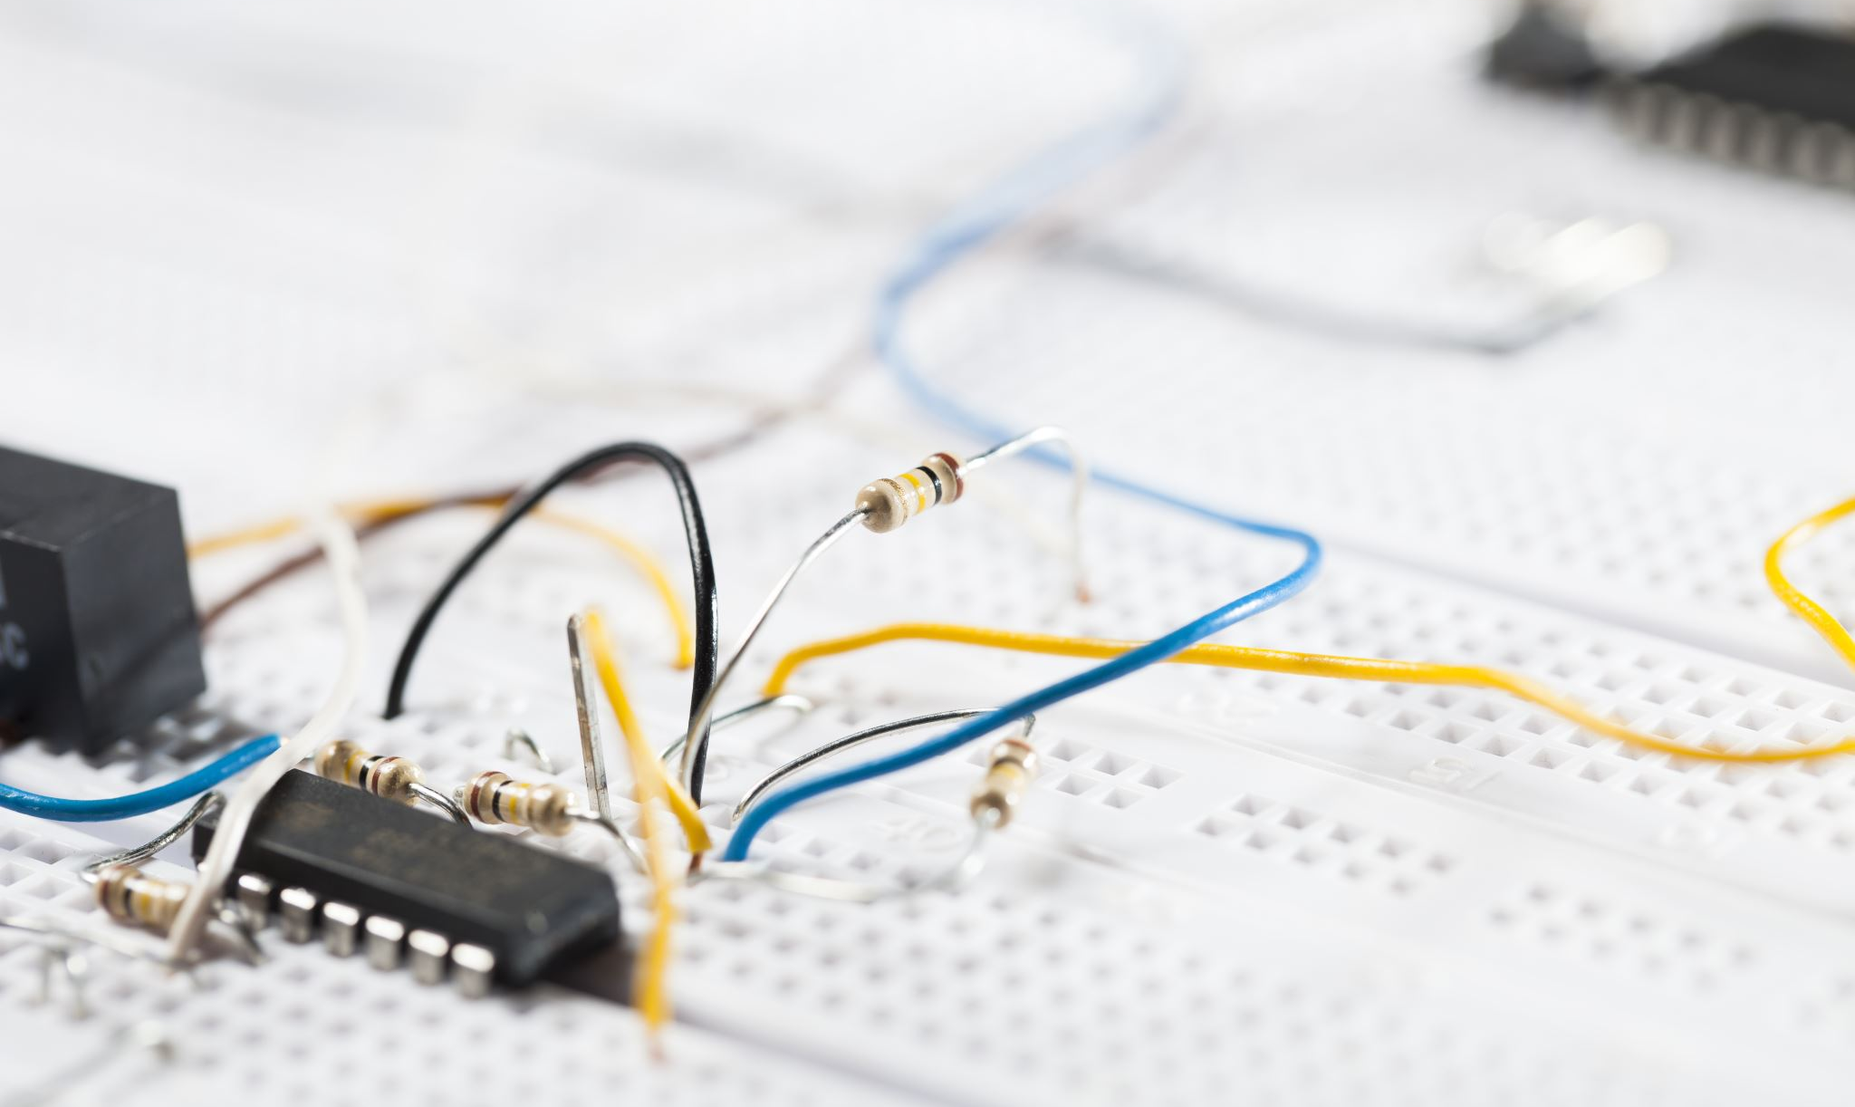
The Transistor
The design of a transistor allows it to function as an amplifier or a switch.
This is accomplished by using a small amount of electricity to control a gate on a much larger supply of electricity, much like turning a valve to control a supply of water.
Transistors are composed of three parts:
The base is the gate controller device for the larger electrical supply. a collector
The collector is the larger electrical supply
The emitter is the outlet for that supply.
By sending varying levels of current from the base, the amount of current flowing through the gate from the collector may be regulated.
In this way, a very small amount of current may be used to control a large amount of current, as in an amplifier.
The same process is used to create the binary code for the digital processors but in this case a voltage threshold of five volts is needed to open the collector gate. In this way, the transistor is being used as a switch with a binary function: five volts ' ON, less than five volts ' OFF.

Slide 3
Capacitor
In a way, a capacitor is a little like a battery. Although they work in completely different ways, capacitors and batteries both store electrical energy.
A capacitor is much simpler than a battery, as it can't produce new electrons — it only stores them. A capacitor is so-called because it has the "capacity" to store energy.
Inside a capacitor, the terminals connect to two metal plates separated by a non-conducting substance, or dielectric.
When you connect a capacitor to a battery, here's what happens:
The plate on the capacitor that attaches to the negative terminal of the battery accepts electrons that the battery is producing.
The plate on the capacitor that attaches to the positive terminal of the battery loses electrons to the battery.
Once it's charged, the capacitor has the same voltage as the battery (1.5 volts on the battery means 1.5 volts on the capacitor). For a small capacitor, the capacity is small. But large capacitors can hold quite a charge. You can find capacitors as big as soda cans that hold enough charge to light a flashlight for a minute or more.
A capacitor's storage potential, or capacitance, is measured in units called farads.
A 1-farad capacitor can store one coulomb (coo-lomb) of charge at 1 volt. A coulomb is 6.25e18 (6.25 * 10^18, or 6.25 billion billion) electrons.
One amp represents a rate of electron flow of 1 coulomb of electrons per second, so a 1-farad capacitor can hold 1 amp-second of electrons at 1 volt.
A 1-farad capacitor would typically be pretty big. It might be as big as a can of tuna or a 1-liter soda bottle, depending on the voltage it can handle. For this reason, capacitors are typically measured in microfarads (millionths of a farad).
The difference between a capacitor and a battery is that a capacitor can dump its entire charge in a tiny fraction of a second, where a battery would take minutes to completely discharge.
That's why the electronic flash on a camera uses a capacitor — the battery charges up the flash's capacitor over several seconds, and then the capacitor dumps the full charge into the flash tube almost instantly.

Slide 4
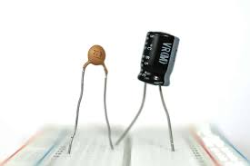
Capacitor Uses
Capacitors are used in several different ways in electronic circuits:
Sometimes, capacitors are used to store charge for high-speed use. That's what a flash does. Big lasers use this technique as well to get very bright, instantaneous flashes.
Capacitors can also eliminate electric ripples. If a line carrying DC voltage has ripples or spikes in it, a big capacitor can even out the voltage by absorbing the peaks and filling in the valleys.
A capacitor can block DC voltage. If you hook a small capacitor to a battery, then no current will flow between the poles of the battery once the capacitor charges.
Alternating current (AC) signal flows through a capacitor unimpeded. That's because the capacitor will charge and discharge as the alternating current fluctuates, making it appear that the alternating current is flowing.

Slide 5
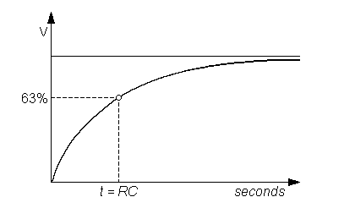
Two main equations for capacitor circuits
Q = CV
Where Q is the charge stored, C is the capacitance, and V is the voltage applied.
This explains that as capacitance increases, the capacitor holds more charge if voltage is constant. If we apply a higher voltage to a capacitor as well, it holds more charge.
τ = RC
τ in this case represents the time constant. It denotes the time it takes to charge an initially uncharged capacitor to 63.2
As resistance decreases, the time constant decreases, making it faster to charge and discharge the capacitor.

