Slide 1

Introduction to Engineering Design
Type your name here

Slide 2
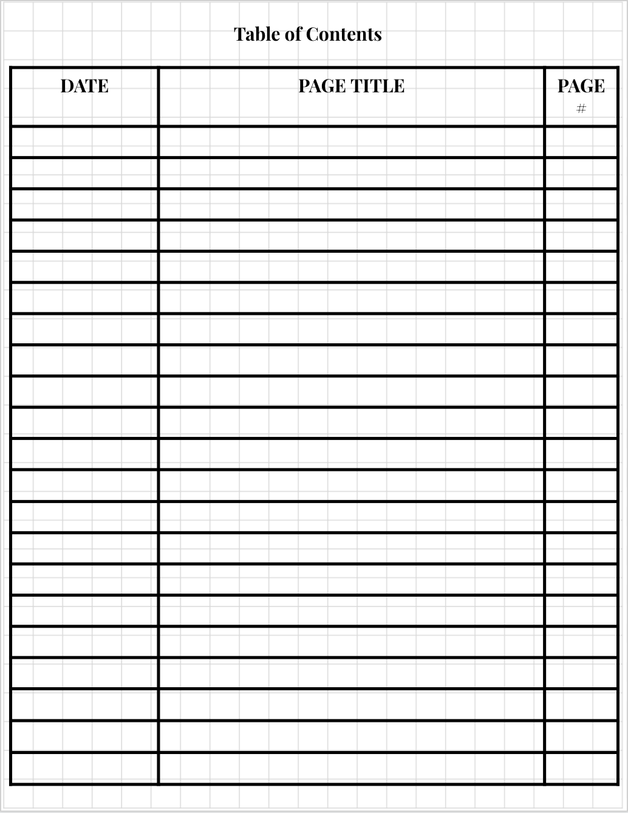

Slide 3


Slide 6
