Slide 1
Variables and Functions
VEXcode V5 Software
Principles of Engineering
© 2021 Project Lead The Way, Inc.

Slide 2
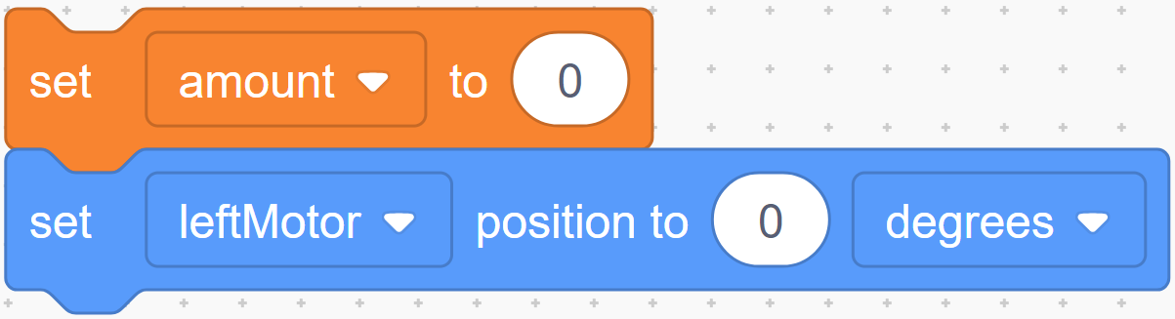
Variables
Stored in a memory location.
Examples: integers, decimals, and true/false statements.
Names use same rules for naming a motor or sensor, including capitalization, spelling, and availability.
Can improve readability and expandability of programs.
Important: Set initial value for variable before you use it.

Slide 3
Variable Types
Data Type | Description | Examples
Integer | Positive and negative numbers, as well as 0 | –35, –1, 0, 33, 100
Floating Point Number | Numeric values with decimal points (even if the decimal part is 0) | –.123, 0.56, 3.0, 1000.07
Boolean | True or false – Useful for expressing the outcomes of comparisons | true, false

Slide 4
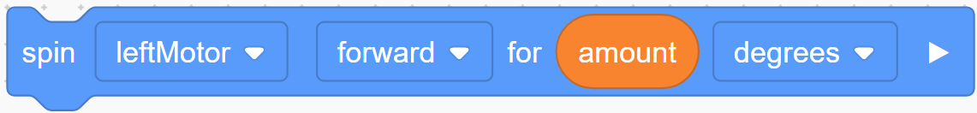
Variable Usage
Variable value can be referenced by variable name in place of value.
Value is only referenced when “called” and line of code is executed.
In the example, motor spin is set when line is executed.

Slide 5
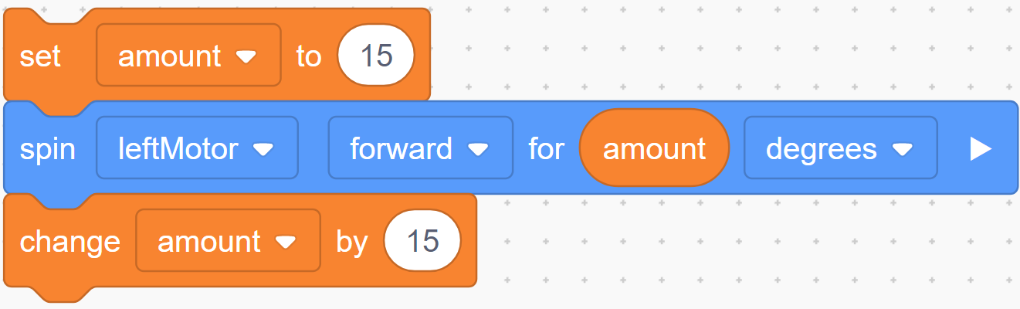
Assigning a Value to a Variable
Variable can be updated any time during a program.
When variable is called, it uses last value stored; can always be changed before called again.

Slide 6
Variable Applications
Variables can be used for most programs
Examples:
  Count how many times code is executed.
  Count user button presses
  Remember if user EVER pushed a button
  Remember a maximum value
  Debug a program by remembering which branch of code has executed

Slide 7
Variable Application 1:
Loop n times
Task description:
Start and stop motor 5 times.
Instead of writing same code multiple times, use variable to remember how many times the code executed.

Slide 8
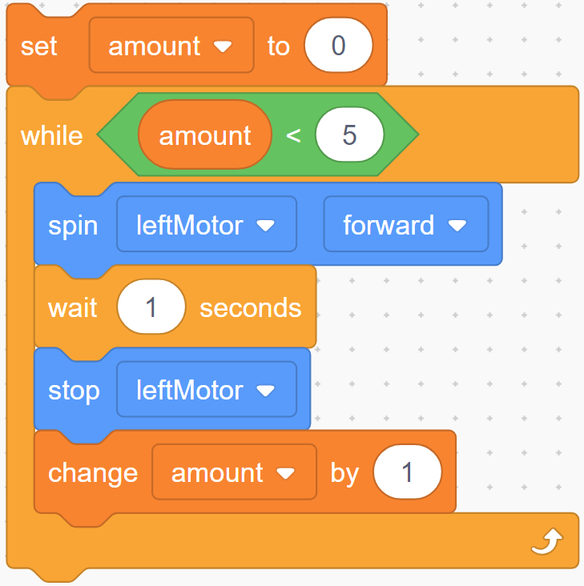
Variable Application 1: Loop n times
Loop runs five times; variable count changes, as described by sequence: 0,1,2,3,4.
Initialize variable
Increment count

Slide 9
Variable Application 2:
Count user actions
Task description: Count number of times user does something.
Example: How many times did user press “increase volume” button on remote control?
Use variable to remember how many times user performed that action.

Slide 10
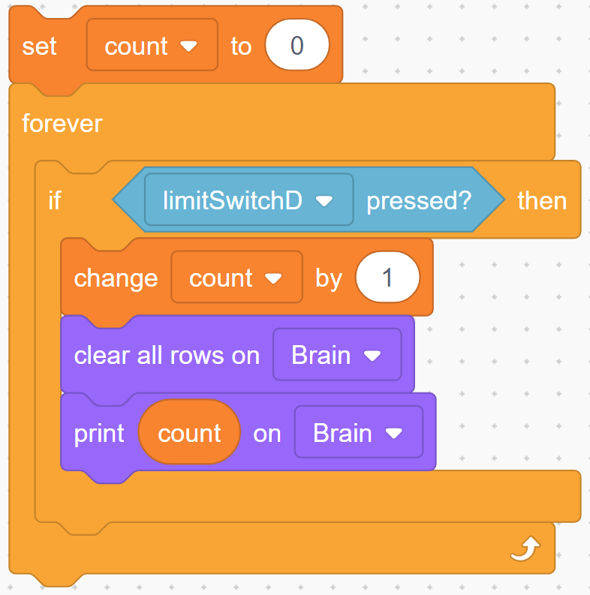
Variable Application 2:
Count user actions
Variable “count” remembers how many times limit switch was pressed; prints current “count” to brain display.

Slide 11
Variable Application 3:
Set a flag
Task description: Observe user for 5 seconds; remember whether switch was EVER pressed, even if briefly.
Use a variable to store whether an event has happened. This is called a flag. Flag stays thrown until cleared.
Notes:
A flag is “raised” (i.e., set to true) if a condition is *ever* met during a certain period, even if it was *usually* not met.

Slide 12
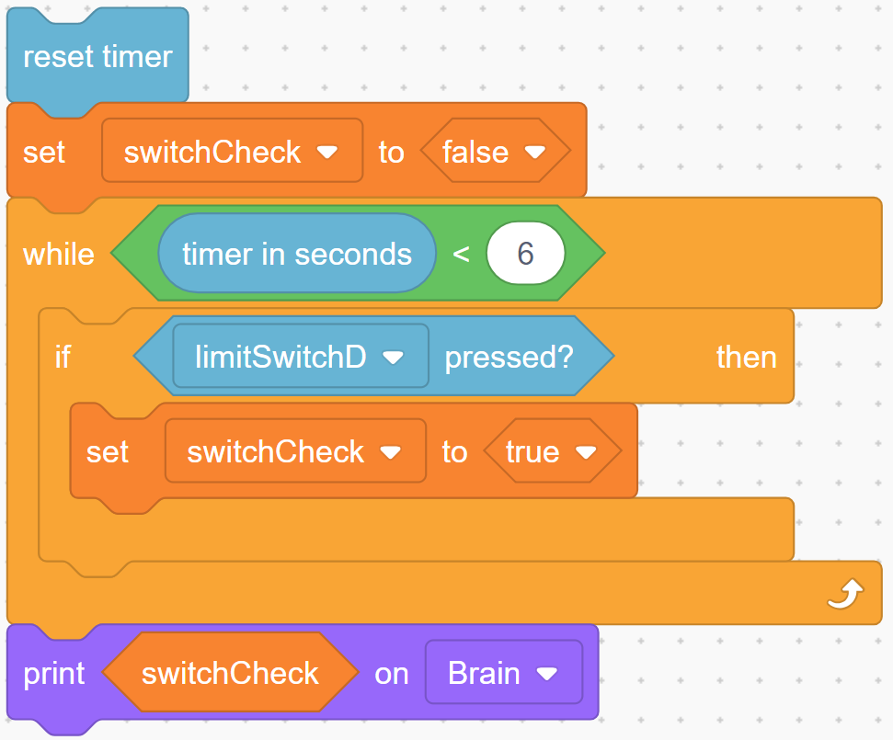
Variable Application 3: Set a flag
Variable switchCheck remembers if bumper switch was EVER pushed.
After code executes, switchCheck will be true, even if switch was pressed and released.
Notes:
This makes use of a Boolean variable such as the press of a limit switch or a volume control button and true or false (yes or no).
The following snippet of code might be useful in a material sorter if the machine is checking for conductivity as a marble rolls by.
To “construct” a sensor that will detect conductivity two 22-, 24-, or 26-gauge wires added to a 3-wire extension cable connected to the black and white wires will work as a digital input, making a “conductivity sensor”.

Slide 13
Variable Application 4:
Remember a maximum value
Task description:
Observe a sensor for 5 seconds; remember the highest value.
Use a variable to remember a highest value that occurred.
Notes:
This might be used with a scale as a truck drives over the scale. The heaviest value was when the entire truck was on the scale.
It might also be used with a light sensor as an opaque object passes in front of a light. The dimmest value was when the object was blocking the light.

Slide 14
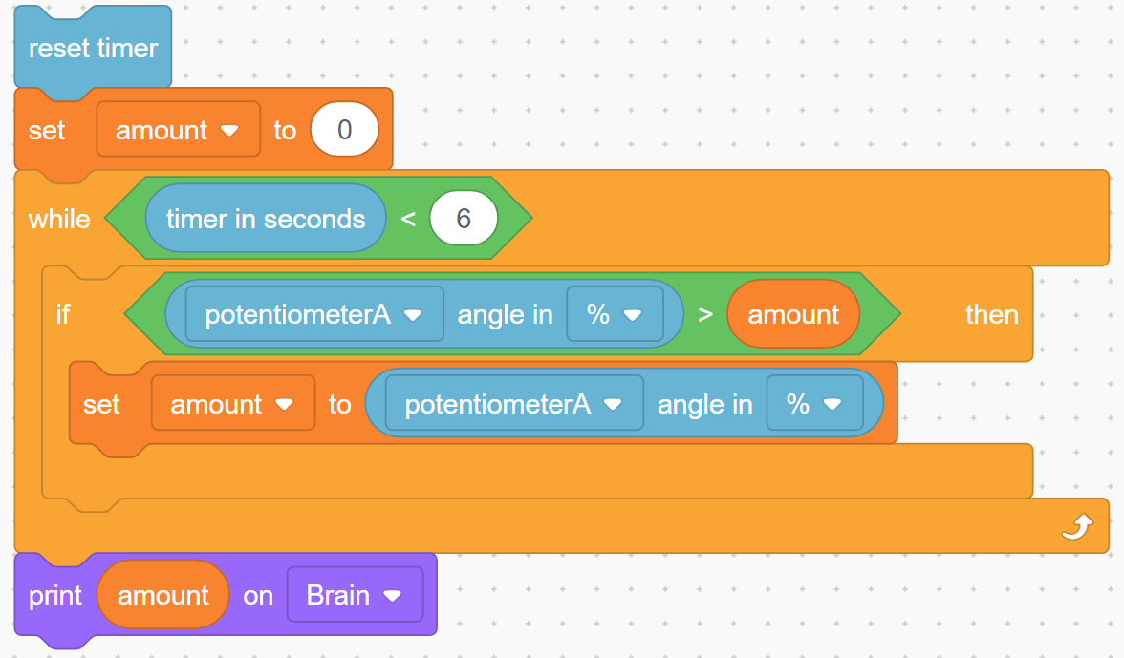
Variable Application 4:
Remember a maximum value
Similar to a flag, but variable remembers an integer instead of boolean.
Remember the new max!

Slide 15
Function
Groups several lines of code
  Referenced many times in task main or
  other functions
Creating Function Example:
LED is on if bumper pressed, off if released
    Function definition (code in the function)
    Function call (where function code will run)

Slide 16
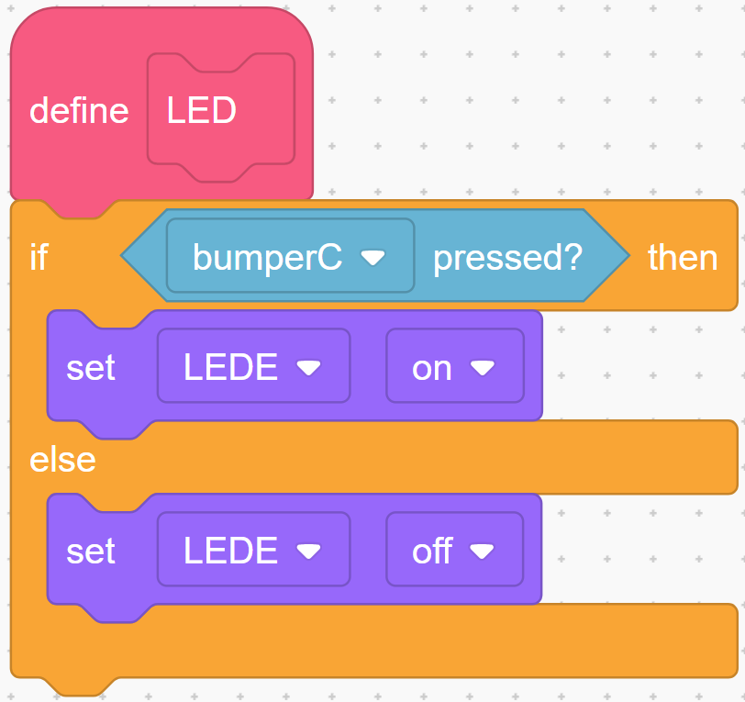
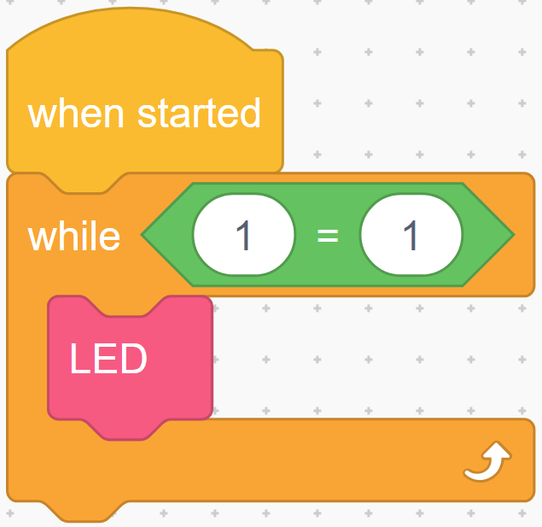
Sample Function “LEDControl()”

Slide 17
Function Definition
Definition defines code that belongs to function

Slide 18
Function Call
Call and run code from function
Placed with when started

