Slide 1
While Loops and If-Else Structures
Using VEXcode V5 Software
Principles of Engineering
© 2021 Project Lead The Way, Inc.

Slide 2
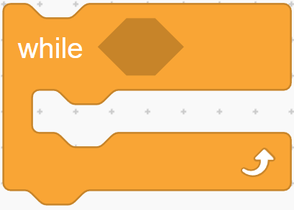
While loop
Structure within VEXcode
Allows section of code to repeat as long as condition remains true
Three main parts to every while loop:
  The word “while”
  The condition
  Commands to repeat
Condition
goes here
Commands
go here

Slide 3
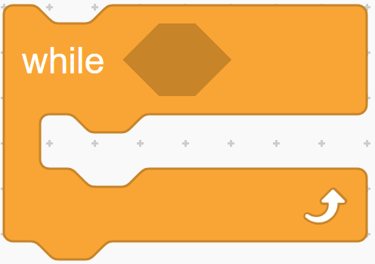
1. While
Every while loop begins with keyword while

Slide 4
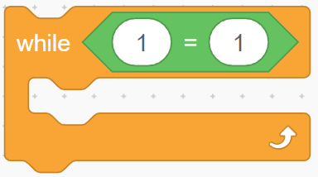
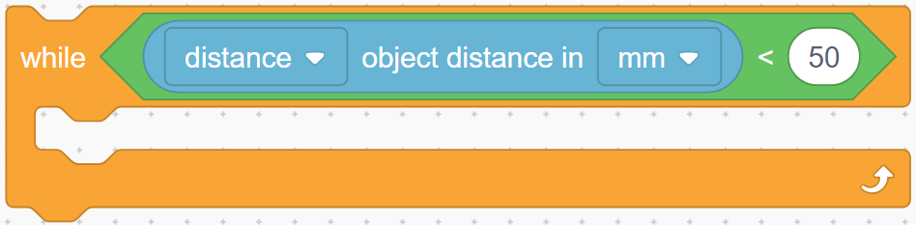
2. Condition
Condition controls how long or how many times while loop repeats
  When condition is true, while loop repeats
  When condition is false, while loop ends and rest of program executes
Condition is checked once every time loop repeats.

Slide 5
3. Commands
Commands repeat while condition is true
Program checks the condition at beginning of each pass through loop
Repeated commands here

Slide 6
Boolean logic
Program decisions always based on questions
Only two possible answers
  yes or no
  true or false
Statements that can be only true or false are called “Boolean statements”
True-or-false value is called “truth value”

Slide 7
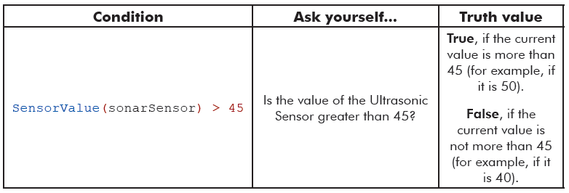
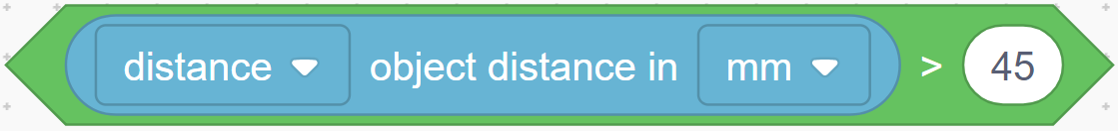
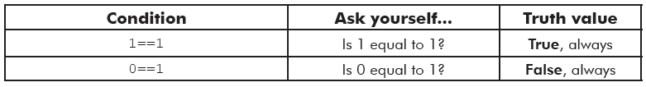
Boolean logic
Is the value of the distance sensor greater than 45?

Slide 8
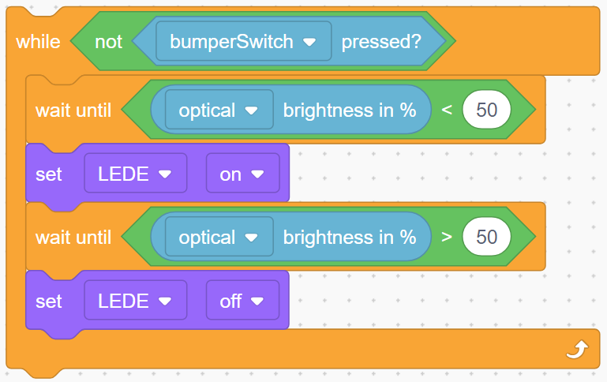
Writing a condition: Example
While bumper switch not pressed:
wait until it’s dark, then turn on light;
wait until it’s light, then turn off light
Conditional provides input sensor value
Sensor name
Boolean Logic Condition

Slide 9
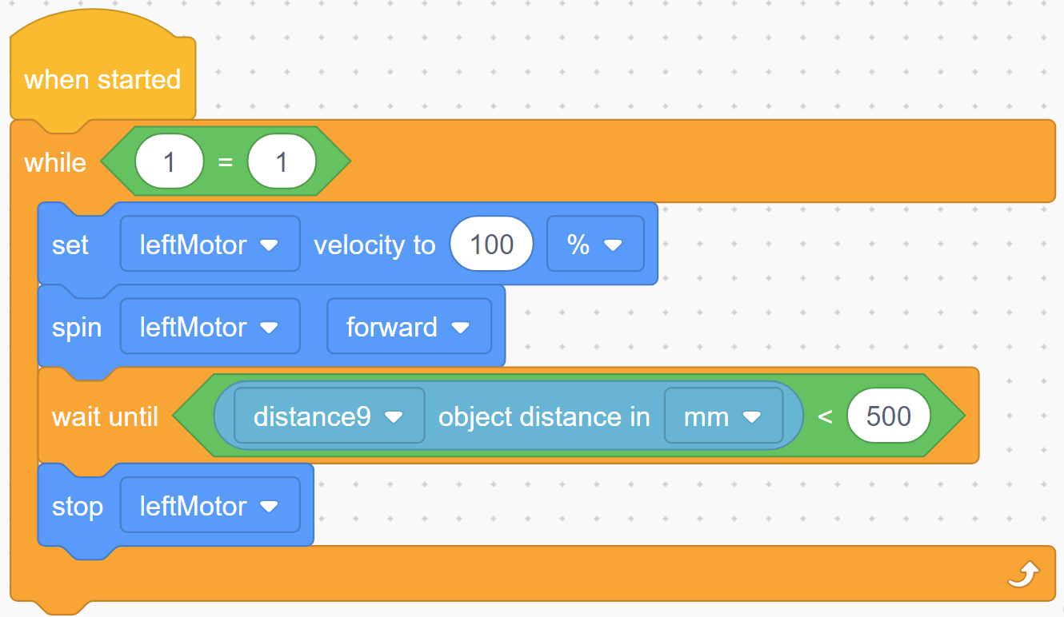
While loop: More flexible than until statement
Motor runs until object is within 500 mm.
Program can’t respond to emergency shutoff switch.
Program can’t control other outputs in response to other inputs.
Program waits here until object is near

Slide 10
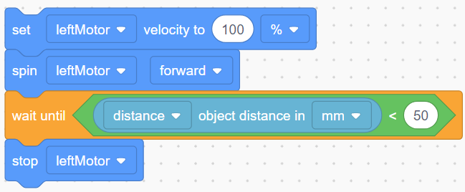
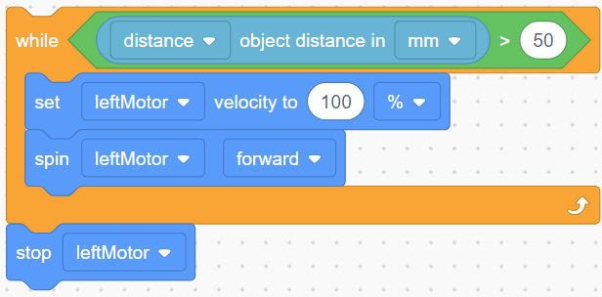
While loop: More flexible than until statement
While loop can do same as until statement.
Example code using until statement:
Program waits until object is near
While loop can do same thing:
Program loops until object is near

Slide 11
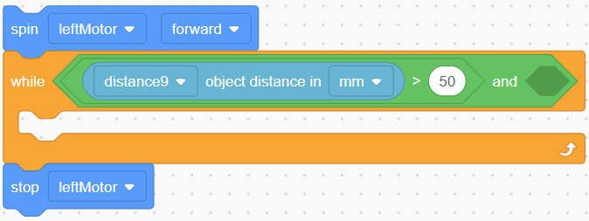
While loop: More flexible than until statement
  Can add other conditions to while condition, such as emergency shutoff
  Can execute other code in while loop
Expand condition
Control other outputs inside bracket

Slide 12
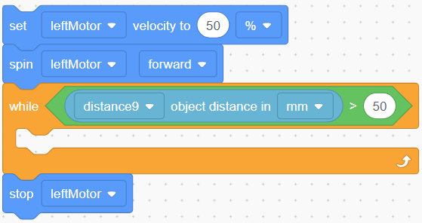
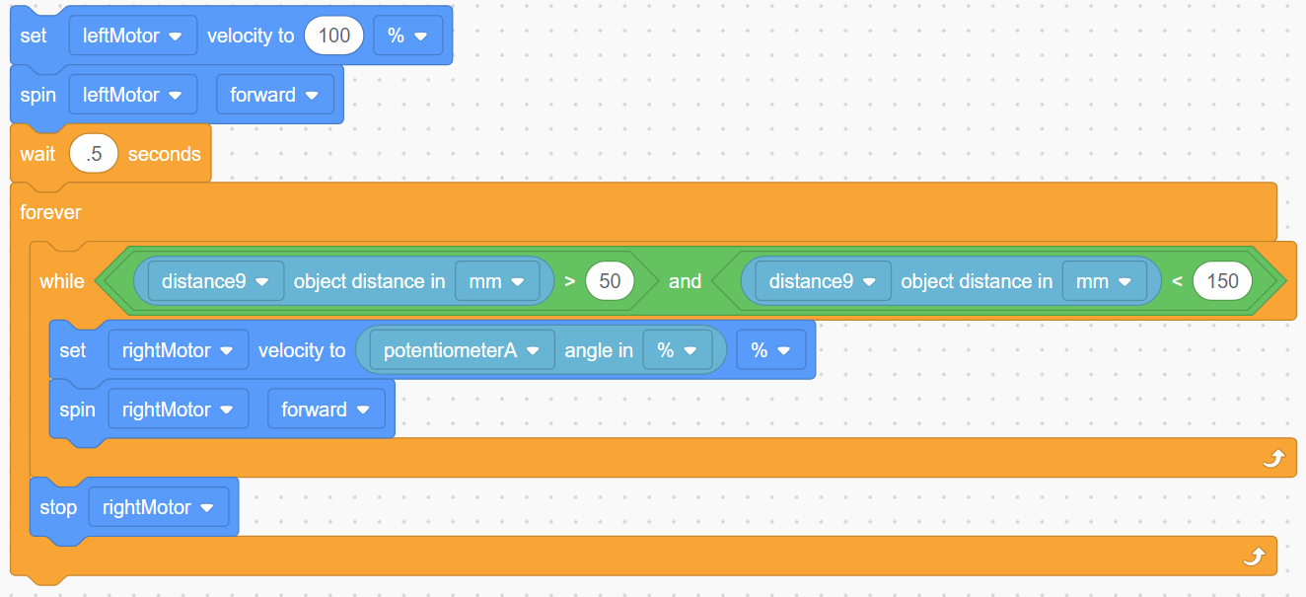
While loop: More flexible than until statement
  Example equivalent to until:
Expand condition
Control other outputs inside bracket
  Example using this flexibility:
Notes:
In the top example, the leftMotor starts and then continues until distance > 50
In the bottom example, the leftMotor starts and continues until distance > 50 and distance < 150. Meanwhile, the potentiometer controls the rightMotor speed.
Note: After the loop exits, the rightMotor will continue running at its last assigned speed until reassigned or until the program ends.

Slide 13
Timer
Loop control
  Where would wait statement go if we want loop to repeat for controlled period?
  Nowhere! Need something else.
Solution: Timer
  Internal stopwatch
  Clear timer before use
  Be careful: Don’t clear timer in timed loop.
Notes:
Clearing timers within a loop may continually reset the timers, which may create an infinite loop.

Slide 14
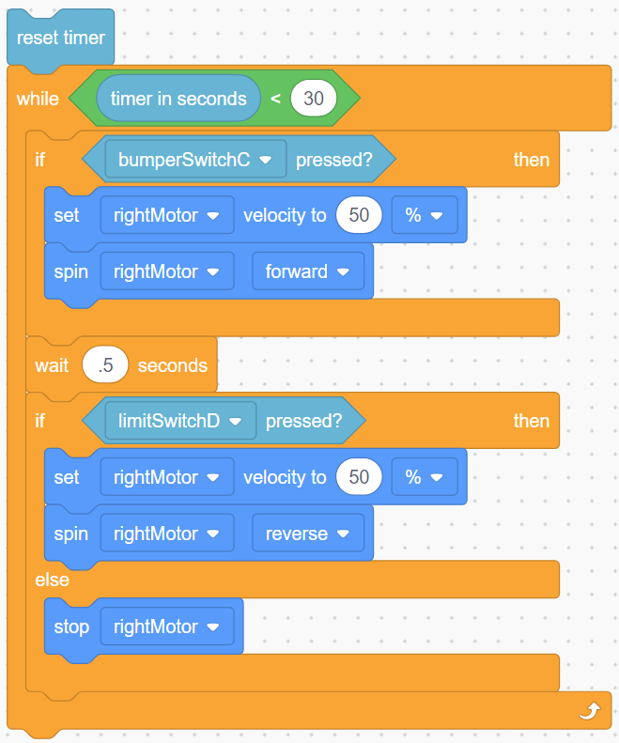
Timer
Timer is condition for while loop, which runs 30 seconds.
Notes:
The reason for the “wait 0.5 seconds” is that the 'stop motor' of the else happens a split second after the bumper switch is told to start, so we never see motion; the stop is always the last command given. The motor will always stop if the limit switch isn’t being pressed.

Slide 15
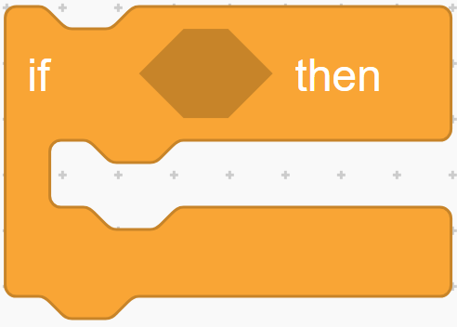
If statement
(condition)
Either true or false
If statement evaluated by condition in parentheses
  If condition is true, commands between braces are run
  If condition is false, those commands are ignored
Similar to how while loop works, but does not repeat code
(true) commands
If (condition) is true Commands run

Slide 16
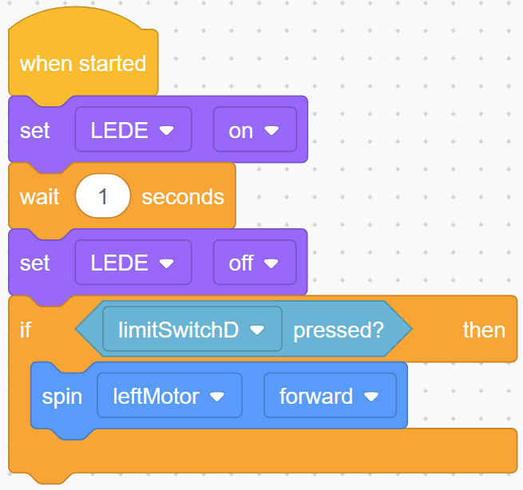
If statement - Example
If statement evaluated by condition in parentheses
  If condition is true, commands between braces are run
  If condition is false, those commands are ignored
Similar to how while loop works, but does not repeat code

Slide 17
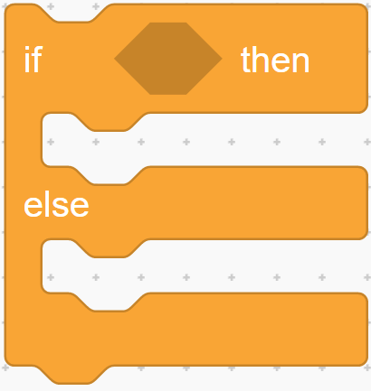
If-else statement
If-else statement is expansion of if statement
  If checks condition,
  runs appropriate
  commands when it
  evaluates to true
  Else allows code to
  run when condition is
  false
  Either if or else branch
  is always run once
(condition)
Either true or false
(true) commands run
If (condition) is true
(false) commands run
If (condition) is true

Slide 18
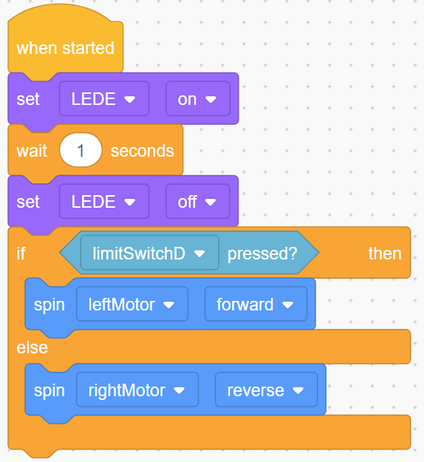
If-else statement - Example
If-else statement is expansion of if statement
  If checks condition, runs appropriate commands when it evaluates to true
  Else allows code to run when condition is false
  Either if or else branch is always run once

Slide 19
Multiple if-else statements
Be careful when using two if-else statements, particularly if both control same mechanism
One branch of each if-else statement is always run, so you may create scenario where two statements “fight” one another

Slide 20
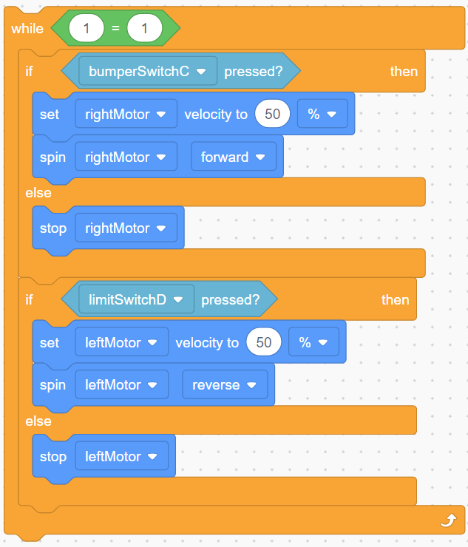
Multiple if-else statements example
If one touch sensor is pressed, rightMotor will be turned on in one if-else statement and immediately turned off in other

Slide 21
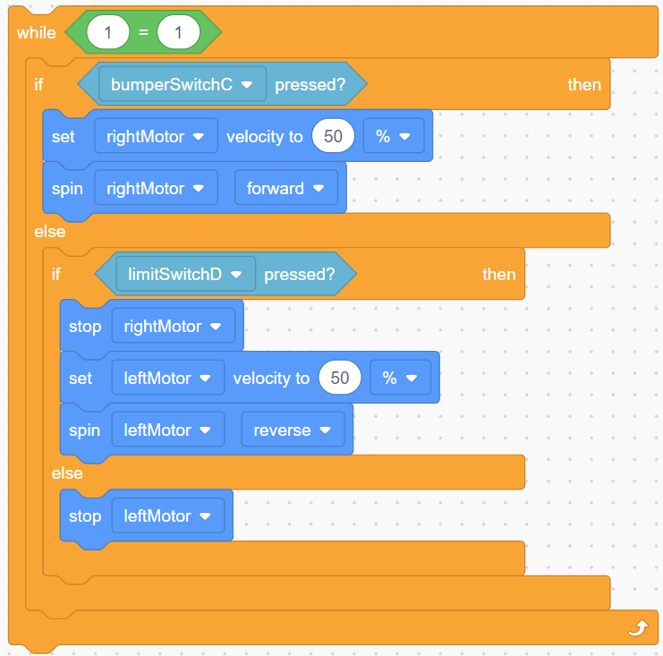
Multiple if-else statements example
Can be corrected by embedding second if-else within else branch of first if-else. Second condition is only checked if first condition is false.

Slide 22
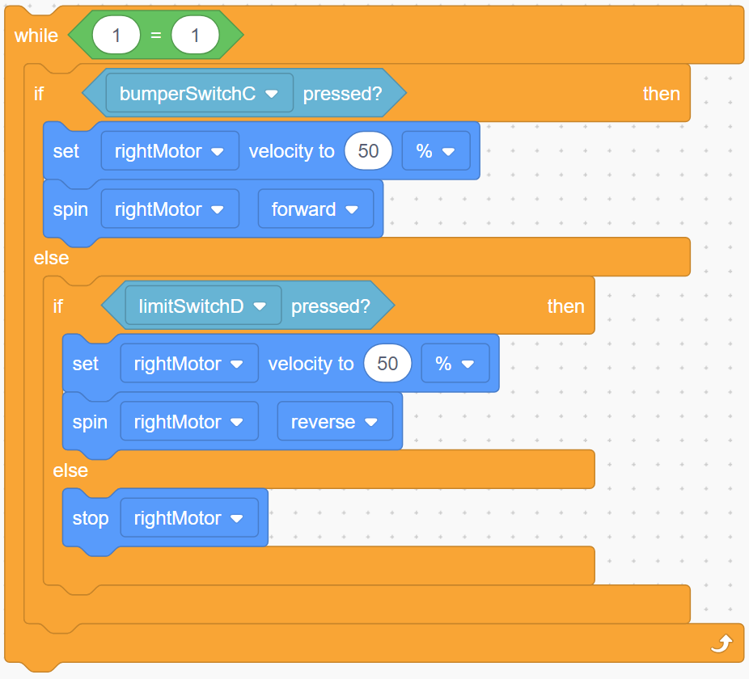
Nested if-else statements
Example

Slide 23
Using range of values in condition
Two strategies:
Boolean logic
Nested if-else statements
Example
Task: Control motor with potentiometer
Potentiometer Values |  | Motor Speed
10–500 | 12% | 0
501–1000 | 12% to 25% | 50%
1001–4095 | 25% to 100% | 100%

Slide 24
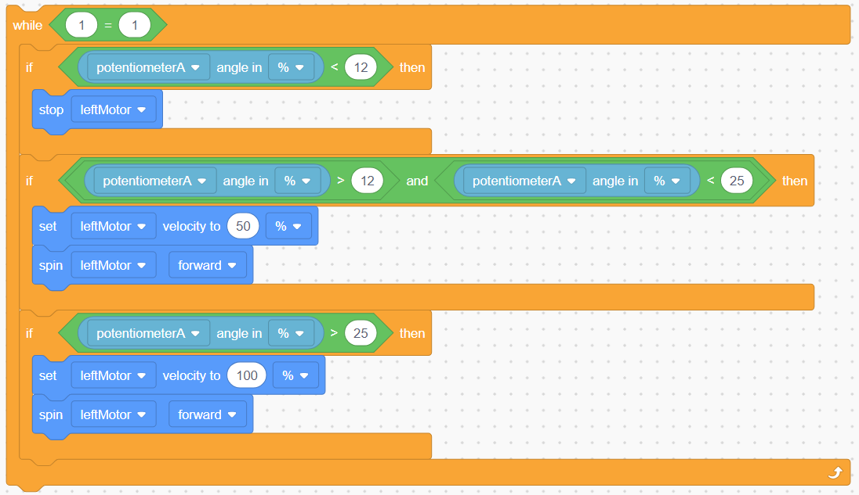
Using range of values in condition
Strategy 1: Boolean logic
Potentiometer Value |  | Motor Speed
10–500 | 12% | 0
501–1000 | 12% to 25% | 50%
1001–4095 | 25% to 100% | 100%
Boolean Operators
AND | OR
True only if sensor value is more than 500 AND less than 1000

Slide 25
Using range of values in condition
Strategy 1: Boolean logic
In this example, strategy wastes time and processor power. The next strategy is better.
Four comparisons; waste time each loop

Slide 26
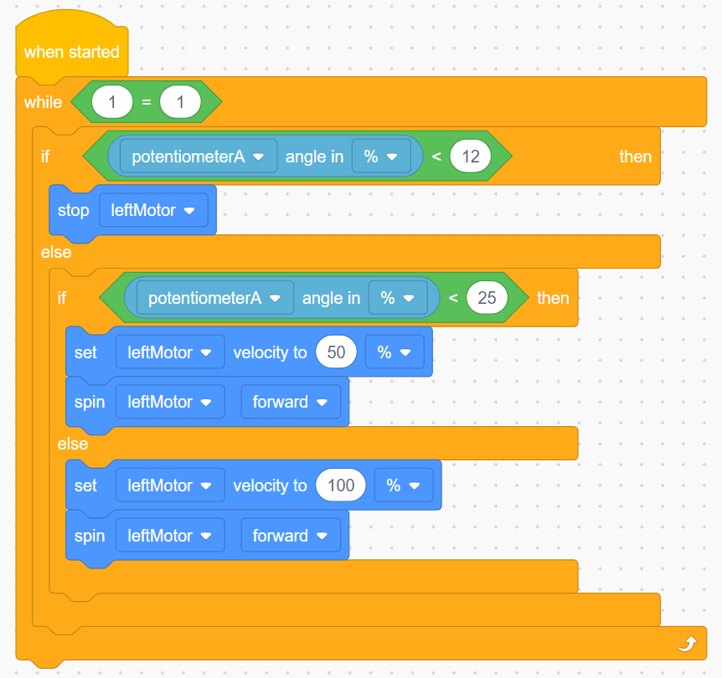
Using range of values in condition
Strategy 2: Nested if-else preferable
In this case a false value of the first condition can be used again by nesting a second if statement inside the first else. Order is important—any value less than 12% will also be less than 25%.
Potentiometer Value | Motor Speed
11% | 0
12% to 24% | 50%
25% to 100% | 100%

