Slide 1
Introduction to
VEX® Robotics Platform (VEX V5)
Principles of Engineering
© 2021 Project Lead The Way, Inc.

Slide 2
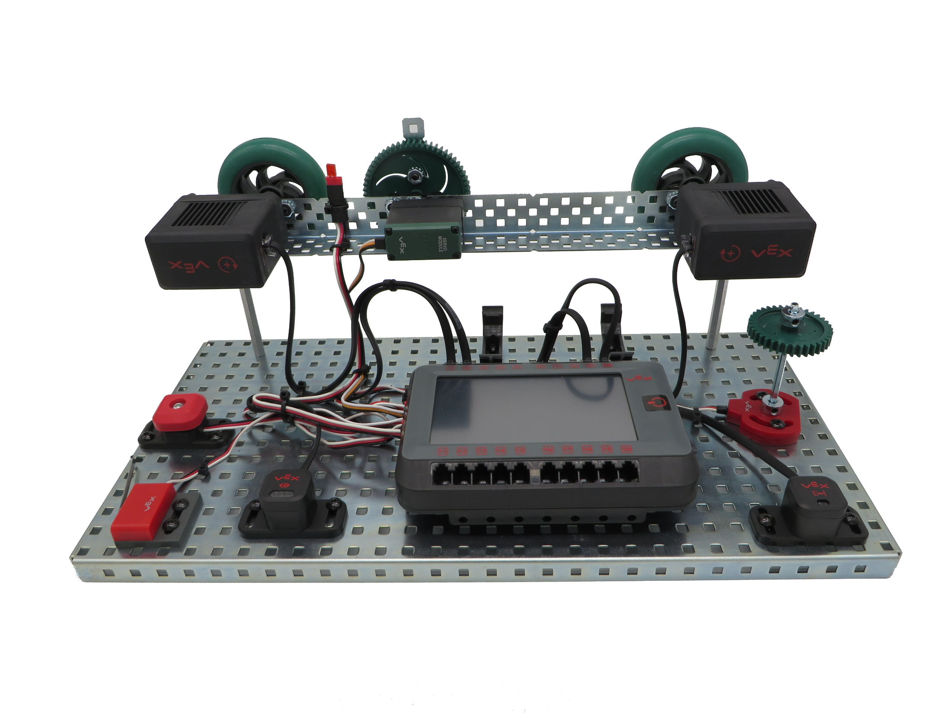
VEX V5 Robotics Platform:
Testbed for Learning Programming

Slide 3
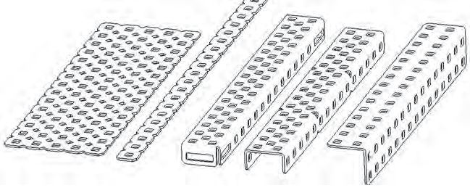
VEX Structure Subsystem
VEX Structure Subsystem forms a robot base
Contains square holes on a standardized ½-inch grid
Allows VEX components to be assembled in various configurations
Notes:
This is a very brief overview of the VEX robotics platform. Refer to the Inventor’s Guide in the student resources for more details.

Slide 4
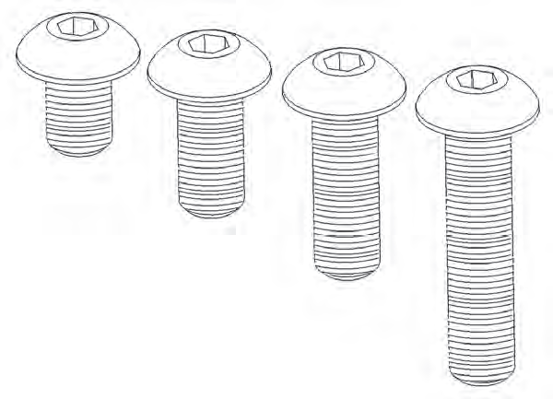
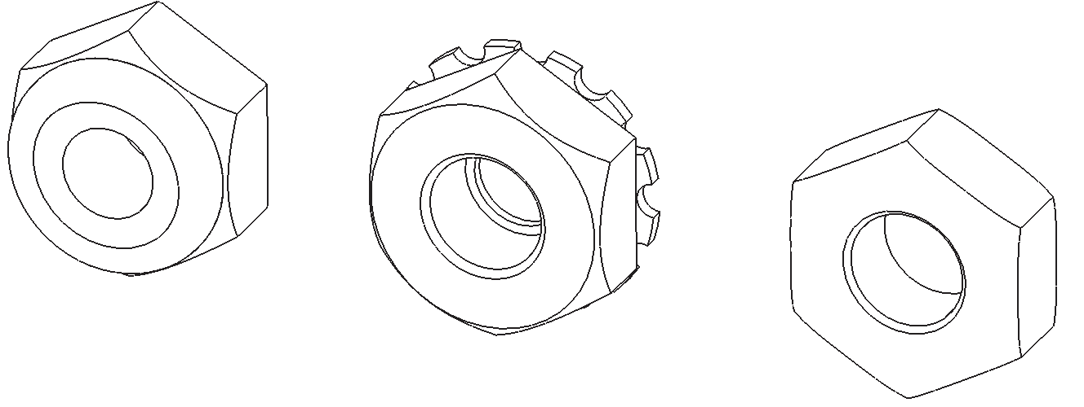
VEX Structure Subsystem
Metal components are directly attached using
8-32 screws and nuts
  Nylock nut has a plastic insert to prevent unscrewing
  KEPS nut has a ring of “teeth” on one side to grip the piece being installed
  Regular nut has no locking feature
Nylock
Nut
KEPS
Nut
Regular
Nut
8-32 screws

Slide 5
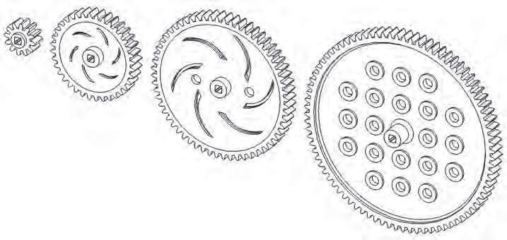
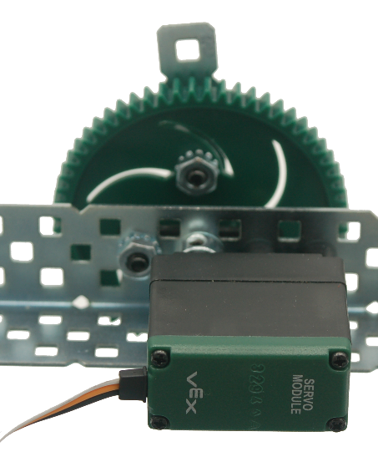
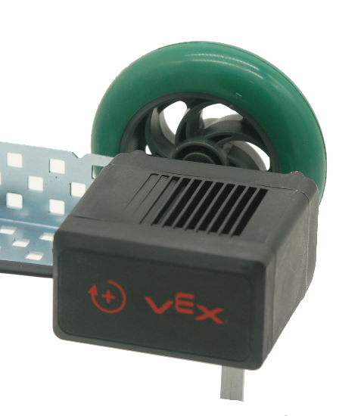
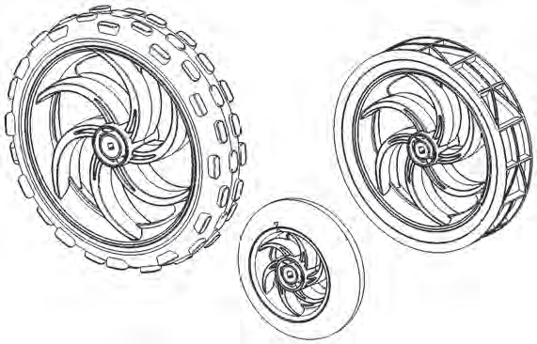
VEX Motion Subsystem
Components that make a robot move
  Gears
  Wheels
  Motor
  Servo
Gears
Servo
Motor
Wheels

Slide 6
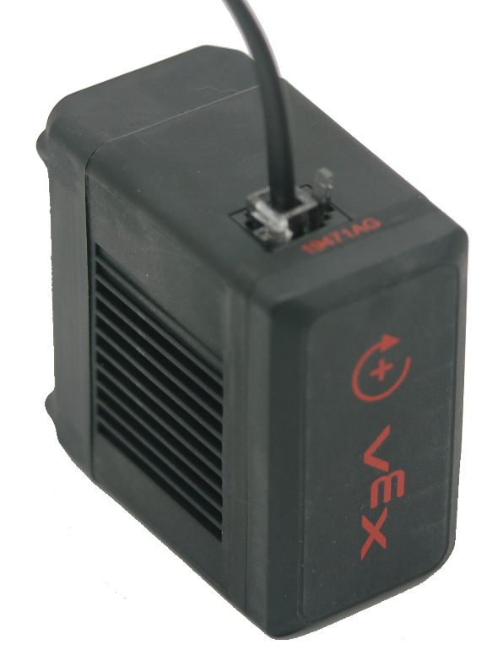
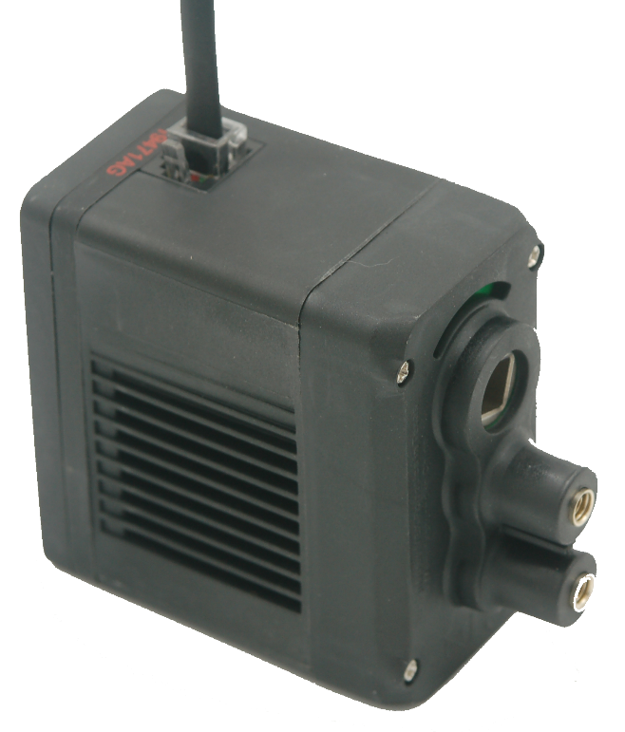
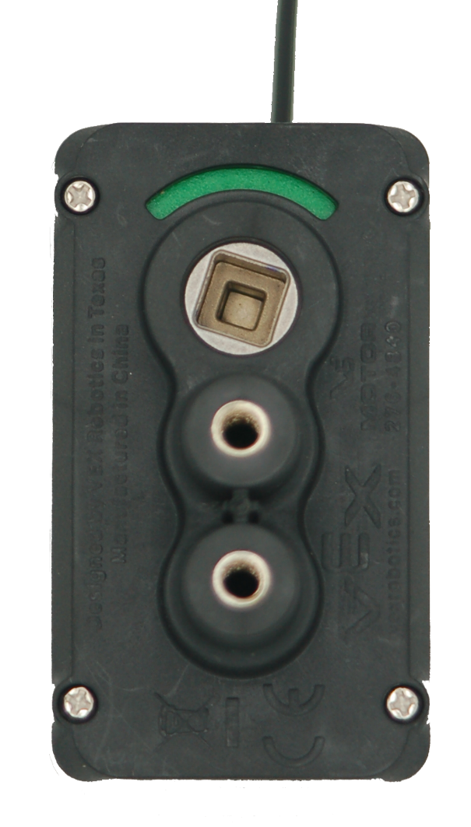
VEX Motion Subsystem
VEX V5 Smart Motor
  Connects to any Smart Port 1–21

Slide 7
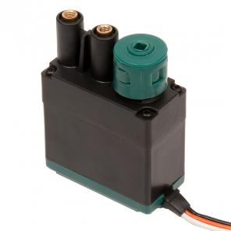
VEX Motion Subsystem
VEX Servo
Similar appearance to a motor
Significantly different operation
  Motor spins continuously at a power value
  Servo rotates to a position between 0 to 100 degrees

Slide 8
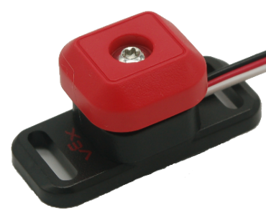
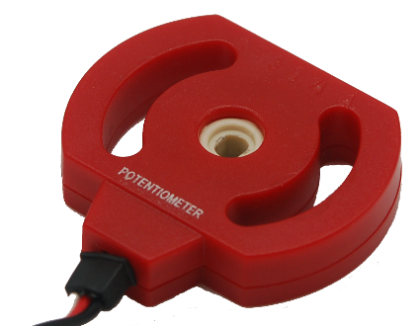
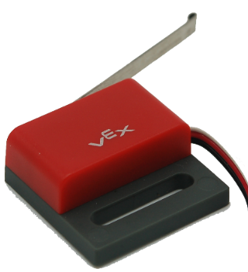
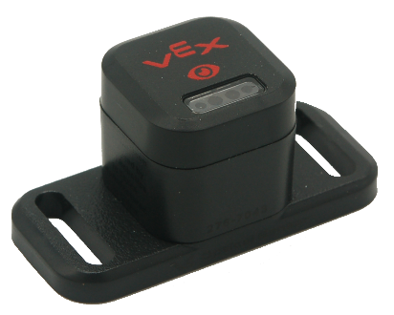
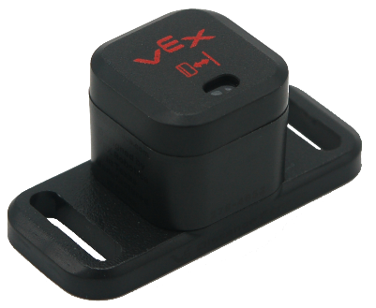
VEX Sensors Subsystem
Provides inputs that sense the environment
Digital Sensors:
  Bumper
  Switch
  Limit
  Switch
Analog Sensor:
  Potentiometer
Analog or Digital Sensors (depending on use):
  Optical Distance

Slide 9
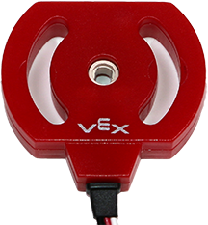
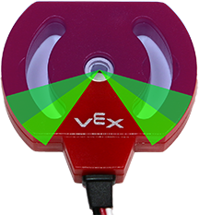
Potentiometer
How It Works
  Analog sensor
  Measures rotation of a shaft
  between 0 and ~265 degrees
  Returns a value range with maximum of 4095
Caution
  Internal mechanical stops prevent potentiometer from turning a full revolution
  Excess torque against internal mechanical stops cause them to wear away
Notes:
Excess torque against the internal mechanical stops by hand or by a VEX motor will cause the stops to wear away. The potentiometer will continue to function but will have a range between the positions where mechanical stops were located. This is known as a dead zone. In this range, no values are sensed.

Slide 10
V5 Distance Sensor
Uses a pulse of laser light to
measure distance from front
of sensor to an object
Can detect an object and determine relative size. Approximate size of an object is reported as small, medium, or large.
Can calculate a robot’s approach speed. Approach speed measures the speed of the robot/sensor as it moves toward the object.
V5 Distance Sensor’s measurement range is 20 millimeters to 2,000 millimeters.
Notes:
Do not use the ultrasonic sensor as the very first command of a program. Until the first sound echo returns to the sensor, it will have a value of –1. A simple delay at the beginning of your program solves this.

Slide 11
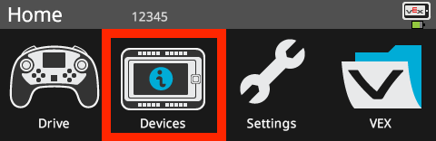
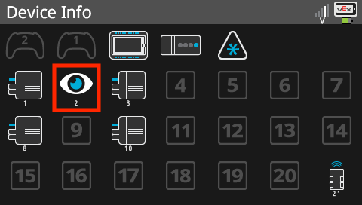
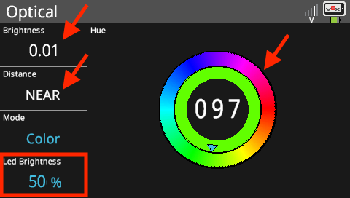
Optical Sensor
Color Mode
Place an object in front of the Optical Sensor. The display will show the brightness the sensor is detecting, the proximity of the object, and the number for the hue of the color of the object. Touching the LED brightness portion of the screen will change the brightness of the LED.

Slide 12
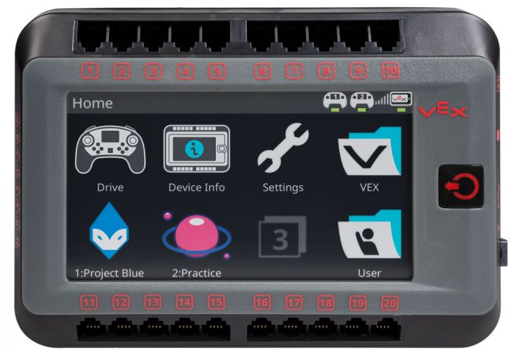
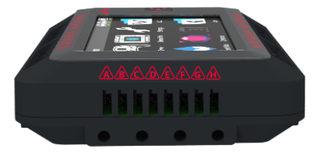
VEX V5 Brain
  3-Wire
  Ports
21 Smart Ports
8 3-Wire Ports
Stores 8 Programs
  Smart
  Ports

Slide 13
VEX V5 Brain – Smart Ports
Auto recognition of any V5 sensor
Auto recognition of any V5 motor
  Smart
  Ports

Slide 14
VEX V5 Brain – 3-Wire Ports
  3-Wire
  Ports
Four settings for each port
  Analog Input: Brain displays the analog value.
  Digital Input: Brain displays the digital value.
  Digital Out High: Brain generates a “high” (1) signal to send to the device.
  Digital Out Low: Brain generates a “low” (0) signal to send to the device.

