Slide 1
Welcome To
Please make your way to your mentor pod!
G107 - Pods 1-6
G106 - Pods 7-12
G105 - Pods 13 - 18
G143 - Pods 19 - 24
G144 - Pods 25 - 30
Notes:
Claire

Slide 2
Upcoming Milestones
Drop Deadline Due (9/27) - TODAY!!!!
VBC Registration opens (10/3)
Learn more @ workshop
VCMC Registration opens (10/4)
First Years are required to attend

Slide 3
Quest Talk
Mr. Mark Weiner, Business Fundamentals/Entrepreneurship Honors teacher
Friday 9/29, Lunch in G105-107
FREE PIZZA!

Slide 4
Workshop Today - Written Structure
Logistics
Start Time: 2:50pm
Room G105 closed until 3:00pm
Entrepreneurship → G105-107
IMC → G108
BOR → G109

Slide 5
Excused Absences
Excused (0.5 pts): Medical appointments, away sports games, school traveling competitions (PIE, MATE, FRC, ISS, etc.)
Not Excused: After-school sports practices
Requirement: MINIMUM 2 workshops/month
MUST communicate ahead of time

Slide 6
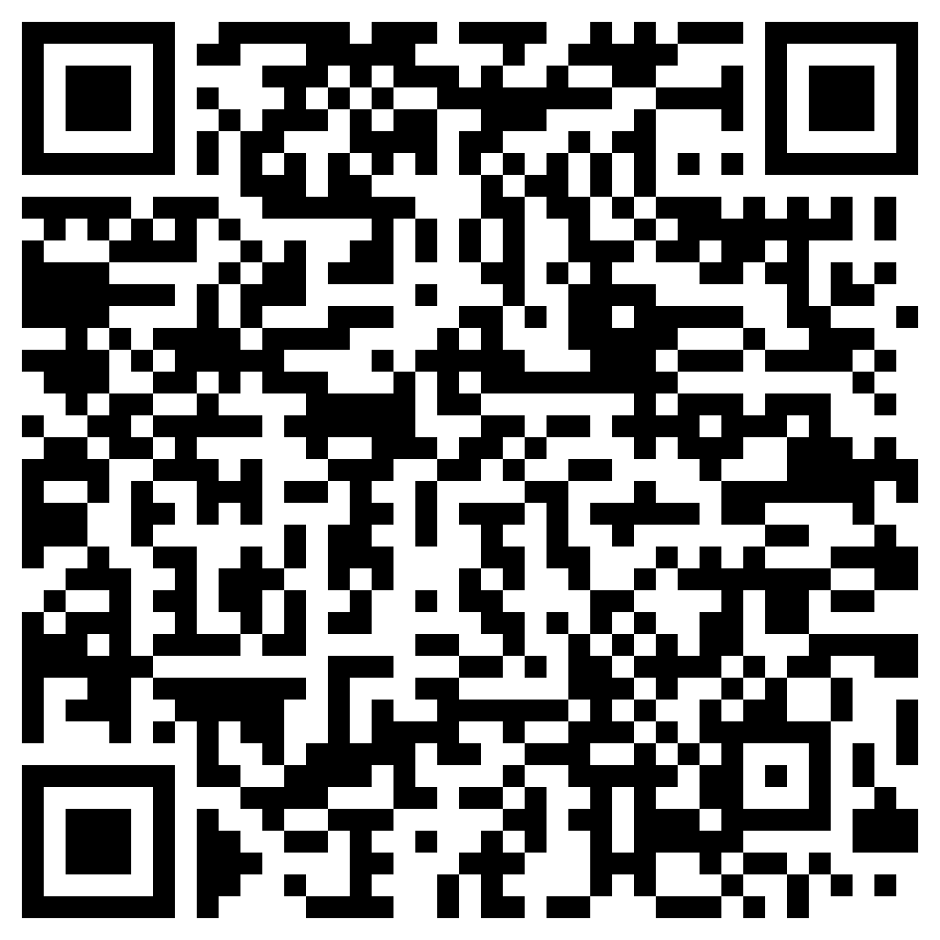
Before Going into Mentor Pods…
Mandatory Exit Ticket Quiz :)
Must complete w/ 100%
Show your Mentor

Slide 7
MENTOR POD TIME!!

Slide 8
Any Questions?
Notes:
Max & Claire

