Slide 1



Welcome To
Please make your way to your mentor pod!
G107 - Pods 1-6
G106 - Pods 7-12
G105 - Pods 13 - 18
G143 - Pods 19 - 24
G144 - Pods 25 - 30
Notes:
Claire

Slide 2
DECA+ Login
Go to DECAPLUS.ORG/LOGIN
Credentials
  Username: wshimada@vcs.net
  Password: finance?56

Slide 3
Upcoming Milestones
Drop Deadline Due (9/27)
VCMC Registration opens (10/4)
  First Years are required to attend

Slide 4
Workshop Today - Intro to ROLEPLAY
Logistics
  Start Time: 2:50pm
    Room G105 closed until 3:00pm
  First Years (Principles) → G106-107
  Individual Series → G105
  Team Decision → G108

Slide 5
All-Hands Mentor Pod Expectations
Come promptly to your mentor pod table
  Your mentor will track attendance
  Must communicate ahead of time if absent
Respect your mentor and others in your pod
Be willing to participate/engage when asked
Be ready for your mentor to check your progress

Slide 6
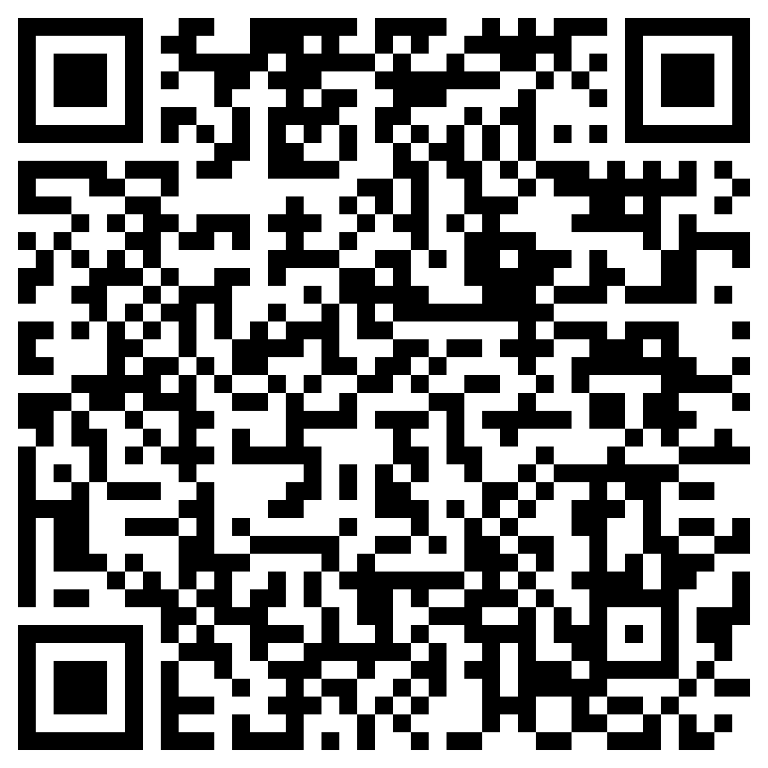
Before Going into Mentor Pods…
Mandatory Exit Ticket Quiz :)
  Must complete w/ 100%
  Show your Mentor

Slide 7
MENTOR POD TIME!!

Slide 8

Any Questions?
Notes:
Max & Claire

