Slide 1
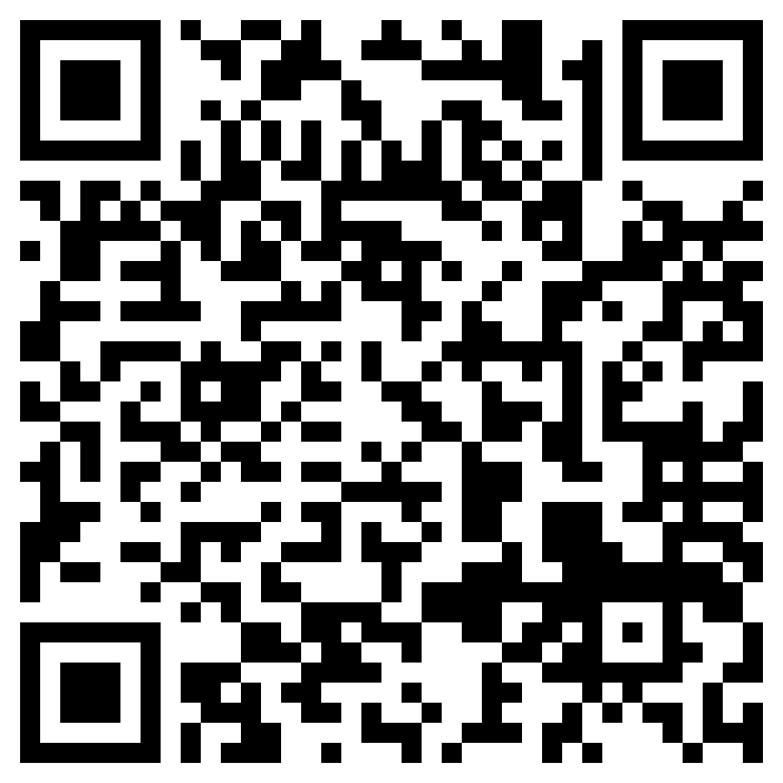
Welcome To
Follow along with the slides!
Notes:
Claire

Slide 2
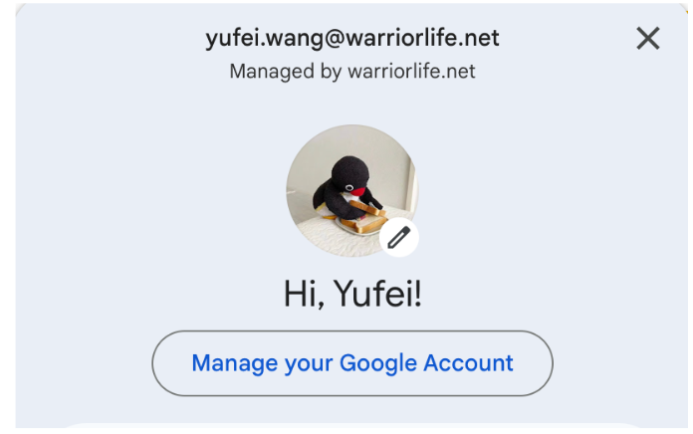
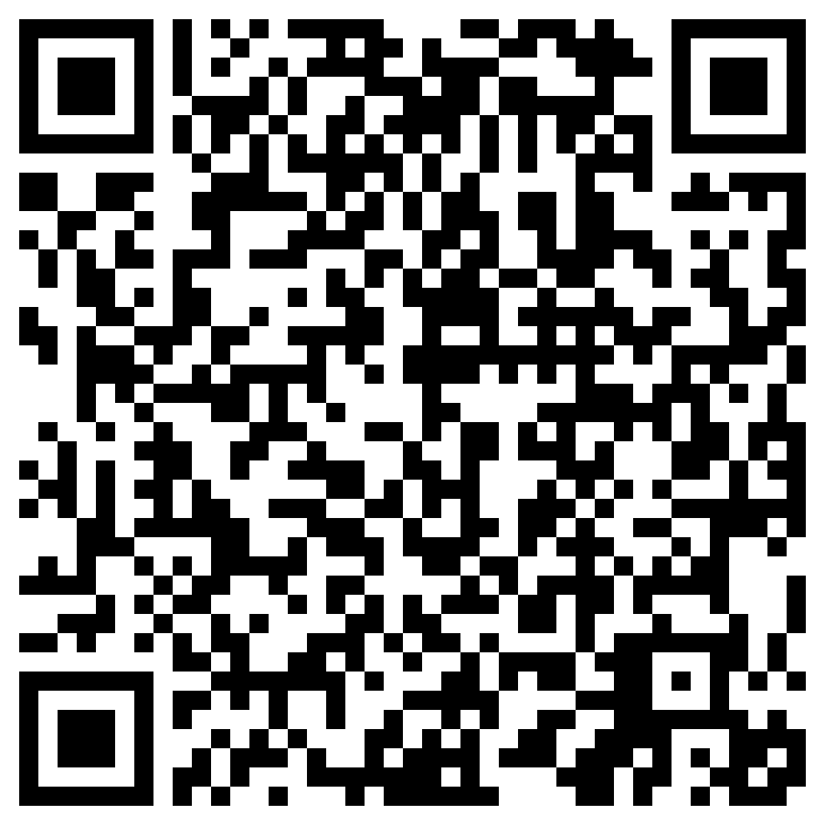
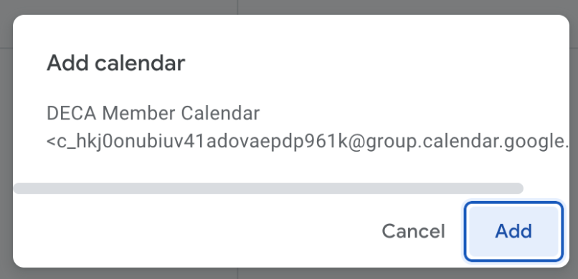
Join the DECA Calendar
Step 1: Log into google calendar with your warriorlife email address
Step 2: Click here or scan the QR code to have access to the calendar.
Step 3: Click add

Slide 3
Expectations
Mandatory to attend ALL All-Hands Meetings (lunch meetings)
Arrive Promptly!
Required to attend AT LEAST 2 Workshops a month
Progress on your writtens, will have Written Check-ins
Mandatory for 1st Years to attend VC Mock Conference (11/11)

Slide 4
Workshop
Last day of EE
No more Tuesday Events
1st Workshop Today!
Topics
EE Recap
Intro to Roleplays & Writtens
Idea Generation
If you don’t have a partner yet, we will continue speed dating

Slide 5
Workshop
Logistics
Start Time: 2:50pm
Room G105 closed until 3:00pm
Workshop
All years → G105-107
Speed Dating & Trifolds
→ G108-109
Once done, join workshop

Slide 6
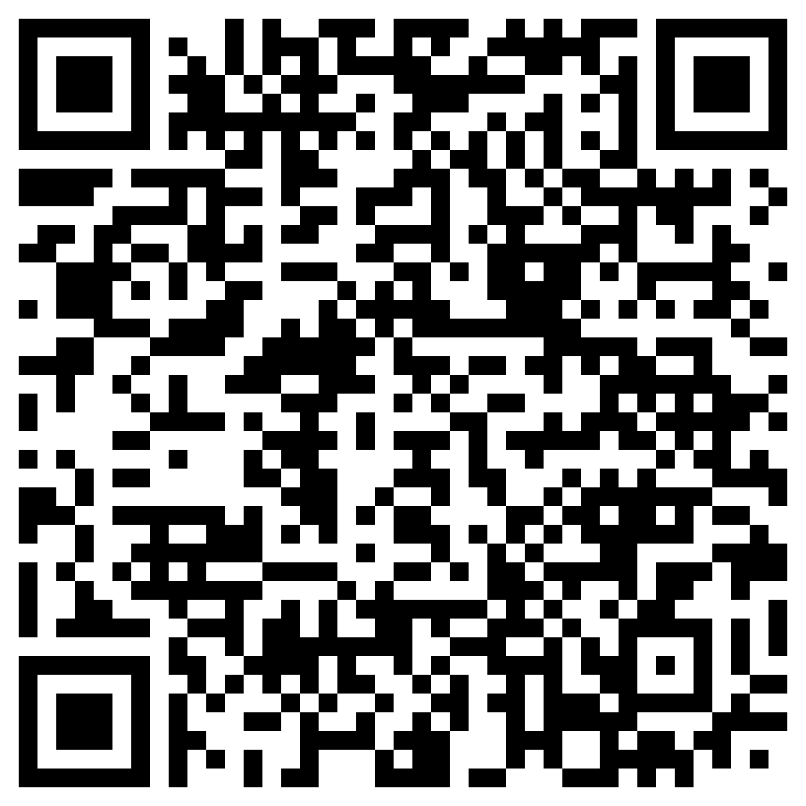
Upcoming Milestones
DECA Parent Night Tomorrow at 7pm in Conservatory Hall (C338-339)
Remind your Parents!!
Drop Deadline Due (9/27)
EVENT SELECTION FORM DUE THIS FRIDAY (9/15)

Slide 7
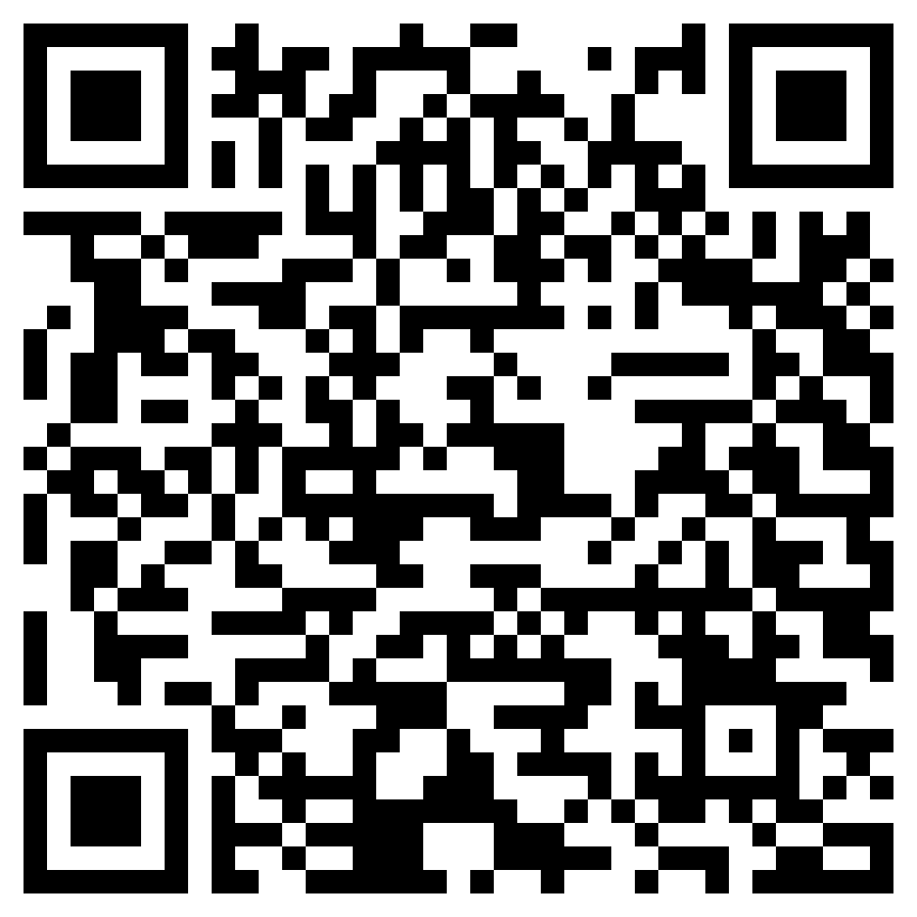
Competition BEGAN 9/11
Can still register!
Registration QR Code
Registration ends 10/13
Great event if you’re looking to qualify for ICDC

Slide 8
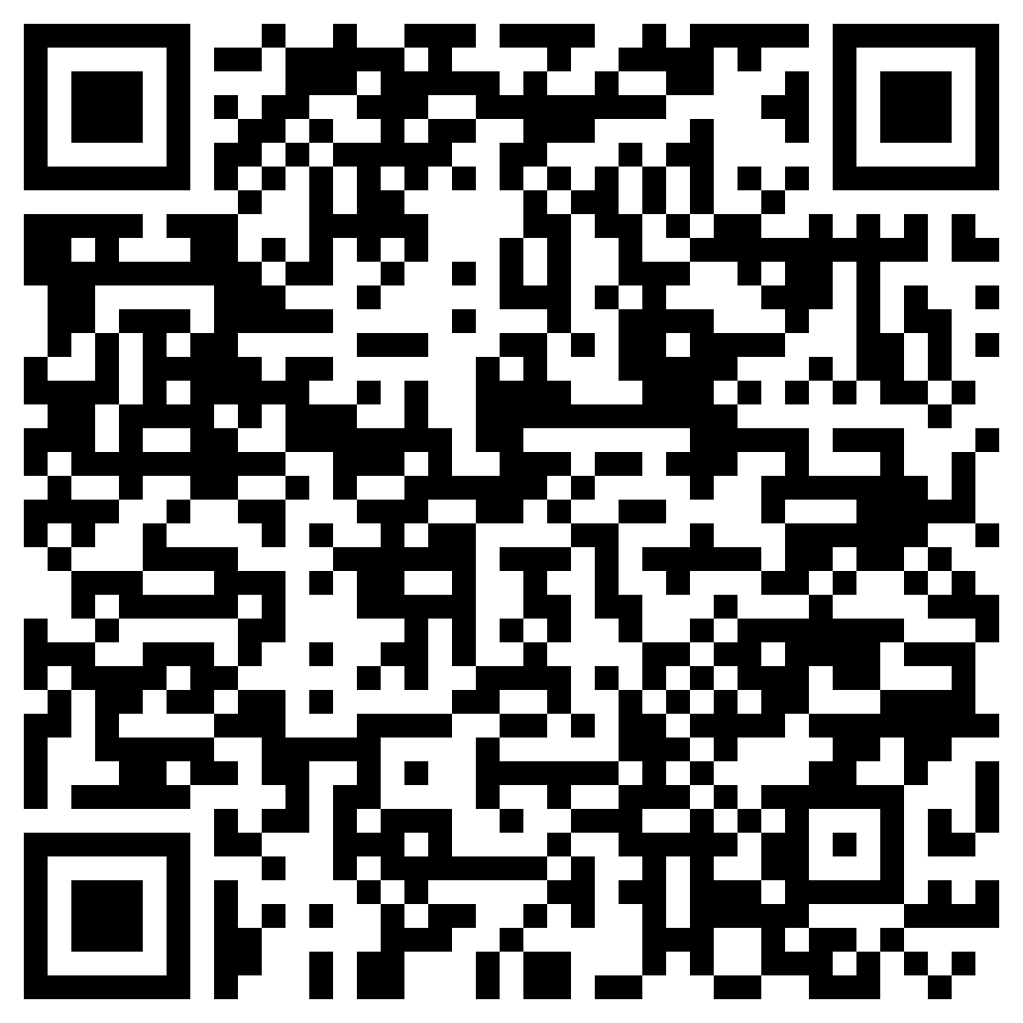
Before you Leave
Mandatory Exit Ticket Quiz
Must complete before leaving
Handing out “ETD” stickers as you leave

Slide 9
Any Questions?
Notes:
Max & Claire

