Slide 1
Welcome To
Please make your way to your mentor pod!
G107 - Pods 1-6
G106 - Pods 7-12
G105 - Pods 13 - 18
G143 - Pods 19 - 24
G144 - Pods 25 - 30
Notes:
Claire

Slide 2
Upcoming Milestones
SVCDC written submission opens NEXT WEDNESDAY
CLOSES on FRIDAY 12/8
YOU are responsible for turning in your own written, NOT your mentor.

Slide 3
Workshop - Food & Fellowship
Logistics
Start Time: 2:50pm
Room G105 closed until 3:00pm
Pods 1-8: G107
Pods 9-16: G106
Pods 17-24: G105
Pods 25-30: G108
Only individuals who RSVP’d and turned in their cranes will be allowed to get food!

Slide 4
Quest Talk
This Friday!
Speaker: Nathan Lord
Software & AI

Slide 5
Other Announcements
VCMC Data is available!
Your mentor will share it with you
Please make sure you shared your written AND written presentation link with your mentor

Slide 6
California DECA Events
Champ Camp
Zoom webinar workshops from ICDC winner (recorded & published)
Pin Design Competition
Business Pitch Competition
All of the links for these are in the email we sent! VC DECA will not provide support for these events

Slide 7
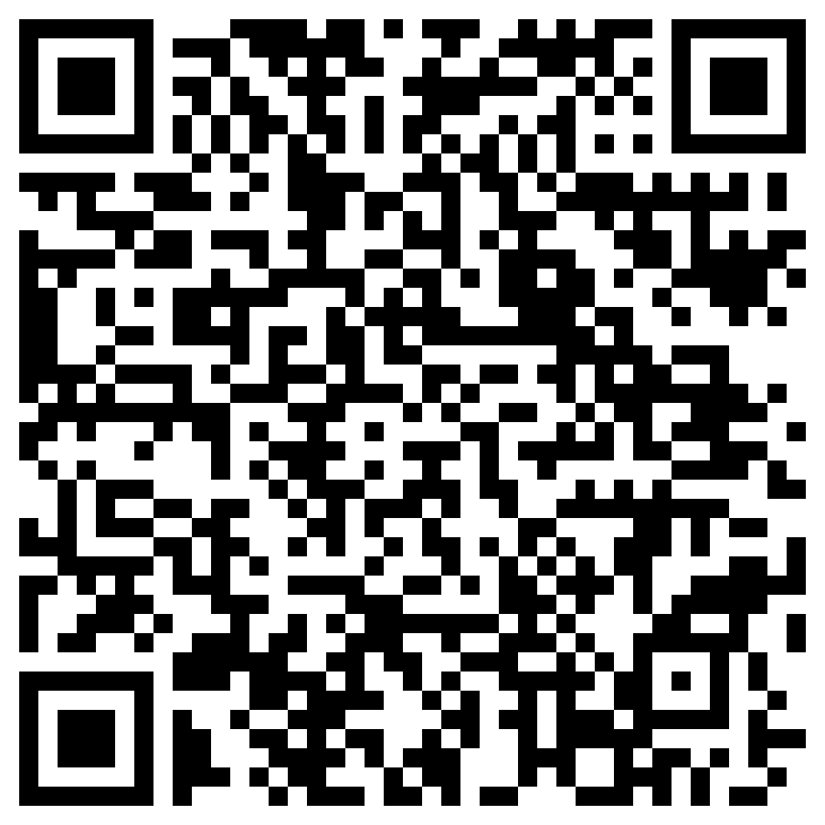
Before Going into Mentor Pods…
Mandatory Exit Ticket Quiz :)
Must complete w/ 100%
Show your Mentor

Slide 8
Any Questions?
Notes:
Max & Claire

