Slide 1
Welcome To
Please make your way to your mentor pod!
G107 - Pods 1-6
G106 - Pods 7-12
G105 - Pods 13 - 18
G143 - Pods 19 - 24
G144 - Pods 25 - 30
Notes:
Claire

Slide 2
Upcoming Milestones
VCMC Written Submission
CLOSES 11/3 at 11:59 PM
Executive Summary MUST be submitted to your MENTOR by them
VCMC is in 10 days!

Slide 3
Community Service
OPERATION
CHRISTMAS
CHILD
Notes:
Today I'm gonna introduce our DECA community service project: Operation Christmas Child, otherwise known as OCC.

Slide 4
What is OCC?
01
Organization that helps spread the word of Jesus by packing shoeboxes and sending them around the world
02
Shoeboxes include toys, school supplies, personal care items, etc
03
Delivered to OCC’S local church partners → sent around the world
Notes:
OCC is a Christian organization that helps spread the word of Jesus by packing shoeboxes and sending them around the world
The shoeboxes have things like toys, school supplies, personal care items, and other objects that helps make an impact into each child's' life.
After being packed, the shoeboxes are delivered to OCC's local church partners, and then sent around the world.

Slide 5
What will we be doing?
Purchasing items to be placed into the boxes
Mentors have purchased most of the items, but reach out to your mentor if you want to contribute!
Hosting a “packing day” where all members are expected to come out and help place the items into the shoeboxes
Notes:
For our DECA chapter specifically, first we'll be purhcasing items to be placed into the boxes. Your mentors have already purchased most o fhte items, but make sure to reach out to them if you want ot help contirbute.
Second, we'll be hosting a packing day where all members are expected to come out and help place the items into the shoeboxes.

Slide 6
SOME HIGHLIGHTS:
Notes:
Here are some highlights of OCC from last year!
We can see the assemblyline and generally everyone having a pretty good time!

Slide 7
Time/Place
WHEN
Packing day will be AFTER SCHOOL
TUESDAY, NOVEMBER 14TH
WHERE
In G105-G107
Notes:
This year, out OCC packing party will be after school on the Tuesday after Mock Conference, so November 14th in rooms G105-G107. I'll be sending out an email for this as the date comes closer, but check your email for more specifics!

Slide 8
Workshop - Executive Summary
Logistics
Start Time: 2:50pm
Room G105 closed until 3:00pm
Entrepreneurship → G105-107
IMC → G108
Operation Research → G109

Slide 9
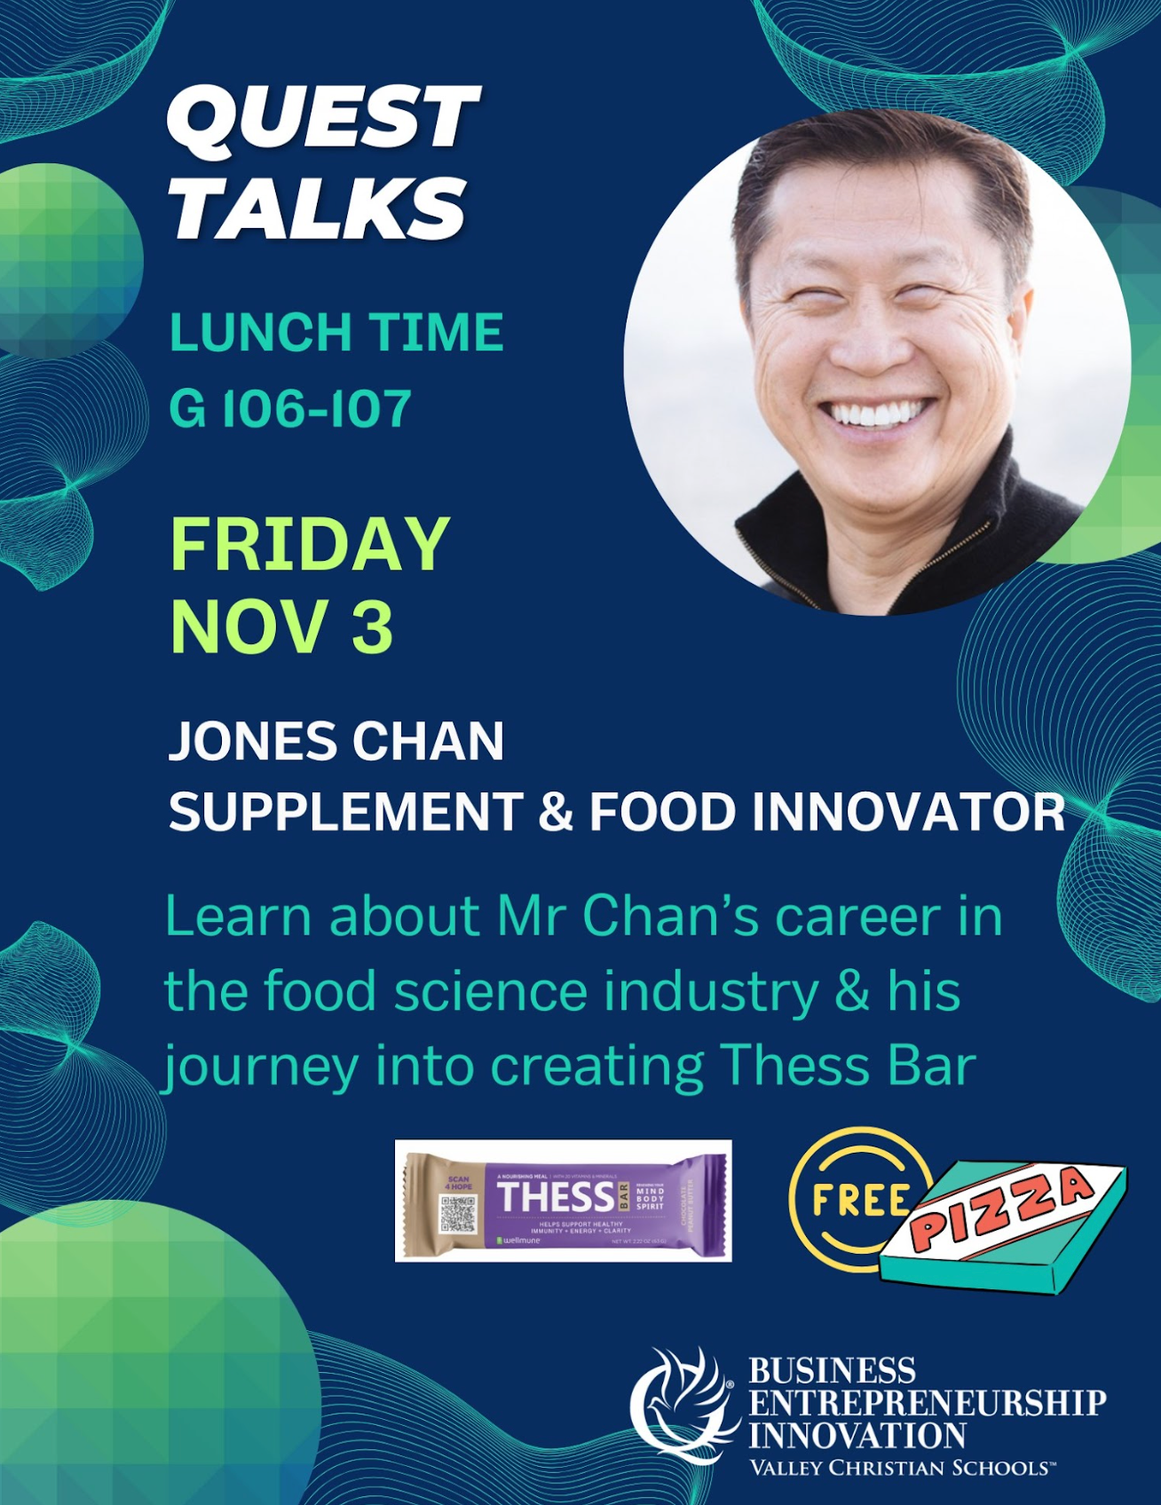
Quest Talk!
This Friday
Jones Chan
Food Science

Slide 10
Other Announcements
VCMC Schedule is out! (attached in email)
Double check your schedule to confirm there are no errors
Chapter Merch Distribution
No size exchanges
Need to trade with others
MENTORS - Mark T-shirts given out on sheet

Slide 11
California DECA Events
Champ Camp
Zoom webinar workshops from ICDC winner (recorded & published)
Pin Design Competition
Business Pitch Competition
All of the links for these are in the email we sent! VC DECA will not provide support for these events

Slide 12
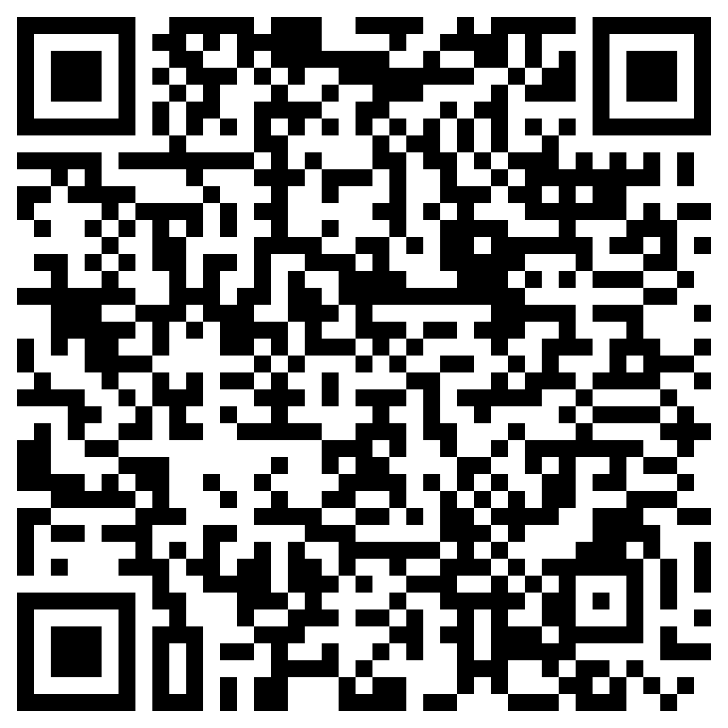
Before Going into Mentor Pods…
Mandatory Exit Ticket Quiz :)
Must complete w/ 100%
Show your Mentor

Slide 13
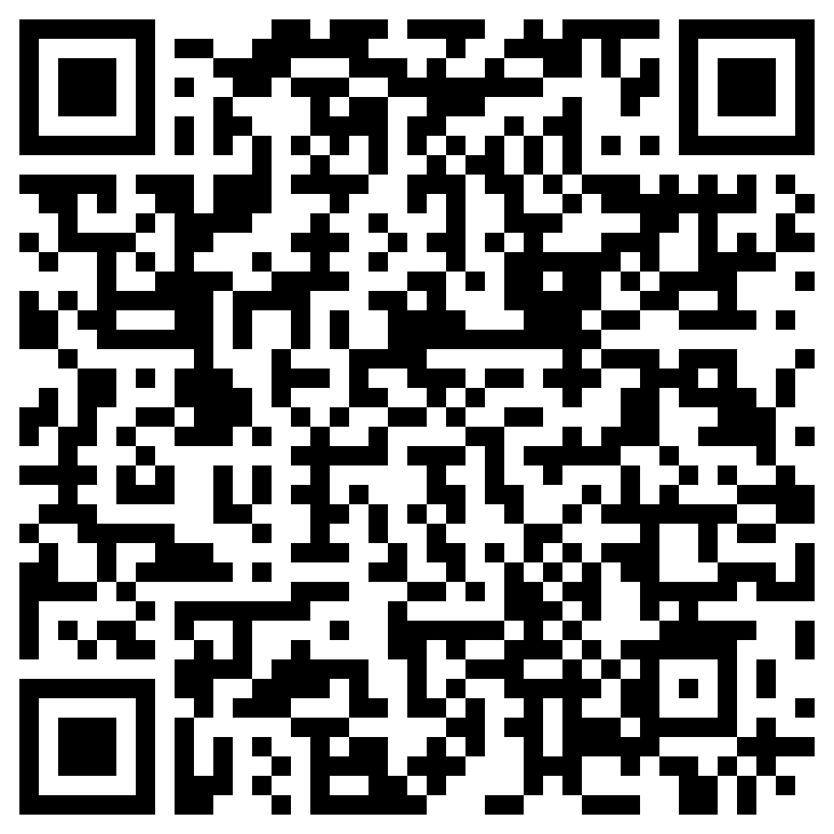
Any Questions?
Notes:
Max & Claire

Slide 14
MENTOR POD TIME!!

