Slide 1
Welcome To
Please make your way to your mentor pod!
G107 - Pods 1-6
G106 - Pods 7-12
G105 - Pods 13 - 18
G143 - Pods 19 - 24
G144 - Pods 25 - 30
Notes:
Claire

Slide 2
Upcoming Milestones
VCMC Registration is open today!
Register ASAP! Due 10/11
Email will be sent today
Follow the instructions on the form carefully
VBC Registration is also open
Great opportunity to qualify for ICDC
Once you register, you MUST email Mr. Crandall (jcrandall@vcs.net) with your team and event to confirm your team

Slide 3
Workshop Today - Writtens
Logistics
Start Time: 2:50pm
Room G105 closed until 3:00pm
Entrepreneurship → G105-107
IMC → G108
BOR → G109

Slide 4
California DECA Events
Champ Camp
Zoom webinar workshops from ICDC winner (recorded & published)
Pin Design Competition
Business Pitch Competition
All of the links for these are in the email we sent! VC DECA will not provide support for these events

Slide 5
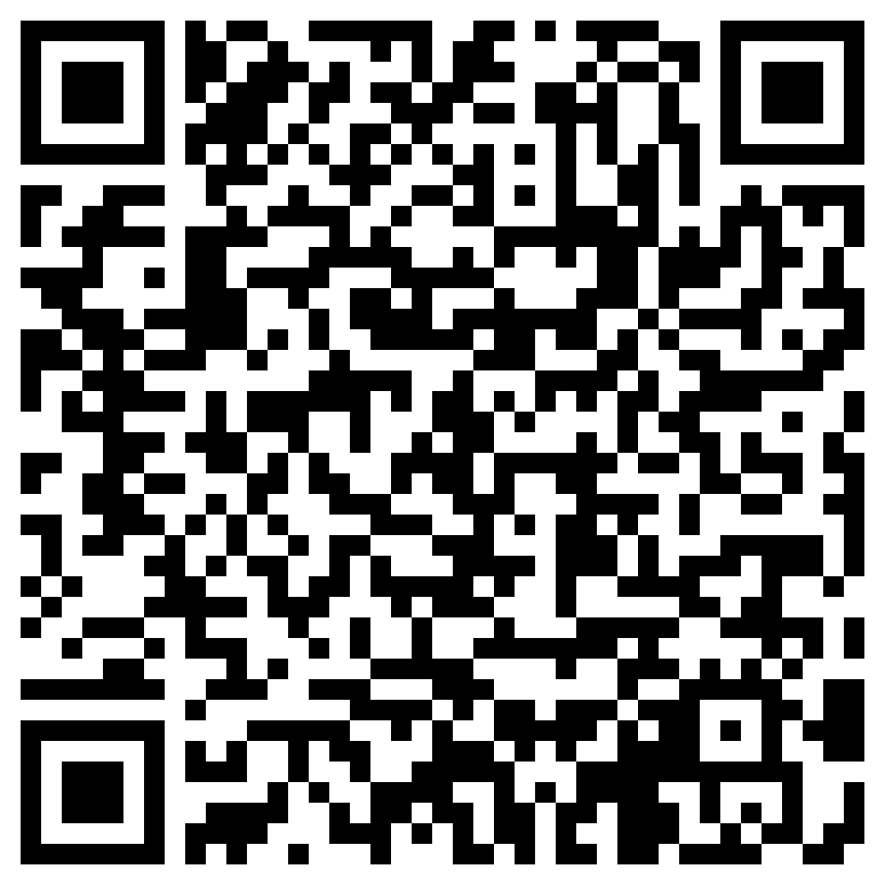
Before Going into Mentor Pods…
Mandatory Exit Ticket Quiz :)
Must complete w/ 100%
Show your Mentor

Slide 6
MENTOR POD TIME!!

Slide 7
Any Questions?
Notes:
Max & Claire

