Slide 1
Welcome To
Please make your way to your mentor pod!
G107 - Pods 1-6
G106 - Pods 7-12
G105 - Pods 13 - 18
G143 - Pods 19 - 24
G144 - Pods 25 - 30
Notes:
Claire

Slide 2
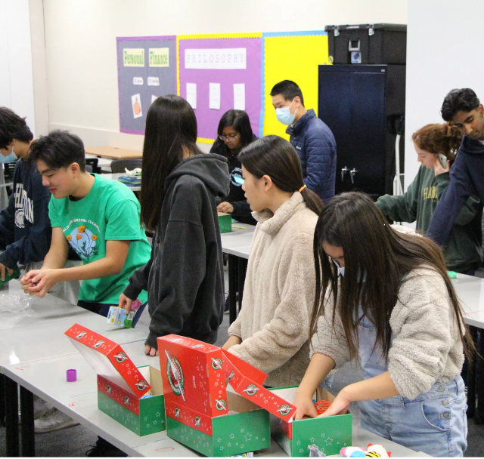
Upcoming Milestones
OCC (Operation Christmas Child)
Will be on 11/14
More details will be shared later
VCMC Written Submission
OPENS 10/30, CLOSES 11/3
Executive Summary MUST be finished by then!

Slide 3
1st FOOD & FELLOWSHIP!!
Logistics
Start Time: 2:50pm
Room G105 closed until 3:00pm
POD 1-8 → G107
POD 9-16 → G106
POD 17-24 → G105
POD 25-29 → G108

Slide 4
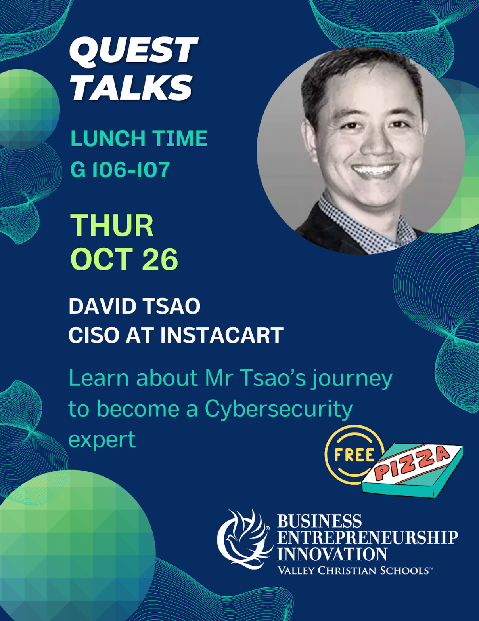
Quest Talk!
Next Thursday
David Tsao
Cybersecurity expert

Slide 5
Other Announcements
Practice Roleplay
MANDATORY to do before VCMC
Should be DONE or at least SCHEDULED
Bus Kids
Try to take a later bus (if possible)

Slide 6
California DECA Events
Champ Camp
Zoom webinar workshops from ICDC winner (recorded & published)
Pin Design Competition
Business Pitch Competition
All of the links for these are in the email we sent! VC DECA will not provide support for these events

Slide 7
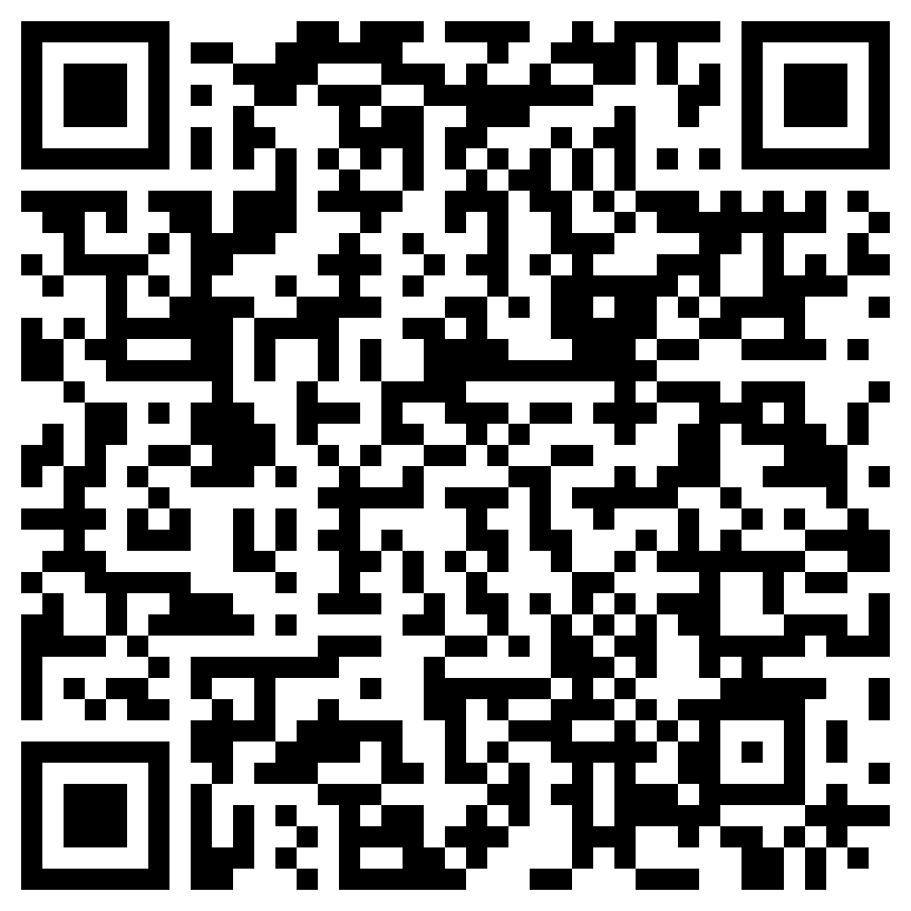
Before Going into Mentor Pods…
Mandatory Exit Ticket Quiz :)
Must complete w/ 100%
Show your Mentor

Slide 8
Any Questions?
Notes:
Max & Claire

Slide 9
MENTOR POD TIME!!

