Slide 1
Welcome To
Please make your way to your mentor pod!
G107 - Pods 1-6
G106 - Pods 7-12
G105 - Pods 13 - 18
G143 - Pods 19 - 24
G144 - Pods 25 - 30
Notes:
Claire

Slide 2
Upcoming Milestones
REGISTER FOR SVCDC!!
DUE THIS SUNDAY 10/22
First official Conference
Follow the instructions in the email sent.
Parent/guardian must fill out field trip form first

Slide 3
Workshop Today - Parent Judge Speakers
Logistics
Start Time: 2:50pm
Room G105 closed until 3:00pm
Principles (1st years) → G105-107
Individual Series → G108
TDM → G109

Slide 4
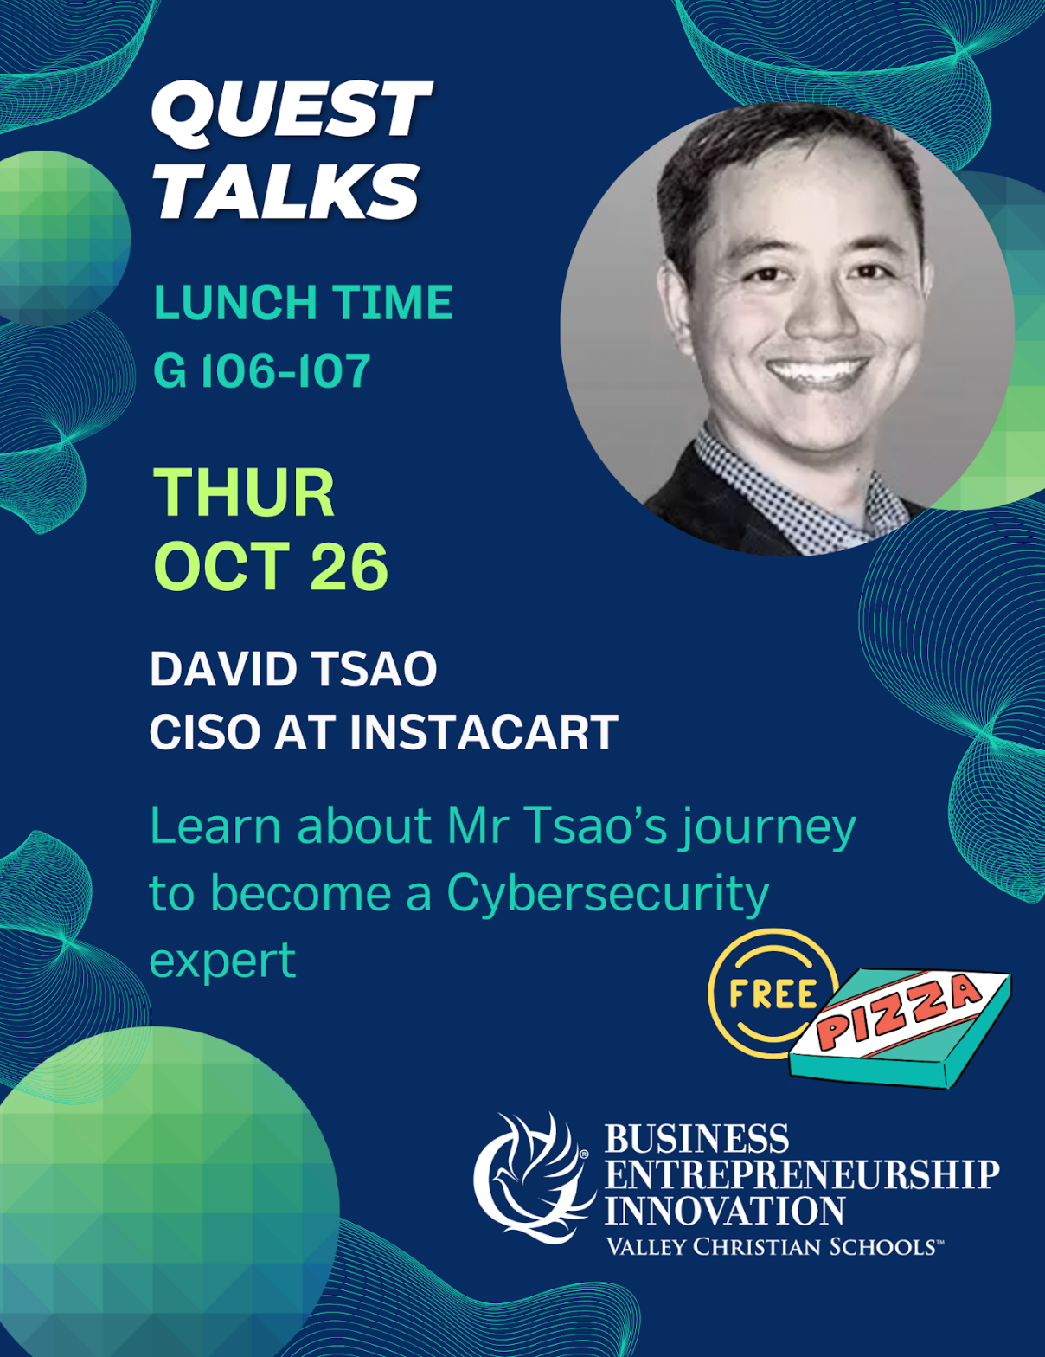
Quest Talk!
Next Thursday
David Tsao
Cybersecurity expert

Slide 5
Practice Roleplay
MANDATORY practice roleplay before VCMC
Mentors will schedule a session with you today

Slide 6
California DECA Events
Champ Camp
Zoom webinar workshops from ICDC winner (recorded & published)
Pin Design Competition
Business Pitch Competition
All of the links for these are in the email we sent! VC DECA will not provide support for these events

Slide 7
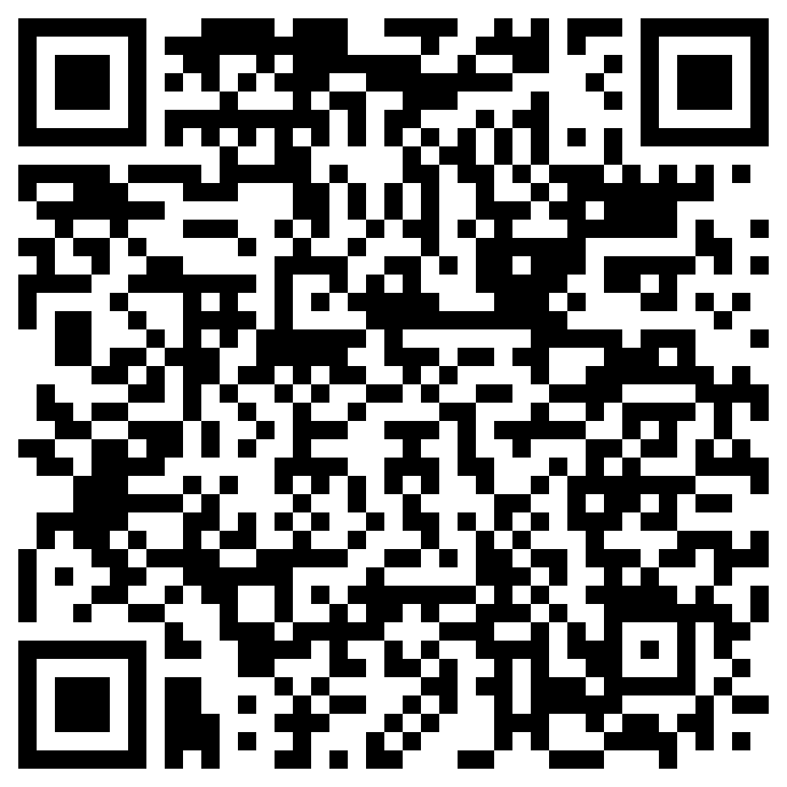
Before Going into Mentor Pods…
Mandatory Exit Ticket Quiz :)
Must complete w/ 100%
Show your Mentor

Slide 8
MENTOR POD TIME!!

Slide 9
Any Questions?
Notes:
Max & Claire

