Slide 1
Welcome To
Please make your way to your mentor pod!
G107 - Pods 1-6
G106 - Pods 7-12
G105 - Pods 13 - 18
G143 - Pods 19 - 24
G144 - Pods 25 - 30
Notes:
Claire

Slide 2
Upcoming Milestones
If you haven’t already… REGISTER FOR VCMC NOW!! DUE TODAY!! (no late registrations)
If you are in a group of 2+ members, designate ONE person as team captain
If you are doing an event individually (principle/individual roleplays), then you are the captain
If you are the "captain" of two teams (for example, an individual roleplay and a team written), you must submit the form twice.

Slide 3
Upcoming Milestones
VBC Registration is also open
Great opportunity to qualify for ICDC
Once you register, you MUST email Mr. Crandall (jcrandall@vcs.net) with your team and event to confirm your team

Slide 4
Workshop Today - Benchmark Exam
Logistics
Start Time: 2:50pm
Room G105 closed until 3:00pm
Business Admin (1st years) → G105-107
Personal Financial Literacy → G105
Business management & Marketing → G108
Finance & Hospitality → G109

Slide 5
Benchmark Exam
If you’re unable to come to the workshop today or don’t finish
MUST be completed by this Sunday
Exam can be found on moodle

Slide 6
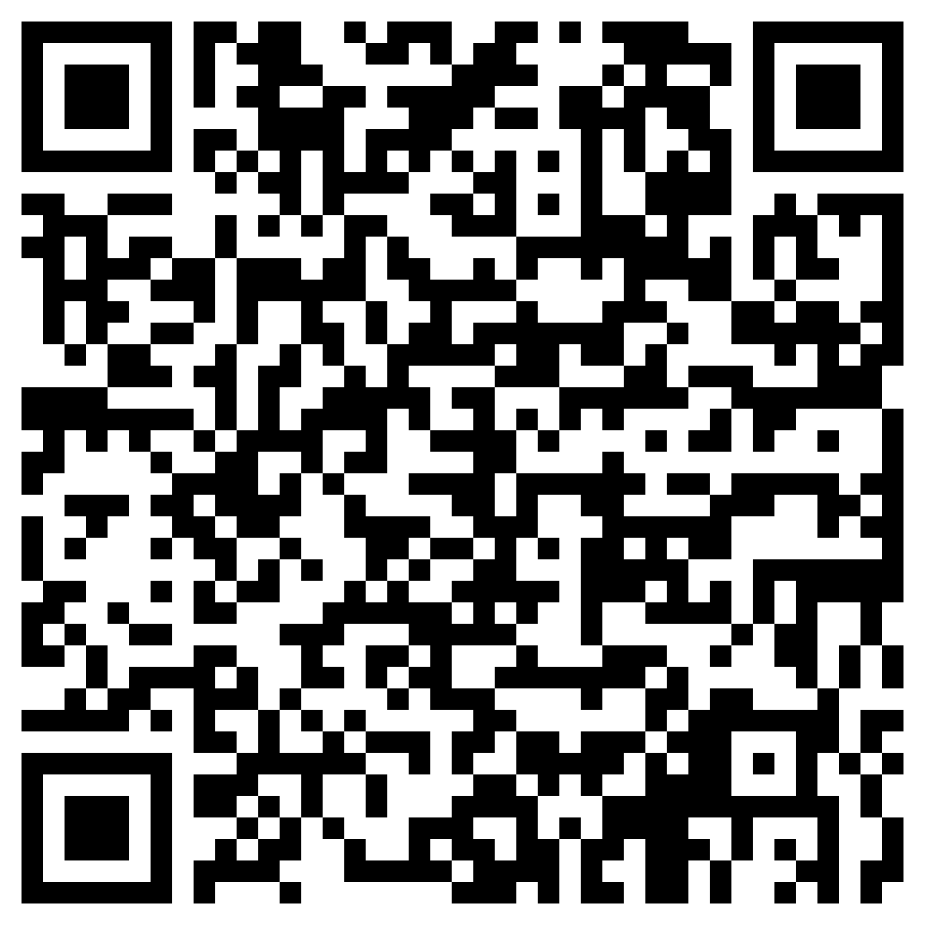
If you take a bus after school
Fill out this form
Will be used for attendance purposes

Slide 7
ROLEPLAY BIN!!
Demo
Ask your mentors if you want to use it
MANDATORY practice roleplay before VCMC
Mentors will schedule a session with you today

Slide 8
California DECA Events
Champ Camp
Zoom webinar workshops from ICDC winner (recorded & published)
Pin Design Competition
Business Pitch Competition
All of the links for these are in the email we sent! VC DECA will not provide support for these events

Slide 9
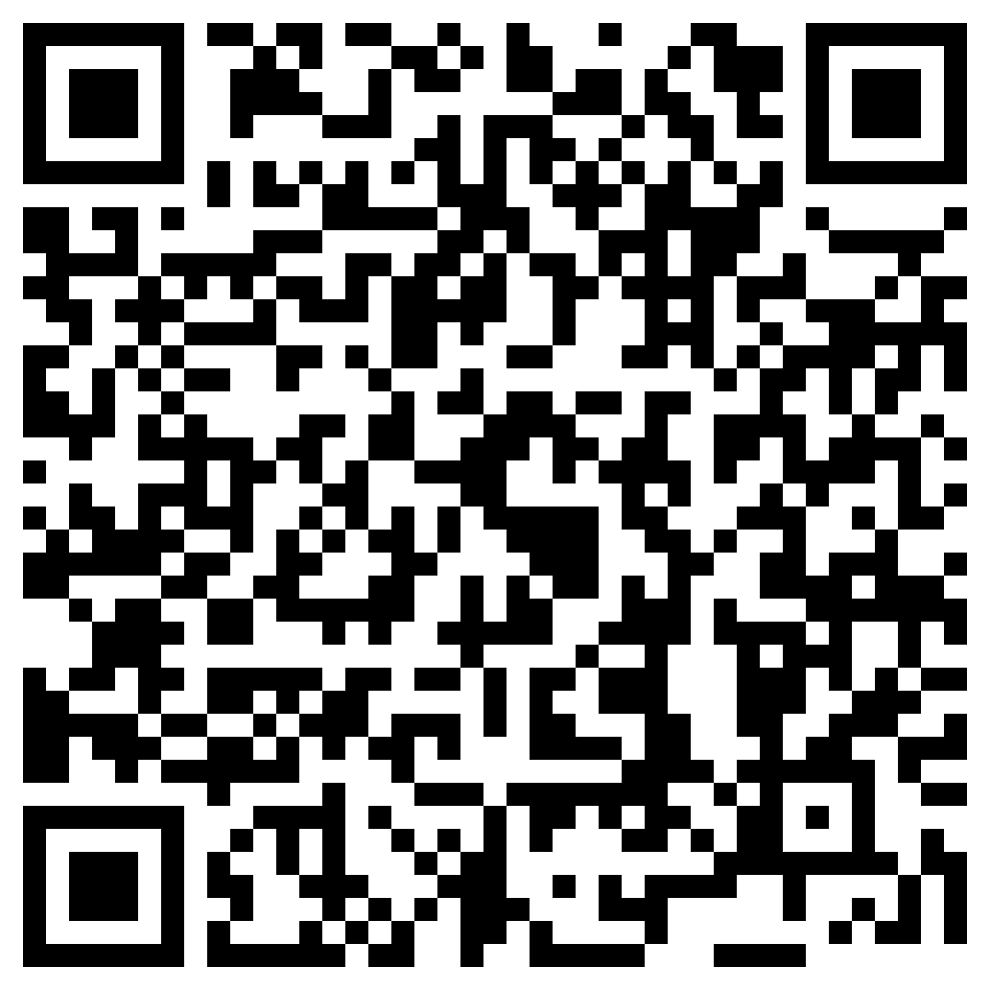
Before Going into Mentor Pods…
Mandatory Exit Ticket Quiz :)
Must complete w/ 100%
Show your Mentor

Slide 10
MENTOR POD TIME!!

Slide 11
Any Questions?
Notes:
Max & Claire

