Slide 1
Types of Essay
文章的种类

Slide 2
Descriptive Essay: is an essay that describes a person, place, memory, event , experience, or thing.
Objective descriptive essay: physical objects by providing facts, not opinions.
Subjective descriptive essay: write about what they perceive in all senses, including details such as height, weight, color and smell, and their feelings toward the object.
It is important to carefully select specific, concrete details to support their dominant impression.

Slide 3
Descriptive Essay: may useful in Story Narration, or Email response.
Start with the obvious, then develop and describe.
Provide plenty of specific descriptions to give reader a complete and vivid perception and impression.
Choose appropriate words that convey their emotions or perspectives, and use words。
Create a clear pattern of organization , use a wide range of grammatical structures.

Slide 4
Essay for Comparing the dietary customs of China and the Western world.
Describing a experience:
Require students to master a variety of desCriptive vocabulary and appropriate expressions. A wide range vocabulary helps students create vivid images and enhance reader’s interest in the easy.
Adjectives： 鲜美、清淡、新鲜、爽口、又嫩又香、又甜又辣、香
Prepositions –can’t use it by itself，has to combine with noun （or other 。。）
从、在、当、把、对、为、就、用、比、到、连、将、因、让、并、跟、自从、等到、按照、由于
3. Descriptive complements：Verb/adj + 得+, verb + 起来
你说得很好。 孩子们听得认真。他看起来很累。

Slide 5
Sample：
当我们评价中国菜的时候，它的标准是色香味。对于各个不同的菜系的特色，首先要知道它们是来自哪个区域、地理位置和气候。比如说：川菜，又麻又辣，看起来都是桔红色，各道菜里都有看得见的红红的辣椒，还没吃，就让人浑身热得不得了。

Slide 6
L-3 的文章的内容包括：
饮食习惯：南北方不同的主食
饮食内容：
饮食规矩：
烹饪方法：
健康影响：

Slide 7
Persuasive Essay 有说服力的 文章
Logical, ethical, and emotional appeal to reader
Present information about a controversial subject and also an argument the pros and cons of the subject
Has to clearly take a stand write as if he/she is trying to persuade an opposing audience to accept new beliefs.
Assesses student’s interpretive communication skills (Understanding what is being asked of them), and their presentational and interpersonal communication skills (delivering the response).

Slide 8
文章顺序 Essay Order
I. Introduction
A. Capture readers’ attention with a “hook”
II. Analysis
A. Offer own opinions
B. Present opposing arguments
III. Conclusion
A. Present rebuttal evidence in favor of own viewpoints
B. Add a personal call to action or solution

Slide 9
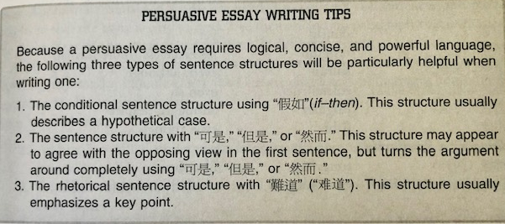

Slide 10
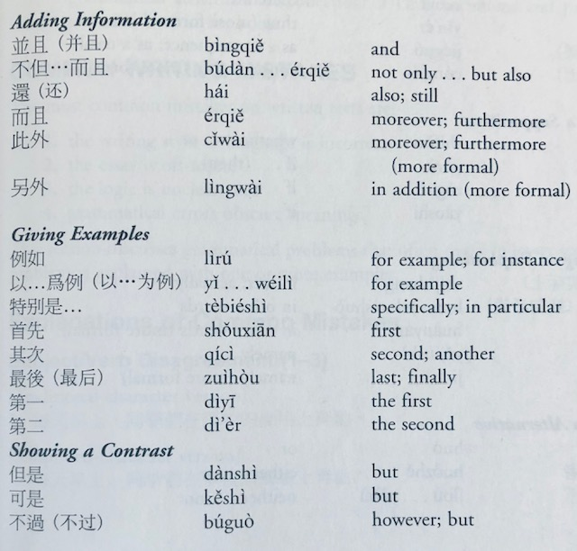
Words and phrases used for transitioning from one ideal to the next：

Slide 14
第八课：高中生该不该打工

