Slide 1
Work, Energy, and Power
Principles of Engineering

Slide 2
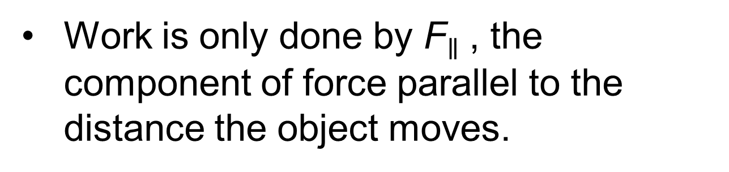
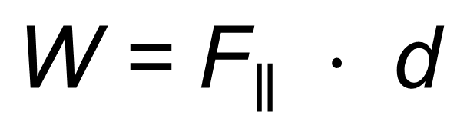
Work
Work (symbol W) is the energy transferred when a force F is applied to an object moving through a distance d.
$$\text{W}\text{ = }{\text{F}}_{∥} ⋅ \text{d}$$
Work is only done by ${\text{F}}_{∥}$, the component of force parallel to the distance the object moves.
The SI unit of work or energy is the joule (symbol J).
1 J = 1 N·m
Notes:
Note: Vectors and scalars are introduced in Unit 2. Depending on your students, you may wish to connect to that content here. Force and displacement are vectors. Energy and work are scalars. In this formula, work is the scalar product, aka the dot product, of these two vectors. The scalar product multiplies the magnitude of the vector components that are parallel to each other.

Slide 3




Work Example
A student lifts a 50.0 pound ball 4.00 feet in 5.00 seconds.
How many joules of work did the student complete?
$$\text{W}\text{ = }\text{F}\text{ ∙ }\text{d}$$
$$\text{= 50.0 }\text{lb}\text{ ∙ 4.00 }\text{ft}$$
$$\text{= 200. }\text{ft}\text{∙}\text{lb}$$
This is an amount of work. But it is not in the SI unit of joules.

Slide 4
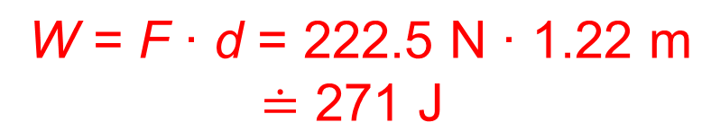
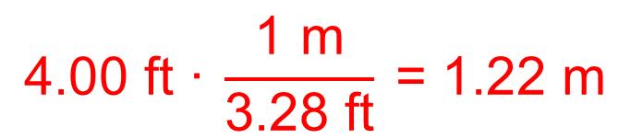
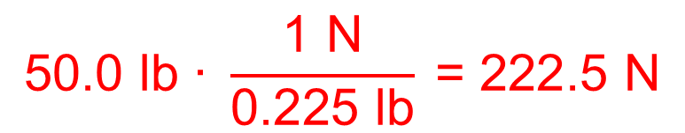
Work Example
A student lifts a 50.0 pound ball 4.00 feet in 5.00 seconds.
How many joules of work did the student complete?
Convert to SI units and then calculate work:
$$\text{50.0 }\text{lb}\text{ ∙ }\frac{\text{1 }\text{N}}{\text{0.225 }\text{lb}} \text{= 222.5 }\text{N}$$
$$\text{4.0}\text{0 }\text{ft} \text{∙} \frac{\text{1 }\text{m}}{\text{3.28 }\text{ft}} \text{= 1.22 }\text{m}$$
$$\text{W}\text{ = }\text{F}\text{ ∙ }\text{d} \text{= 222.5 }\text{N}\text{ ∙ 1.22 }\text{m}$$
$\text{≐ 271 }\text{J}$

Slide 5
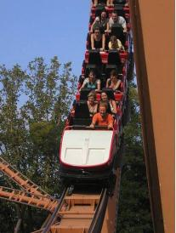
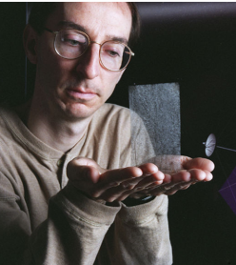
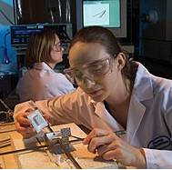
Energy
Ability to do work
Light, heat, mechanical, chemical, and electrical forms of energy can all be used to exert a force for a distance.
Roller coaster
NASA solar sail
Fuel cell

Slide 6
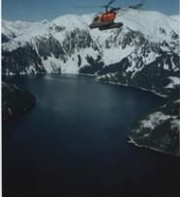

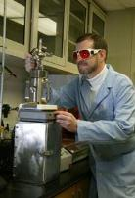
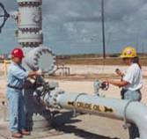
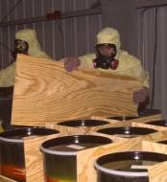
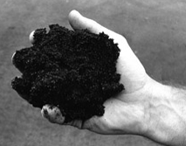
Forms of Energy
Potential Energy (Stored energy, often referring to gravitational potential energy)
The capacity to do work by virtue of position or configuration
Notes:
Placing an object “upstream” against any of the four forces of the universe (gravity, electromagnetic, strong, and weak forces) gives the object potential energy.
Examples of potential energy:
Gravitational potential energy—Lifting an object away from the earth’s surface gives the object gravitational potential energy because the object has moved against the earth’s gravity.
Elastic energy—Stretching a rubber band gives the rubber band electromagnetic potential energy because the rubber band's molecules have been forced apart, overcoming the molecules’ electromagnetic attraction.
Electrical energy—Applying a voltage to a conductor gives the conductor electromagnetic energy because the electrons have not yet “given in” to the electromagnetic force.
Chemical energy—The electrons in molecules of fuel have electromagnetic potential energy because they have not yet “fallen” closer to the nuclei of the product that can be formed during combustion.
Thermal or Heat Energy—Changes among solid, liquid, and gaseous states are electromagnetic potential energy because the molecules have overcome the attraction between electrons in one molecule and the nuclei of neighboring molecules.

Slide 7
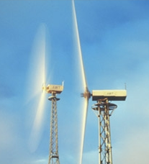
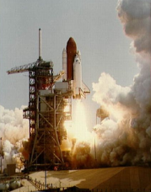
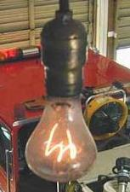
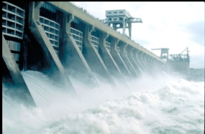
Forms of Energy
Kinetic Energy (Energy of motion)
Energy which a body possesses because of its motion, which occurs anywhere from an atomic level to that of a whole organism
Notes:
Examples of Kinetic Energy
Energy of Motion—The movement of whole objects; this is usually the type meant by “kinetic energy”
Electrical Energy—The movement of electrons in a conductor as they respond to an applied voltage.
Thermal or Heat Energy—The movement of molecules and electrons
Engineers generally refer to thermal/heat energy as “internal energy” and use “kinetic energy” strictly in reference to motion.

Slide 8



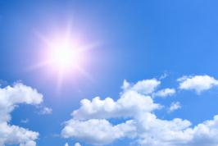
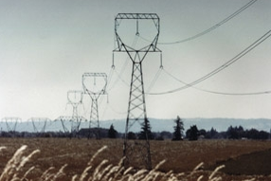
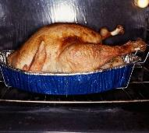
Energy Transformation
Chemical → Kinetic
Radiant → Chemical
Electrical → Thermal
Notes:
Energy transformation involves the conversion of one form of energy into another form.
Examples of energy transformation include:
Chemical to Kinetic—Food is consumed and converted into motion for playing sports or taking a test.
Radiant to Chemical—Sunlight is consumed by plants and converted into energy for growth.
Electrical to Thermal—Energy transferred to an oven is converted to thermal energy for heating our food.

Slide 9

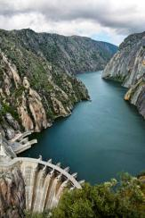
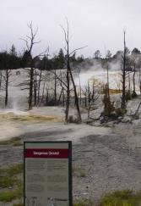
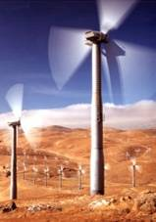
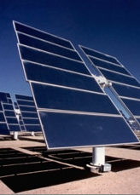
Renewable Energy Sources
Biomass
Hydropower
Geothermal
Wind
Solar
Notes:
Now you know the basic forms of energy. The next question is “What are the energy sources for human activity?”
There are renewable and nonrenewable sources of energy. A renewable energy source is a form of energy that is constantly and rapidly replenished by natural processes.
Examples of renewable energy sources include:
Biomass – The use of a living or once living organism as fuel
Hydropower – The energy produced from the movement of water
Geothermal – The use of heat from within the Earth or from the atmosphere near oceans to warm houses or other buildings
Wind – The use of wind to generate electricity
Solar – The use of the sun as a source of heat; for instance, to heat a room within a house, etc.

Slide 10
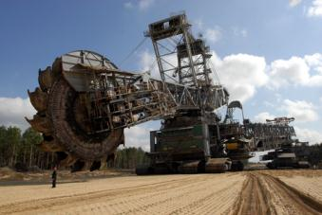
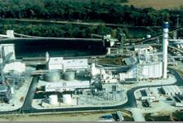
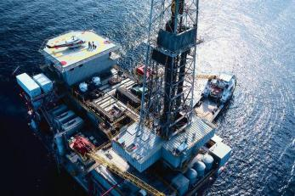
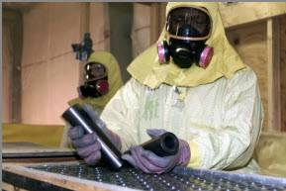
Nonrenewable Energy Sources
Coal
Natural Gas
Petroleum
Uranium
Notes:
A nonrenewable energy source is one that is obtained from the Earth as a liquid, gas, or solid and cannot be replenished in a rapid manner.
Examples of nonrenewable energy sources include:
Petroleum
Natural gas
Coal
Propane
Uranium

Slide 11
Conservation of Energy
Energy cannot be created or destroyed, but it can change from one form to another.
Energy “Lost” to Heat
When an input energy is changed to an output energy, some of the output is usually heat energy.
Notes:
These are the First and Second Laws of Thermodynamics. Why is “lost” in quotation marks? Because energy is never lost; it is only transformed into heat. This is often “lost” because—unless there is a lower temperature to where the heat energy can flow—it cannot be transformed back into another form. Even if there is colder reservoir for the heat to flow to, the Second Law of Thermodynamics puts an upper limit (100% - T_cold/T_hot) on how much of the heat energy can be transformed back into another form.
“Conservation” also has a second meaning: “trying to make do with less.” In this common meaning, for instance, we conserve energy by setting our thermostat to a colder temperature for heating in the winter and a warmer temperature for air conditioning in the summer.

Slide 12
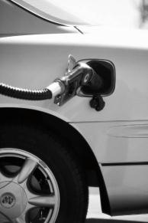
Energy Conversion
Examples of energy conversions for making electricity
Fossil fuels Chemical → Heat → Mechanical → Electrical
Solar cells Sunlight → Electrical
Wind turbines Kinetic → Mechanical → Electrical
Hydroelectric Gravitational potential → Mechanical → Electrical
Nuclear Nuclear → Heat → Mechanical → Electrical
Vehicle System Conversion
Chemical
Mechanical
Heat
Which output is desired: mechanical or heat?
Notes:
What is done with electrical energy?

Slide 13
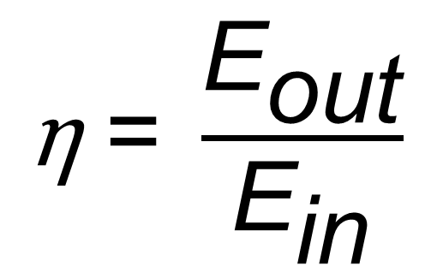
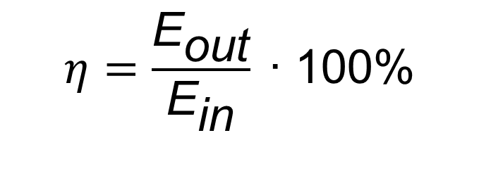
Efficiency
Efficiency (symbol η) is the percentage of the input energy E_{in} that is transformed to the output energy in the desired form E_{out} .
$$\text{η} \text{= }\frac{{\text{E}}_{\text{out}}}{{\text{E}}_{\text{in}}}$$
Efficiency is usually written as a percentage:
$$η=\frac{{\text{E}}_{\text{out}}}{{\text{E}}_{\text{in}}} \text{∙}\text{ 100\%}$$
Notes:
The symbol for efficiency is the Greek letter “eta.” It is a half-height letter that extends below the lower line.
Most electric power plants and internal combustion engines have an efficiency around 30%. For a coal power plant, for example, 30% of the energy from the coal ends up as electricity. The rest of the energy goes out the smokestack as thermal energy in the flue gas. If the power plant is “cogenerating,” it captures this energy as a useful output, heating a building for example. Then the efficiency can be as high as 80%.
In a car engine, the efficiency is also about 30%; about 30% of the fuel’s energy gets to the drivetrain.
“Efficiency” also has a second, related meaning: “trying to accomplish the same result with less.” In this common meaning, for instance, we get an energy-efficient air conditioner that can cool our house by the same amount but using less electricity. Efficiency and conservation (see note in a previous slide) are two complementary strategies for using less energy for human society.

Slide 14
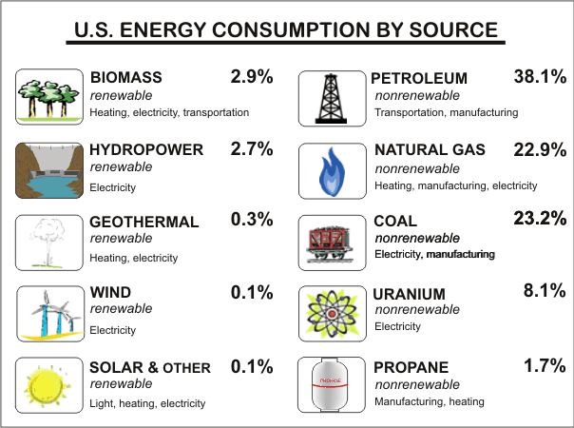
What Are Current Energy Concerns?
Consumption
Pollution
Depletion
Dependency
Cost
http://www.eia.doe.gov
What roles do engineers have in energy?

Slide 15

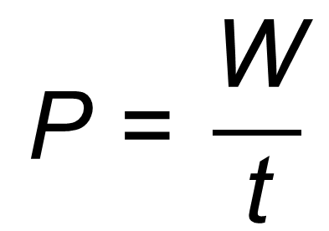
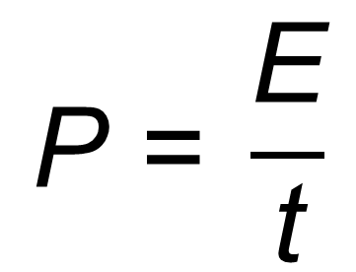
Power
Power (symbol P) is the rate at which energy E is expended or work W is performed in time t.
$$\text{P}\text{ = }\frac{\text{E}}{\text{t}}$$
$$\text{P}\text{ = }\frac{\text{W}}{\text{t}}$$
or
The SI unit for power is the watt (symbol W). $\text{1 }\text{W}\text{ = 1 }\frac{\text{J}}{\text{s}}$
Notes:
Both work and watt are abbreviated W. Since the watt is a unit, it will only appear next to a number, whereas work is a variable and only appears with a number if being multiplied by some other quantity.

Slide 16
Types of Power
Electrical Power
Uses electrical energy to do work
Mechanical Power
Uses mechanical energy to do work (linear, rotary)
Fluid Power
Uses energy transferred by liquids (hydraulic) and gases (pneumatic)

Slide 17


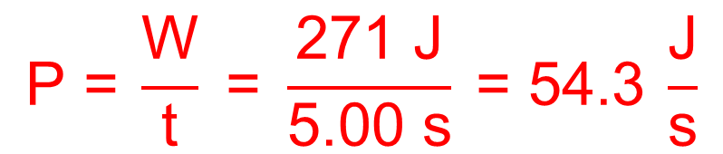
Power Example
A student lifts a 50.0 pound ball 4.00 feet in 5.00 seconds.
How many watts of power did the student use to lift the ball?
Work = 271 J (see earlier slide)
$$\text{P}\text{ =} \frac{\text{W}}{\text{t}}\text{ = }\frac{\text{271 }\text{J}}{\text{5.00 }\text{s}} \text{= 54.3} \frac{\text{J}}{\text{s}}$$
$\text{= }\text{54.3 }\text{W}$

Slide 18
Resources
McGraw-Hill dictionary of engineering. (2nd ed.). New York, NY: McGraw-Hill.
Microsoft, Inc. (2008). Clip art. Retrieved January 10, 2008, from http://office.microsoft.com/en-us/clipart/default.aspx
National Aeronautics and Space Administration (NASA). (1997). Daedalus. Retrieved April 2, 2008, from http://www.dfrc.nasa.gov/Gallery /Photo/Daedalus/
U.S. Department of Energy. (2008). Scientific forms of energy. Retrieved March 23, 2008, from http://www.eia.doe.gov/kids/energyfacts/science/formsofenergy.html

