Slide 1
Principles of Engineering
Unit 1.1: Mechanisms Study Summary

Slide 2
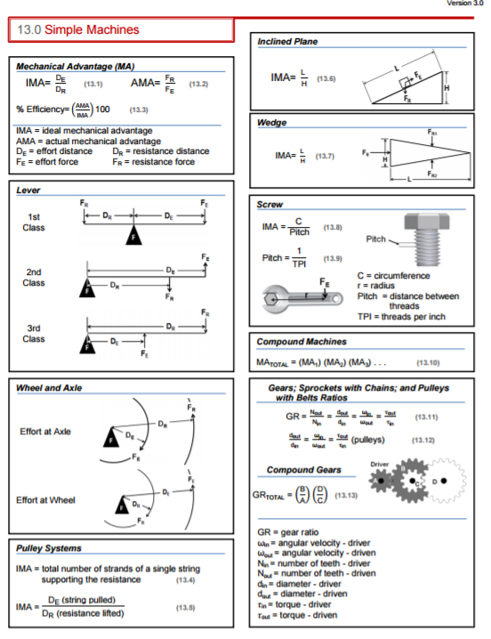
You will have your Engineering
Formula Sheet to use.

Slide 3
Let’s do some substitutions to predict F_{EI} (Ideal Effort Force)
When lever is in rotational equilibrium:
F_{EI} x D_{E} = F_{R} x D_{R}
multiple both sides by 1/ F_{EI} x D_{R}
D_{E} F_{R}
D_{R} F_{EI}
=
=
IMA

Slide 4
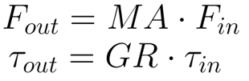

Gear Ratio Review
Conservation of Work
Used similarly to MA
Apply to torque instead of force
In a compound machine, total MA and GR are products of components
MA is used only to calculate forces, not torques.
GR is used only to calculate torques, not forces.

Slide 5
Final Reminder:
Actual Mechanical Advantage (AMA)
Inquiry-based calculation
Frictional losses are taken into consideration
Used in efficiency calculations
Ratio of force magnitudes
F_{R} = Magnitude of resistance force
F_{E} = Magnitude of effort force

Slide 6
Put it all together to solve a compound mechanism problem
Compute IMA for each stage using its geometry
  Effort ~ input
  Resistance ~ output
Total IMA is the product of all stages
Can then determine Force required to generate an output Force desired

Slide 7
Some Activity Answers

Slide 8
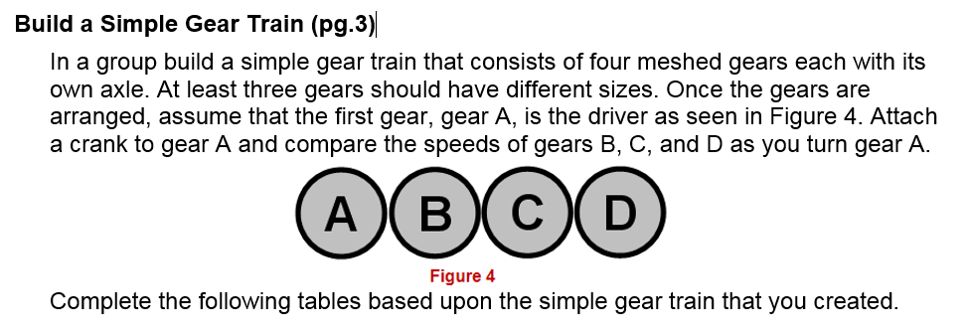
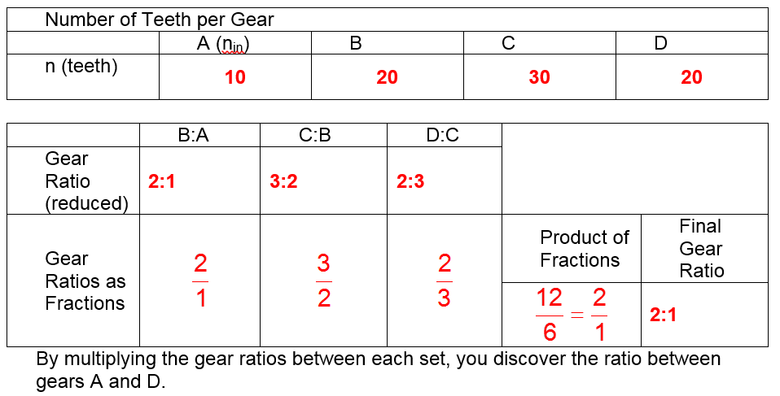
Activity 1.1.3 Gears

Slide 9
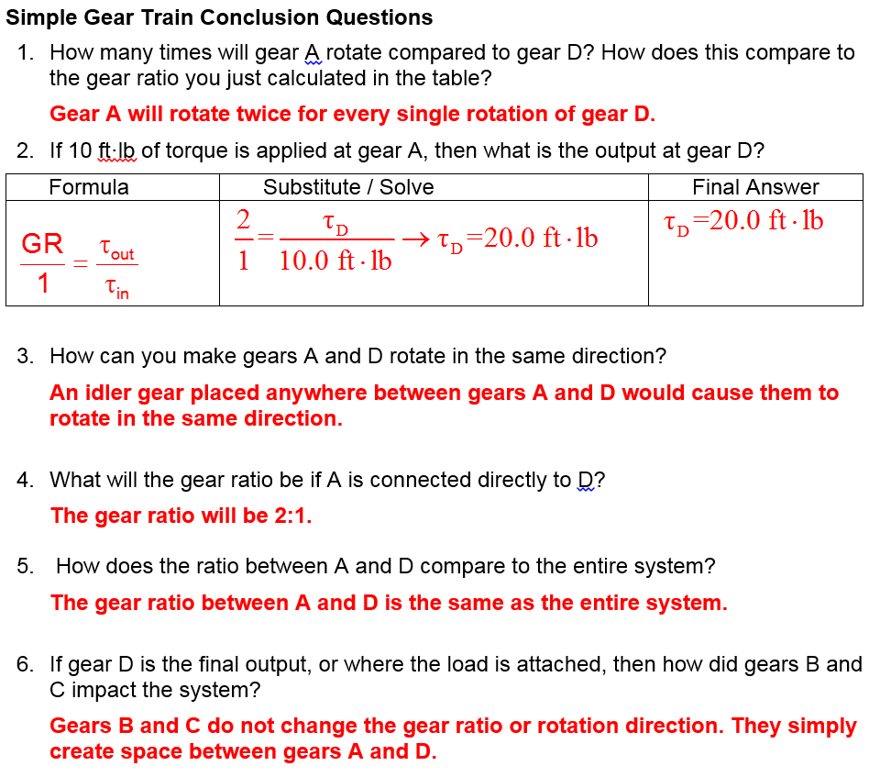

Slide 10
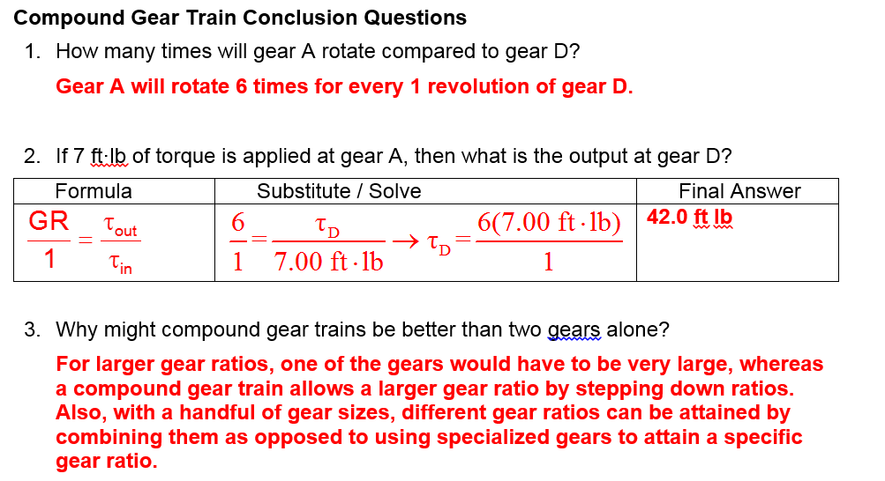

Slide 11
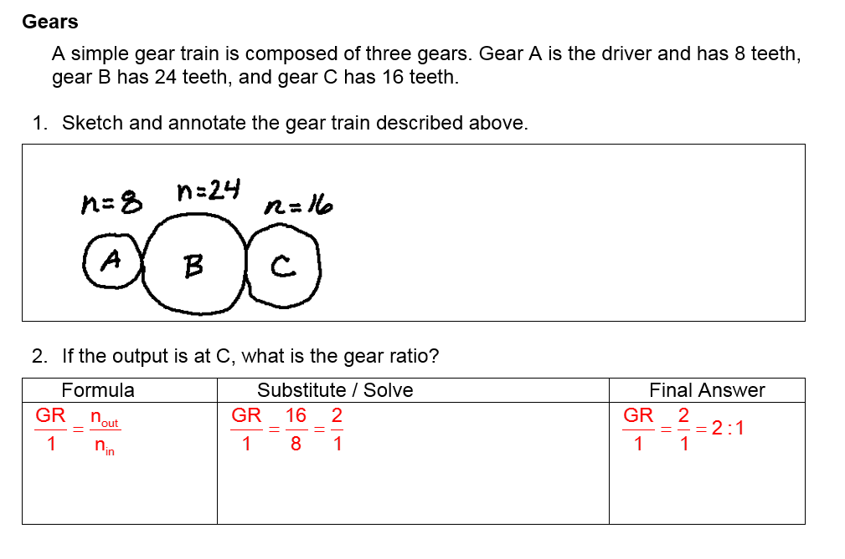
Activity 1.1.5 Gears, Pulley Drives, and Sprockets Practice Problems

Slide 12
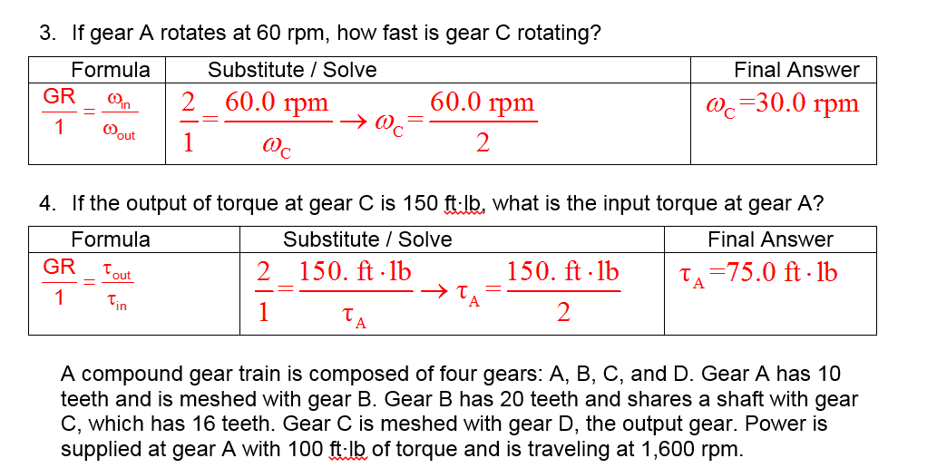

Slide 13
