Slide 1
Gears, Pulley Drives, and Sprockets
Principles of Engineering
© 2012 Project Lead The Way, Inc.

Slide 2
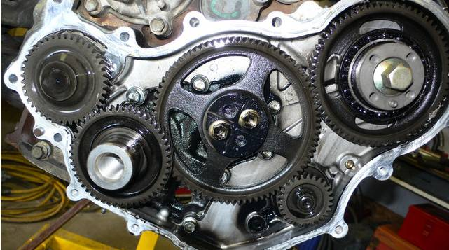
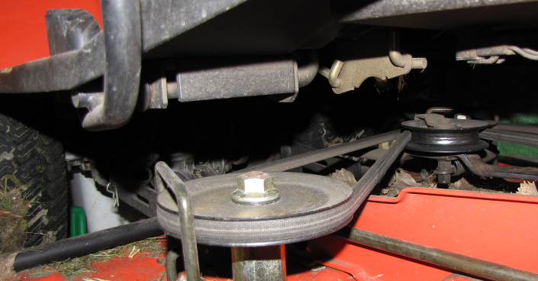
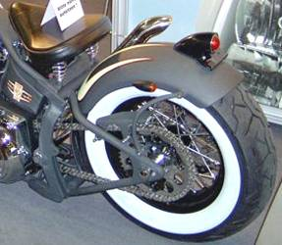
Gears, Pulleys, & Sprockets
These three power train elements transfer energy through rotary motion.
Change the speed of rotation
Change the direction of rotation
Change the amount of torque available to do work

Slide 3

Gears
A gear train is a mechanism used for transmitting rotary motion and torque through interlocking teeth.
A gear train is made when two or more gears are meshed
Driver gear causes motion
Motion is transferred to the driven gear

Slide 4

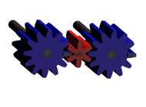
Gears
Mating gears always turn in opposite directions.
An Idler Gear allows the driver and driven gears to rotate in the same direction.
Mating gears always have the same size teeth (diametric pitch).

Slide 5
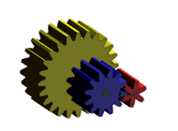
Gears
The rpm of the larger gear is always slower than the rpm of the smaller gear.
Gears locked together on the same shaft will always turn in the same direction and at the same rpm.

Slide 6
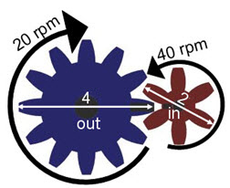
Gear Ratios
Variables to know
n = number of teeth
d = diameter
w = angular velocity (speed)
t = torque
Subscripts in and out are used to distinguish between gears.
4”
n_{in}=
d_{in} =
w_{in} =
t_{in} =
6
2 in.
40 rpm
40 ft-lb
n_{out} =
d_{out} =
w_{out} =
t_{out} =
12
4 in.
20 rpm
80 ft-lb
Notes:
To effectively work with the ratios, you must understand the following symbols.
The symbol for angular velocity is the Greek lower case Omega.
The symbol for torque is the Greek lower case Tau.
The subscript “in” and “out” simply identify whether the characteristic of the gear refers to the input or output gear.
Note the rotation direction of the gears.

Slide 7
Gear Ratios
Equations to know
GR = Gear Ratio
Notes:
Gears, Pulleys, and Sprockets
Principles of EngineeringTM
Unit 1 – Lesson 1.1 - Mechanisms

Slide 8
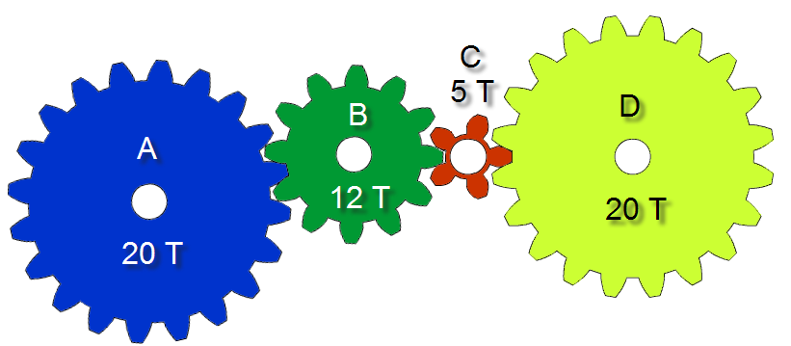
Gear Ratios
What is the gear ratio between gears A and B?
What is the gear ratio between gears B and C?
What is the gear ratio between gears C and D?

Slide 9
Gear Ratios
Idler gears don’t
affect GR!
What is the TOTAL gear train gear ratio?
If gears A and D were directly connected to each other, what would the resulting gear ratio be?
If the last gear had 40 teeth, what would be the total gear ratio?
or

Slide 10


Gear Ratios—Compound Machines
Are used similarly to MA
Apply to torque instead of force
In a compound machine, total MA and GR are products of components
MA is used only to calculate forces, not torques.
GR is used only to calculate torques, not forces.
Notes:
Force is measured through cables or strings; torque is measured about an axis of rotation. In many compound machines, an input force causes a torque around a drive shaft. Similarly, an output torque around a drive shaft can result in an output force from an object attached to the drive shaft. If you only need to know the ratio of the input force and output force, you can ignore the gear ratio; those gear sizes will show up in your mechanical advantage calculations as wheel and axle radii.

Slide 11
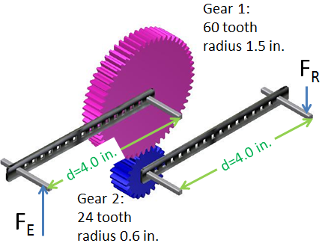
Example Compound Machine
Here are three mechanisms in series:
  Wheel–axle
  Gear train
  Wheel–axle
Notes:
When designing a compound machine, each mechanism is either a simple machine or power train element. The six simple machines (lever, wheel/axle, pulley, inclined plane, wedge, screw) contribute mechanical advantage (but not gear ratio.) The three power train elements (gears, belt/pulley, chain/sprocket) contribute gear ratio (but not mechanical advantage.)
Gears, Pulleys, and Sprockets
Principles of EngineeringTM
Unit 1 – Lesson 1.1 - Mechanisms

Slide 12
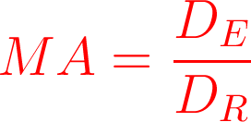
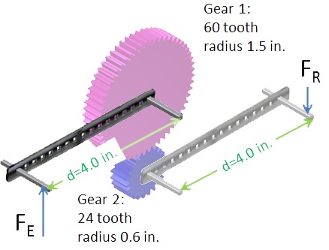
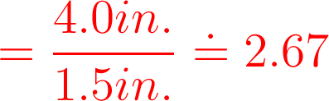
Example Compound Machine
Mechanism #1: Wheel–axle
Notes:
The input force F_E on the black bar transfers force, with mechanical advantage, to the teeth of the purple gear. This wheel/axle system has a mechanical advantage of 2.67. Since the black bar and the purple gear turn at the same angular speed, no gear ratio contributed by this component; i.e., GR = 1.
Gears, Pulleys, and Sprockets
Principles of EngineeringTM
Unit 1 – Lesson 1.1 - Mechanisms

Slide 13
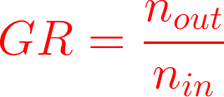

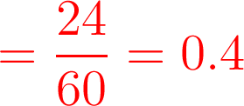
Example Compound Machine
Mechanism #2: Gear train
Notes:
The purple gear transfers force to the blue gear. The force is transmitted teeth-to-teeth, unchanged (i.e., MA = 1), but the force on the blue gear is now at a different distance from its axis of rotation, causing a gear ratio that is not 1.
Gears, Pulleys, and Sprockets
Principles of EngineeringTM
Unit 1 – Lesson 1.1 - Mechanisms

Slide 14
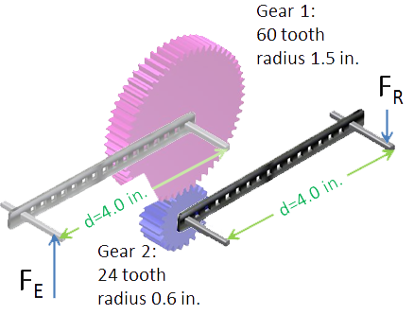
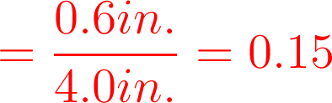
Example Compound Machine
Mechanism #3: Wheel–axle
Notes:
The gear transfers force to the black bar at the output. Because the force on the blue teeth and the force F_R at the output are at different distances from the same axis, rotational equilibrium requires these force to be different. This is a wheel/axle system with mechanical advantage. Again, GR = 1 since the bar and the blue gear rotate around their shared axis at the same rate.
Gears, Pulleys, and Sprockets
Principles of EngineeringTM
Unit 1 – Lesson 1.1 - Mechanisms

Slide 15
Example Compound Machine
Notes:
The total mechanical advantage is the product of all the component mechanical advantages. MA_2 = 1, which doesn’t change the product, since mechanism #2 was a power train element, not a simple machine.
This overall mechanical advantage is used when comparing F_E with F_R.
Gears, Pulleys, and Sprockets
Principles of EngineeringTM
Unit 1 – Lesson 1.1 - Mechanisms

Slide 16

Example Compound Machine
Notes:
The total gear ratio is the product of all component gear ratios. In this example, only one GR was not 1.
You would use the total gear ratio if you want to know how many full revolutions of the effort force are required to get one full revolution at the output.
Gears, Pulleys, and Sprockets
Principles of EngineeringTM
Unit 1 – Lesson 1.1 - Mechanisms

Slide 17
Compound Gear Train
Driver
The two middle gears share a common axle, so they rotate at the same speed.
This allows the final gear to rotate slower and produce more torque than if it were connected only to the driver gear.
Notes:
A simple method to gain torque is to turn the final gear that was added into the driver gear.

Slide 18
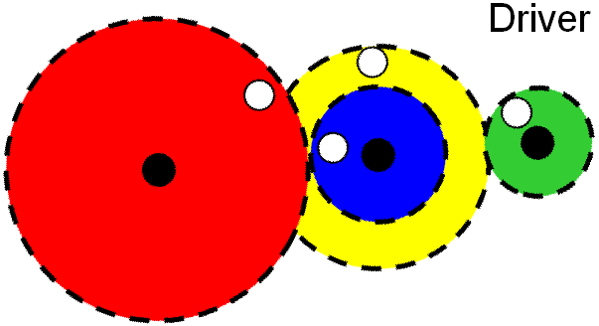
Compound Gear Ratios
D
B
C
A
20 T
10 T
What is the gear ratio between gears A and B?
40 T
50 T
What is the gear ratio between gears C and D?
What is the gear ratio of the entire gear train?
Notes:
Note that this compound machine has a simple machine right in the middle! Transferring energy and power from gear B to gear C is a wheel/axle, with mechanical advantage of DE/DR = 40/20 = 2.

Slide 19
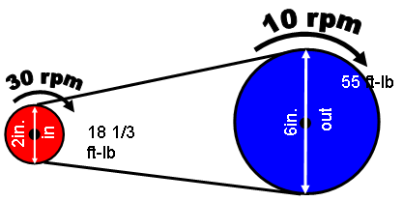
Belt and Pulley Systems
2in.
in
out
Equations
d = diameter ω = angular velocity (speed) τ = torque
Notes:
The belt is a continuous band that wraps around the pulleys to transmit power. The ratios are the same as for gears. The only exception is that there are no teeth to count.
Another difference is that two pulleys connected by a belt rotate in the same direction.
Also, belt/pulley systems are able to slip. This is useful, for example, in a compressor where a motor would otherwise stall once the system was pressurized or in a lawn mower where the pulley is engaged as a clutch.

Slide 20

Sprocket and Chain Systems
45rpm
90rpm
60 ft-lb
3in.
1.5in.
in
120 ft-lb
out
n = number of teeth d = diameter ω = angular velocity (speed) τ = torque
Notes:
Sprockets and gears are often confused. Gears mesh directly with other gears, while sprockets use chains to transfer power between sprockets.

Slide 21
Comparing Pulleys and Sprockets
 | Pulley | Sprocket
Method of Transmitting Force | Belt | Chain
Advantages | Quiet, no lubrication needed, inexpensive | No slip, greater strength
Disadvantages | Can slip | Higher cost, needs lubrication, noisy

Slide 22
Image Resources
Microsoft, Inc. (2008). Clip art. Retrieved January 15, 2008, from http://office.microsoft.com/en-us/clipart/default.aspx

