Slide 1
Mechanisms
Simple Machines
Lever, Wheel and Axle, and Pulley
Principles of Engineering
© 2012 Project Lead The Way, Inc.

Slide 2
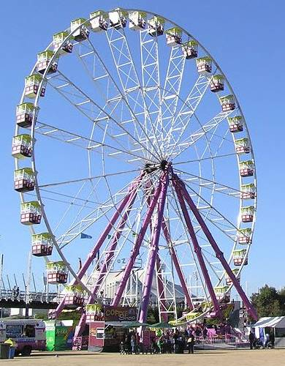
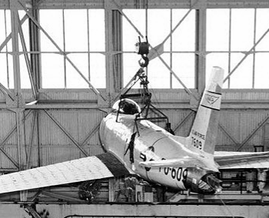
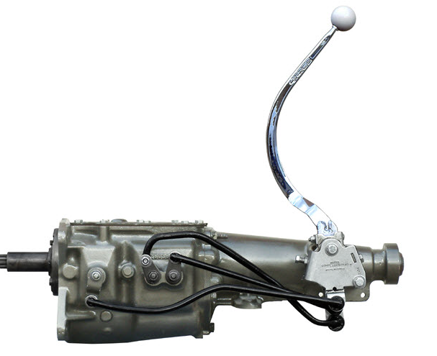
Simple Machines
Mechanisms that manipulate magnitude of force and distance.
The Six Simple Machines
Lever
Wheel and Axle
Pulley

Slide 3
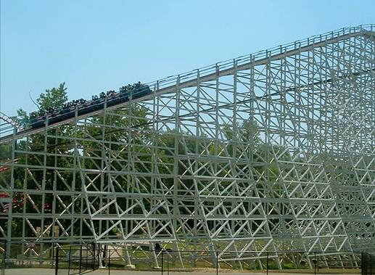
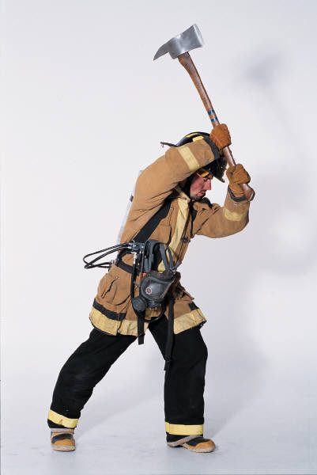
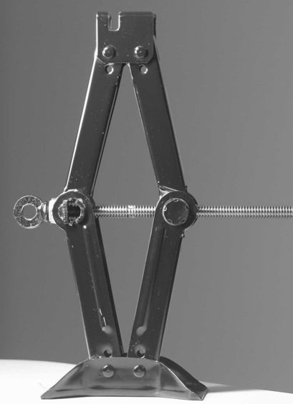
The Six Simple Machines
Inclined Plane
Wedge
Screw

Slide 4
Mechanical Advantage (MA)
Ratio of the magnitude of the resistance and effort forces
Ratio of distance traveled by the effort and the resistance force
Calculated ratios allow designers to manipulate speed, distance, force, and function

Slide 5
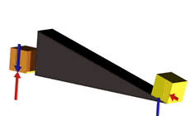
Mechanical Advantage Example
A mechanical advantage of 4:1 tells us what about a mechanism?
Magnitude of Force
Effort force magnitude is 4 times less than the magnitude of the resistance force.
Distance Traveled by Force
Effort force travels 4 times greater distance than the resistance force.

Slide 6
Work
The force applied on an object times distance the object travels parallel to the force
Initial position
Final position
Force (F)
Parallel Distance (d║)
Work = Force · Distance = F · d║

Slide 7
Work
The product of the effort times the distance traveled will be the same regardless of the system mechanical advantage

Slide 8
Mechanical Advantage Ratios
One is the magic number
If MA is greater than 1:
Proportionally less effort force is required to overcome the resistance force
Proportionally greater effort distance is required to overcome the resistance force
If MA is less than 1:
Proportionally greater effort force is required to overcome the resistance force
Proportionally less effort distance is required to overcome the resistance force
MA can never be less than or equal to zero.

Slide 9
Ideal Mechanical Advantage (IMA)
Theory-based calculation
Friction loss is not taken into consideration
Ratio of distance traveled by effort and resistance force
Used in efficiency and safety factor design calculations
D_{E} = Distance traveled by effort force
D_{R} = Distance traveled by resistance force

Slide 10
Actual Mechanical Advantage (AMA)
Inquiry-based calculation
Frictional losses are taken into consideration
Used in efficiency calculations
Ratio of force magnitudes
F_{R} = Magnitude of resistance force
F_{E} = Magnitude of effort force

Slide 11
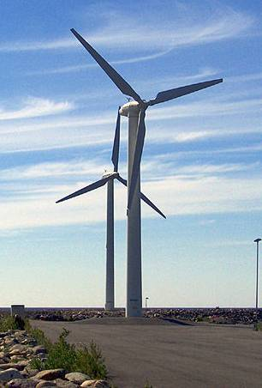
Real World Mechanical Advantage
Can you think of a machine that has a mechanical advantage greater than 1?

Slide 12
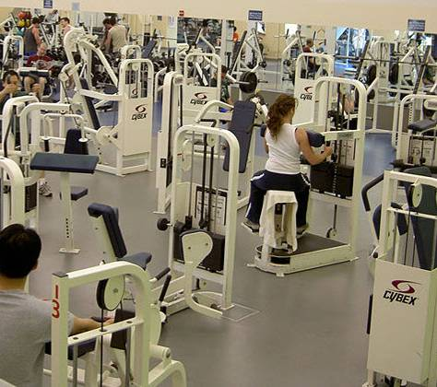
Real World Mechanical Advantage
Can you think of a machine that has a mechanical advantage less than 1?

Slide 13
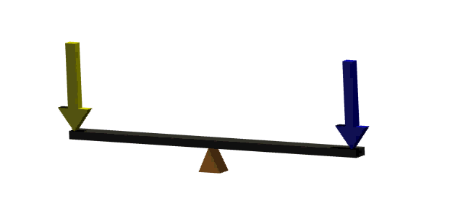
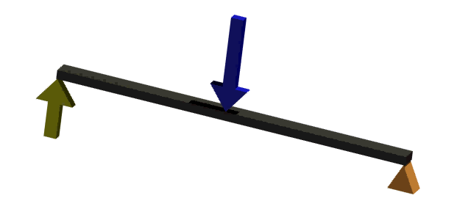
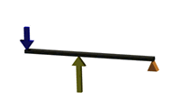
Lever
A rigid bar used to exert a pressure or sustain a weight at one point of its length by the application of a force at a second point and turning on a fulcrum at a third.

Slide 14
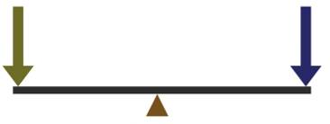
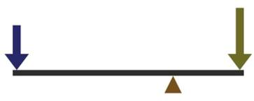
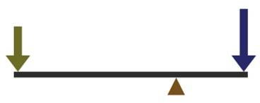
First Class Lever
Fulcrum is located between the effort and the resistance forces.
Effort and resistance forces are applied to the lever arm in the same direction.
Only class of lever that can have an MA greater than or less than 1.
Effort
Resistance
MA =1
Effort
Resistance
Resistance
Effort
MA <1
MA >1

Slide 15
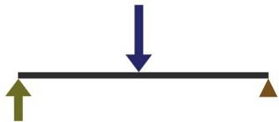
Second Class Lever
Fulcrum is located at one end of the lever.
Resistance force is located between the fulcrum and the effort force.
Resistance force and effort force are in opposing directions.
Always has a mechanical advantage >1.
Resistance
Effort

Slide 16
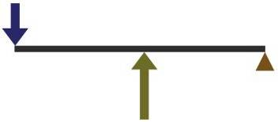
Third Class Lever
Fulcrum is located at one end of the lever.
Effort force is located between the fulcrum and the resistance.
Resistance force and effort force are in opposing directions.
Always has a mechanical advantage < 1.
Resistance
Effort

Slide 17
Moment
The turning effect of a force about a point
equal to the magnitude of the force
times the perpendicular distance from the point
to the line of action from the force.
M = d x F
Torque: A force that produces or tends to produce rotation or torsion.
Notes:
The terms moment and torque are synonymous.

Slide 18
Lever Moment Calculation
5.5 in.
Resistance
15 lb
15 lbs
Effort
Calculate the effort moment acting on the lever.
M =
d x F
Effort Moment =
5.5 in. x 15 lb
Effort Moment =
82.5 in. lb

Slide 19
Lever Moment Calculation
When the sum of all moments on a lever equals 0, the lever is in rotational equilibrium.
Rotational Equilibrium
The state in which the sum of all the clockwise moments equals the sum of all the counterclockwise moments about a pivot point.

Slide 20
Lever Moment Calculation
Effort
Resistance
5.5 in.
?
36 2/3 lb
15 lb
Using what you know regarding rotational equilibrium, calculate the unknown distance from the fulcrum to the resistance force.
Rotational equilibrium:
Effort Moment (cc wise) = Resistance Moment (clockwise)
15 lb x (5.5 in.) = 36 2/3 lb x D_{R}
82.5 in-lb = 36.66 lb x D_{R}
82.5 in-lb / 36.66 lb = D_{R}
2.25 in. = D_{R}

Slide 21
Lever IMA
Resistance
Effort
Both effort and resistance forces will travel in a circle if unopposed.
Circumference is the distance around the perimeter of a circle.
Circumference = 2 p r
D_{E} = 2 π (effort arm length)
D_{R} = 2 π (resistance arm length)
2 π (effort arm length)
______________________
IMA =
2 π (resistance arm length)

Slide 22
Lever AMA
2.25 in.
5.5 in.
The ratio of applied resistance force to applied effort force
32 lb
16 lb
Effort
Resistance
What is the AMA of the lever above?
AMA = 2:1
What is the IMA of the lever above?
IMA = 2.44:1
Why is the IMA larger than the AMA?

Slide 23
Efficiency
In a machine, the ratio of useful energy output to the total energy input, or the percentage of the work input that is converted to work output
The ratio of AMA to IMA
What is the efficiency of the lever on the previous slide? Click to return to previous slide
AMA = 2:1
IMA = 2.44:1
No machine is 100% efficient.

Slide 24
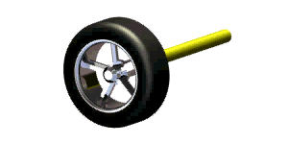
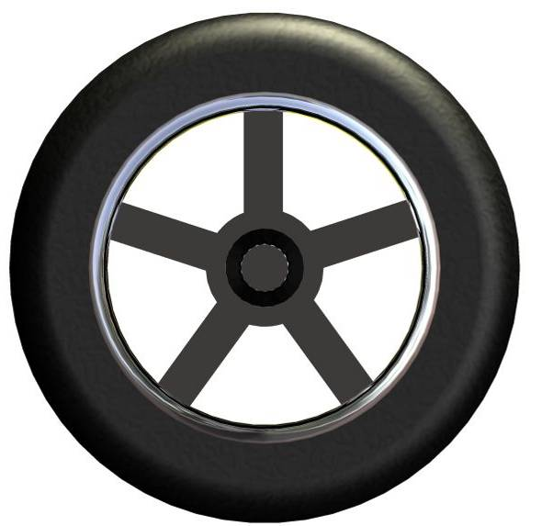
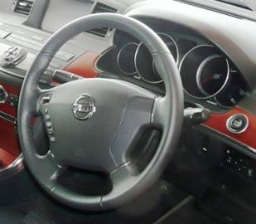
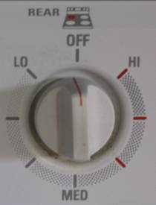
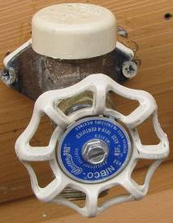
Wheel and Axle
A wheel is a lever arm fixed to a shaft,
called an axle.
The wheel and axle move together as a simple lever to lift or move an item by rolling.
It is important to know which is applying the effort and resistance force – wheel or axle.
Can you think of an example of a wheel driving an axle?

Slide 25
Wheel and Axle IMA
Ǿ6 in.
Ǿ20 in.
Both effort and resistance forces will travel in a circle if unopposed.
Circumference = 2pr or πd
D_{E} = π [Diameter of effort (wheel or axle)]
D_{R} = π [Diameter resistance (wheel or axle)]
π (effort diameter)
______________________
IMA =
π (resistance diameter)
What is the IMA of the wheel if the axle is driving the wheel?
6 in. / 20 in. = .3 = .3:1 = 3:10
What is the IMA of the wheel if the wheel is driving the axle?
20 in. / 6 in. = 3.33 = 3.33:1

Slide 26
Wheel and Axle AMA
Ǿ6 in.
Ǿ20 in.
200lb
Use the wheel and axle assembly illustration to solve the following.
70lb
What is the AMA if the wheel is driving the axle?
200 lb / 70 lb = 2.86 = 2.86:1
What is the efficiency of the wheel and axle assembly?
= 85.9%

Slide 27
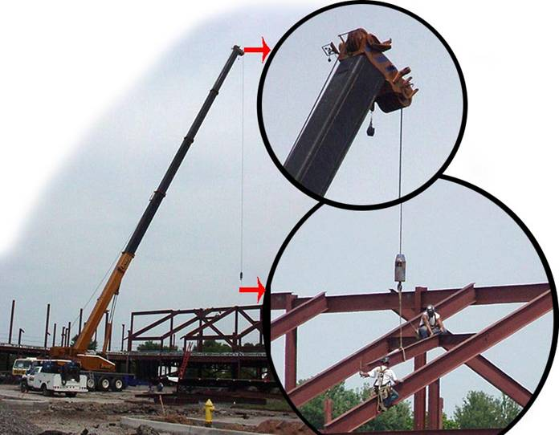
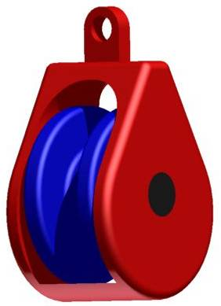
Pulley
A pulley is a lever consisting of a wheel with a groove in its rim that is used to change the direction and magnitude of a force exerted by a rope or cable.

Slide 28
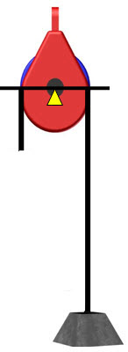
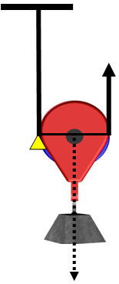
Pulley IMA
Fixed Pulley
- First class lever with an IMA of 1
- Changes the direction of force
10 lb
5 lb
5 lb
Movable Pulley
- Second class lever with an IMA of 2
- Force directions stay constant
10 lb
10 lb

Slide 29
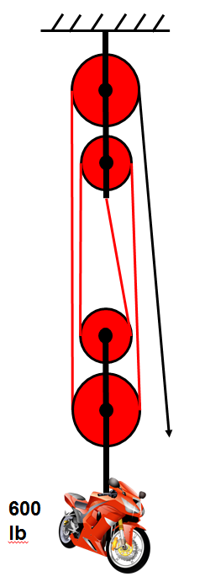
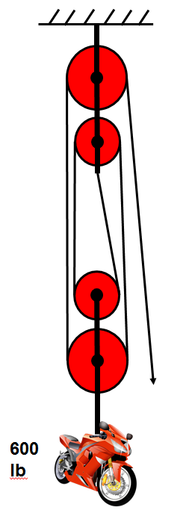
Pulleys In Combination
Fixed and movable pulleys in combination (called a block and tackle) provide mechanical advantage and a change of direction for effort force.
If a single rope or cable is threaded multiple times through a system of pulleys,
Pulley IMA = # strands opposing the
force of the load
What is the IMA of the pulley system on the right?
4
Notes:
Note: The IMA of this system is only about 3.9 because the shortest segment of the rope, tied to the fixed pulley, is not vertical. Since the load is downward, only the upward component of that strand’s force will count, and at the angle shown, the vertical component is about 0.9 times the angled force in that strand. Because resolving a vector into components is not covered until unit 2, this fine point is glossed over at this time.
Could you lift this motorcycle? Ideally, it will take 150 lb of force. A student weighing less than 150 lb could hang on the rope without lifting the motorcycle. This demonstrates an advantage of having the free end pointing upward; then a person can pull with a force greater than their own weight.

Slide 30
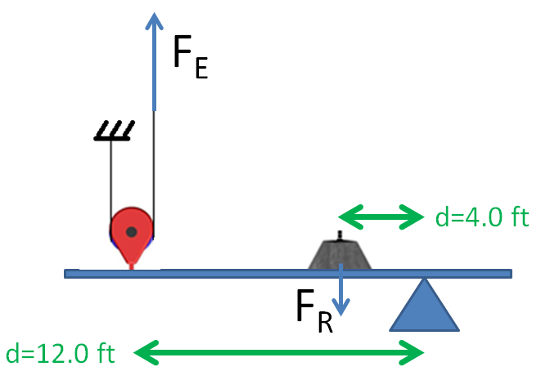


Compound Machines
If one simple machine is used after another, the mechanical advantages multiply.
$$\text{IM}{\text{A}}_{\text{total}}\text{ = }\text{IM}{\text{A}}_{\text{pulley}}\text{⋅}\text{IM}{\text{A}}_{\text{lever}}$$
$$\text{= \#}\text{strands}\text{ ∙ }\frac{{\text{D}}_{\text{E}}}{{\text{D}}_{\text{R}}}$$
$$\text{= }\text{2⋅}\frac{\text{12.0 }\text{ft}}{\text{4.0 }\text{ft}}\text{= 2}\text{⋅3}\text{ = 6}$$

Slide 31





Pulleys In Combination
With separate ropes or cables, the output of one pulley system can become the input of another pulley system. This is a compound machine.
10 lbf
10 lbf
What is the IMA of this pulley system?
20 lbf
20 lbf
40 lbf
40 lbf
80 lbf

Slide 32
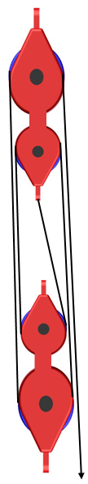
Pulley AMA
What is the AMA of the pulley system on the right?
AMA = 3.48 = 3.48:1
What is the efficiency of this pulley system?
230 lb
% Efficiency =
800 lb
= 87%

Slide 33

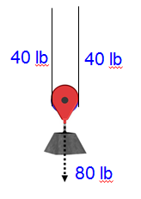
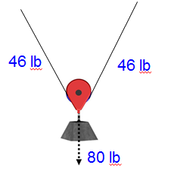
Pulley IMA = # strands opposing load only if strands are opposite/parallel to resistance force.
Common misconception: “Angles don’t matter”
Calculating IMA
requires trigonometry
IMA=2
Notes:
In the pulley on the right, the IMA is not 2. Although the vertical forces from the two strands are each half the resistance force, the tension in the string depends on the angle. We will not address these types of problems here. Though you will learn how to do so in unit 2 when you deal with trusses.
In your measurements, keep the strands in the opposite direction from the resistance force to avoid this complication.

Slide 34
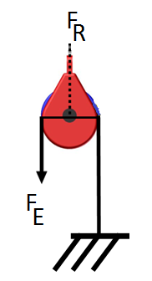
Pulley IMA = # strands opposing the load.
Common misconception:
“Count the effort strand if it pulls up”
sometimes
80 lbf
Count a strand if it opposes the load or the load’s movable pulley. It might pull up or down.
IMA=2
40 lbf
40 lbf
Notes:
In the movable pulley here, the effort force is used to pull the pulley down along with the load. This is used, for example, in pulling the foot of a sail downward after it has been hoisted. The resistance will only be forced downward 1 foot for every 2 feet of rope pulled out of the system.

Slide 35
Image Resources
Microsoft, Inc. (2008). Clip art. Retrieved January 10, 2008, from http://office.microsoft.com/en-us/clipart/default.aspx

